Slide 1
Unit 5 Part 1: Atomic Basics
7th grade Physical Science

Slide 2
Bell Ringer 10/21/19
Please grab a periodic table from the front table.
Locate Fe on the table and complete the following:
Element Name:_______________
Atomic #:___________
Number of Protons:______________
Number of Electrons:______________
Number of Neutrons:_______________
Atomic Mass:________________

Slide 3
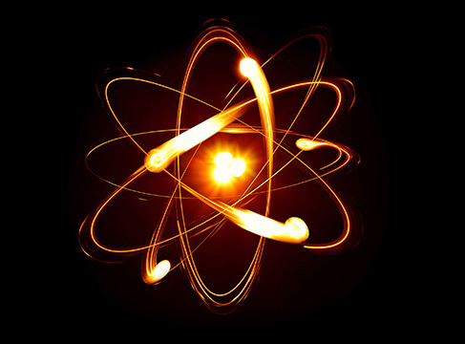
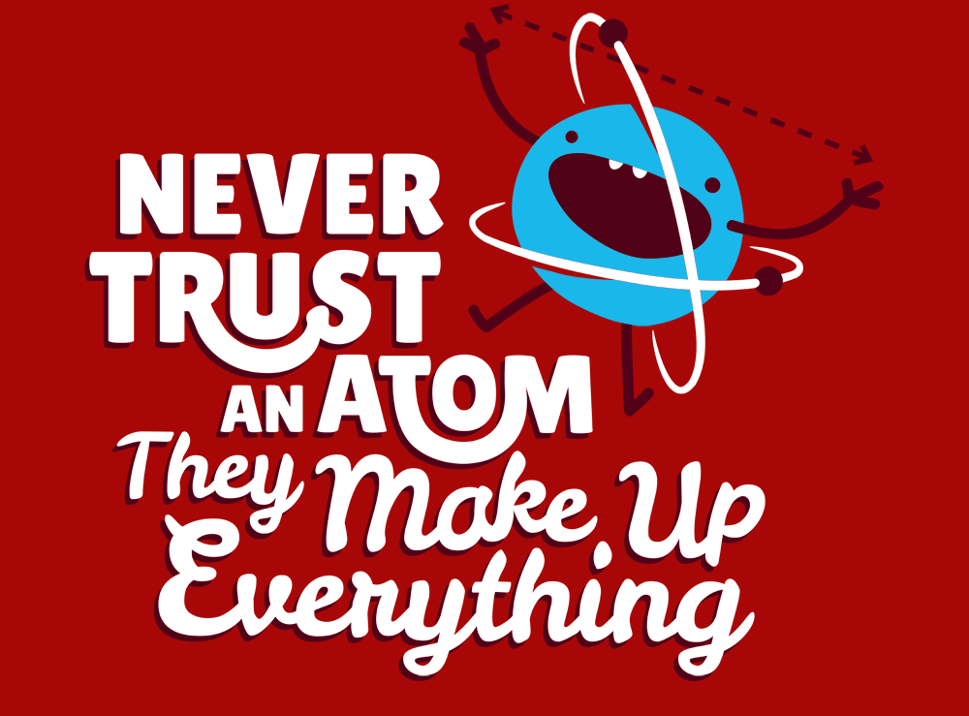
The Atom
Basic building block of matter.
Smallest particle of an element that contains the properties of that element.
Every element on the periodic table represents one atom of that element.

Slide 4
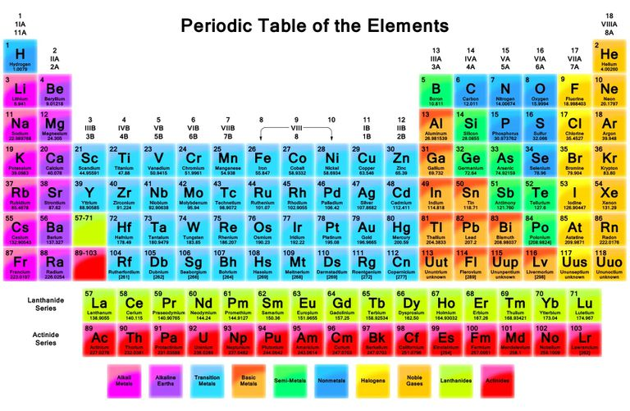
The Periodic Table of Elements

Slide 5
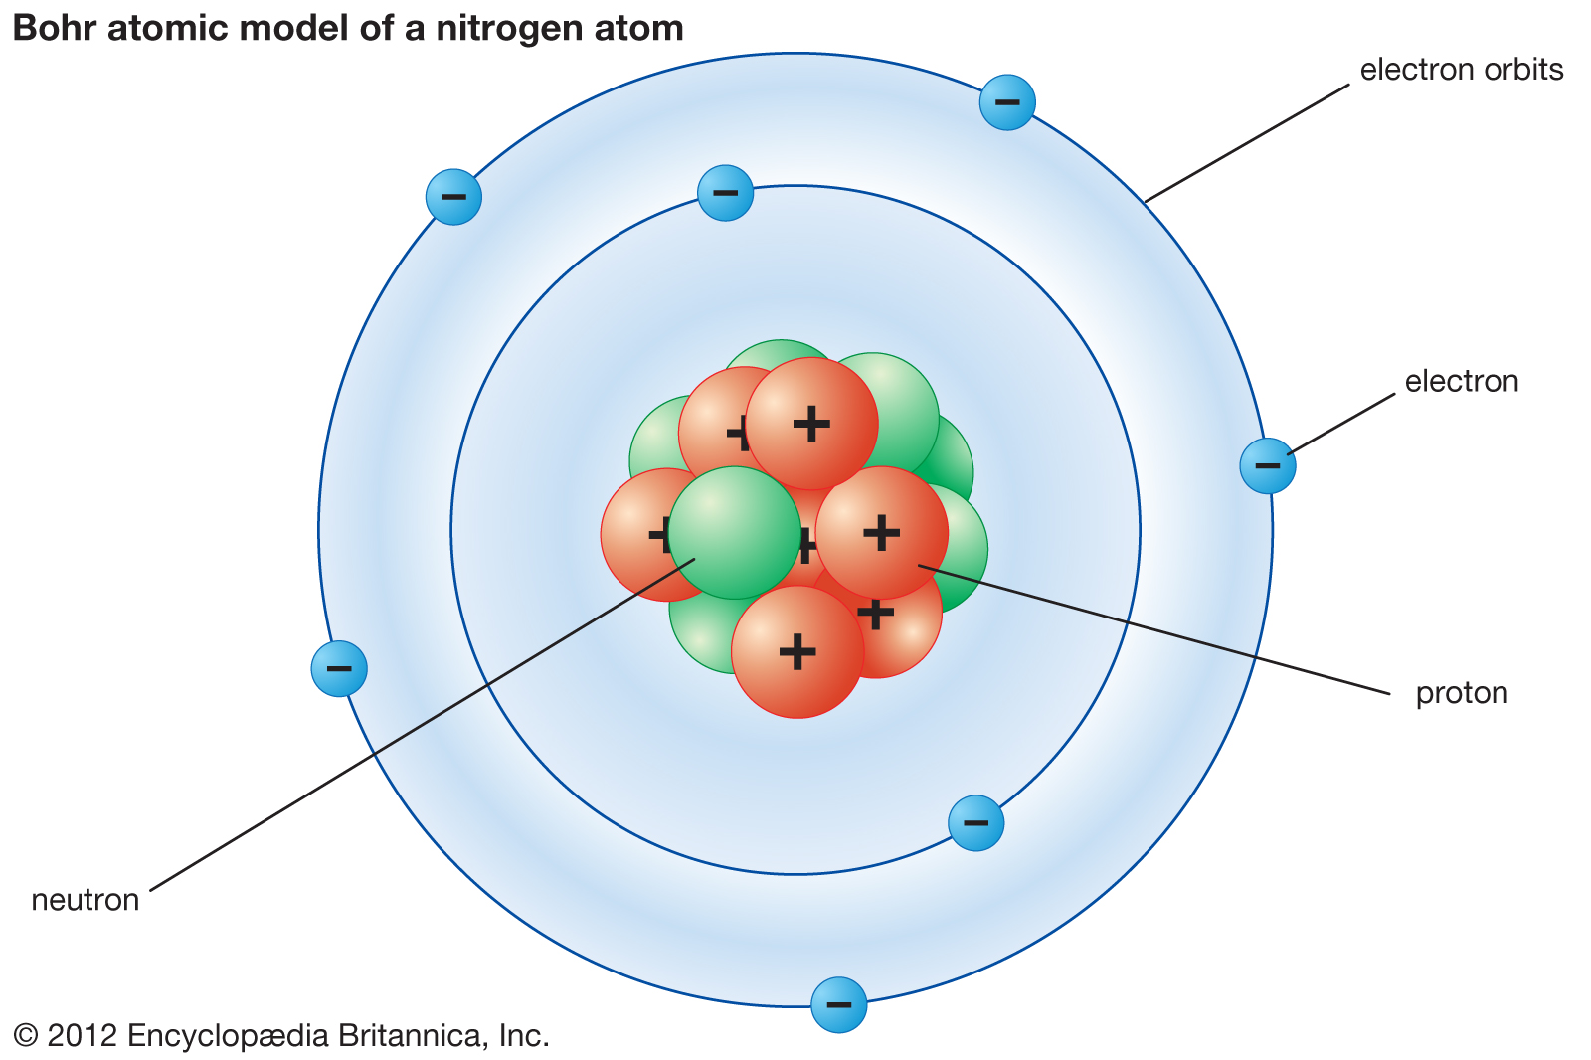
Atomic Model

Slide 6
Subatomic Particles
Protons: positively charged particles located in the nucleus of an atom. Protons identify the element. PROTONS NEVER CHANGE.
Neutrons: Neutrons have no charge and are also located in the nucleus of an atom.
Electrons: negatively charged particles located outside the nucleus in the electron cloud.

Slide 7
Electrons
The charge of an electron is opposite but equal to the charge of a proton. Atoms have the same number of electrons as protons.
As a result, the negative and positive charges "cancel out." This makes atoms electrically neutral.
For example, a carbon atom has six electrons that "cancel out" its six protons.
Electrons have very little mass, which enables them to move so fast and so often
Electrons are involved in bonding.

Slide 8
Atomic Forces
When it comes to atomic particles, opposites attract. Negative electrons are attracted to positive protons. This force of attraction keeps the electrons moving about the nucleus.

Slide 9
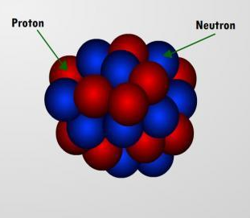
Atomic Mass
The nucleus is the central part of the atom.
In the nucleus are the protons and the neutrons.
The nucleus is the most massive part of the atom.
Atomic Mass = protons + neutrons

Slide 10
Atomic Mass Unit (amu)
The SI unit for the mass of an atom is the atomic mass unit or amu.
One atomic mass unit equals the mass of a proton, which is about 1.7 × 10⁻²⁴ g ( a neutron also has a mass of about 1 amu).
What is the atomic mass of Zinc?

Slide 11
Atomic Number
The atomic number is the number of protons in an atom.
This number is unique for atoms of each kind of element.
For example, the atomic number of all Helium atoms is 2.

Slide 12
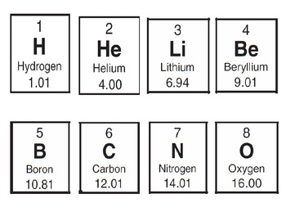
Practice: For each element to the right identify the atomic number, atomic mass, protons, neutrons, and electrons.

Slide 13
Ions
Atoms can gain or lose electrons. When this happens, an atom becomes charged.
Atoms that have an equal number of protons and electrons are neutral atoms (no charge).
If an atom gains electrons, it is negatively charged. It is called an anion.
If an atom loses electrons, it is positively charged. It is called a cation.

Slide 14
Ion Practice
How many electrons did the following atoms gain or lose for each element listed below:
1.Ca²⁺
2. Cl⁻
3.O²⁻
4.Li³⁺

Slide 15
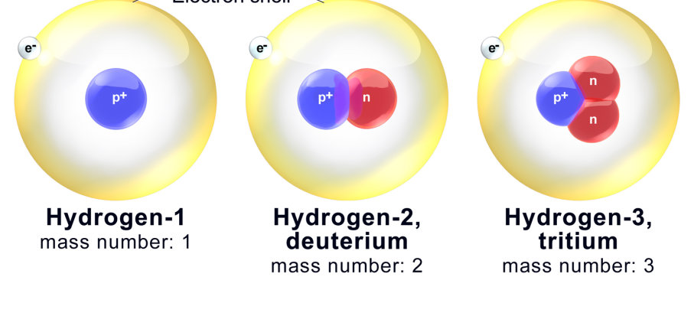
Isotopes
Atoms of the same element have a different number of neutrons. These atoms are called isotopes.
The atomic mass will be different because of the different number of neutrons.

