Slide 1
The Bohr Model of the Atom
I pictured electrons orbiting the nucleus much like planets orbiting the sun.
But I was wrong! They’re more like bees around a hive.
Neils Bohr

Slide 2
Bohr's Model of the Atom
Bohr's model:
-electrons orbit the nucleus like planets orbit the sun
-each orbit can hold a specific maximum number of electrons
-electrons fill orbits closest to the nucleus first.

Slide 3
How many electrons?
Orbit number | Maximum # of electrons
1 | 2
2 | 8
3 | 18
4 | 32

Slide 4
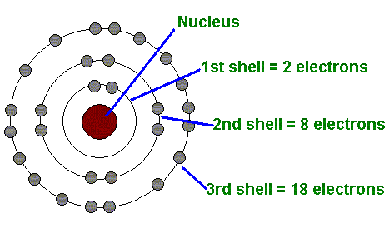

Slide 5
Notes
A Bohr Diagram is the model of an atom with the Nucleus at the center, and the Electrons drawn around it on different energy levels.

Slide 6
Now for some practice
For an Atom of Hydrogen:
1 Electron!
Simple, you just draw the first Electron here

Slide 7
Next
For an Atom of Helium:
2 Electrons!
Simple, you just draw the second Electron here

Slide 8
More
For an Atom of Lithium:
3 Electrons!
But wait a minute…We said that only 2 Electrons can fit into the first level
So what do we do when it’s full????

Slide 9
Just add another level!
That’s right, the first energy level is full
Now we add another level!!!
This new level can hold up to 8 Electrons!!!

Slide 10
So
For an Atom of Lithium:
3 Electrons!
Simple, you just draw the third Electron here

Slide 11
Valence Electrons
Valence electrons are the electrons in the outer energy level of an atom.
These are the electrons that are transferred or shared when atoms bond together.

Slide 12
What does it mean to be reactive?
We will be describing elements according to their reactivity.
Elements that are reactive bond easily with other elements to make compounds.
Some elements are only found in nature bonded with other elements.

Slide 13
What makes an element reactive?
An incomplete valence electron level.
All atoms (except hydrogen) want to have 8 electrons in their very outermost energy level (This is called the rule of octet.)
Atoms bond until this level is complete. Atoms with few valence electrons lose them during bonding. Atoms with 6, 7, or 8 valence electrons gain electrons during bonding.

