Slide 1
Chemical Bonding

Slide 2
Review – What are Valence Electrons?
Valence electrons are the electrons in the outer shell.
The group number of the periodic table tells us the number of valence electrons an element has.

Slide 3
Making Compounds
Many elements exist around you in their uncombined forms, but elements can unite chemically to form compounds when conditions are right
Compounds unite by sharing electrons or transferring electrons in a chemical bond.

Slide 4
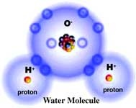
Making Compounds

Slide 5
Making Compounds
Compounds often have unique, different properties than the individual elements that make up the compound

Slide 6
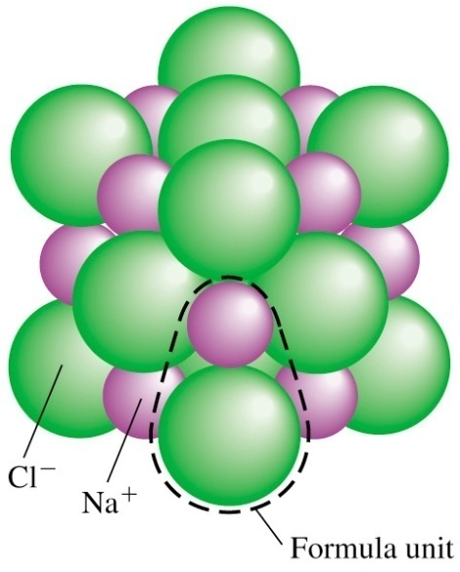
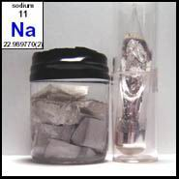
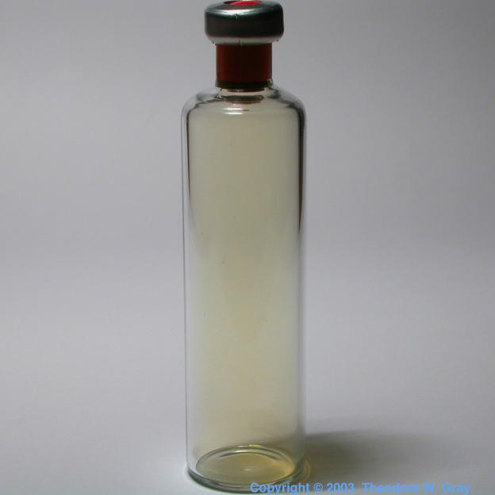
Making Compounds
Consider NaCl
+
=

Slide 7
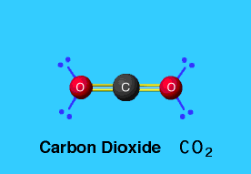
Chemical Formulas
NH₃
A chemical formula tells what elements a compound contains and the exact number of atoms of each element in a unit of the compound

Slide 8
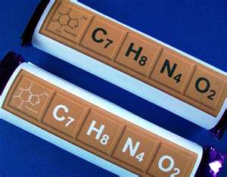
Chemical Formulas
A subscript is written after and below the element’s symbol
Subscripts tell how many atoms are in each unit of a compound
(ex. C₆H₁₂O₆ )

Slide 9
Chemical Formulas
Ex. How many of each atom are in H₂O?
Ex. How many of each atom are in Li₃PO₄?

Slide 10
Atomic Stability
REMEMBER: An atom is chemically stable when its outer energy level is complete (like the Noble Gases)

Slide 11
Atomic Stability
Elements will form chemical bonds in order to become stable!

Slide 12
Atomic Stability
The Octet Rule says that atoms tend to combine so they have eight electrons in their outer energy level or, in the case of elements 1-5, two in their outer shell level.

Slide 13
Atomic Stability
Atoms can gain, lose, or share electrons to complete their outer energy levels and become stable
Gaining, losing, and sharing electrons forms a chemical bond between atoms

