Slide 1
Chapter 12 Light Waves and Sound
, ,

Slide 2
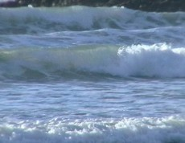
What is a Wave?
Traveling disturbance that carries energy from one place to another
Remember – Energy is the ability to do work or cause change

Slide 3
What is a wave?
Where does the energy of a wave come from?
Vibrations: An object that is vibrating is moving and vibrating objects transfer their energy to objects next to them

Slide 4
Mechanical Wave
Any way requiring a medium to propagate (go through). All waves other than electromagnetic waves (light).

Slide 5
Medium
Matter of some kind through which the energy of mechanical waves can propagate.
Example: Ocean waves medium=water

Slide 6
Slinky Video
https://www.youtube.com/watch?v=iT4KAc0Ag1E

Slide 7
Big Wave Surfing Video
https://www.youtube.com/watch?v=OgDtRmSCxBg

Slide 8
2 Main Types of Waves
Transverse Waves
Examples: Ocean waves, radio waves, light waves and heat waves
Compression (Longitudinal) Waves
Example: Sound waves

Slide 9
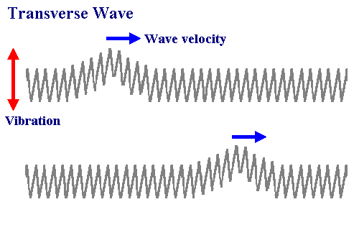
Transverse Waves
Motion of the medium is at a right angle (90°) to the direction of the wave movement

Slide 10
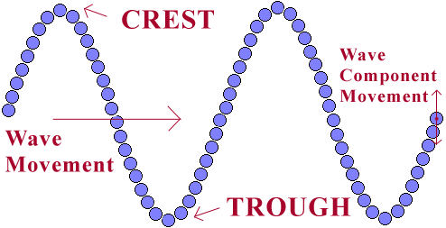
Parts of a Transverse Wave
Crest: highest point of the wave
Trough: lowest point of the wave

Slide 11
More on Transverse Waves
Wavelength: (λ) Distance between a point on one wave to the identical point on the next wave
Amplitude: (a) Distance from crest or trough to the rest position of the wave
Frequency: (f) The number of wave crests that pass a given point in a second

Slide 12
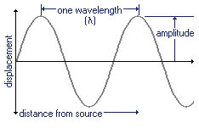
More on Transverse Waves

Slide 13
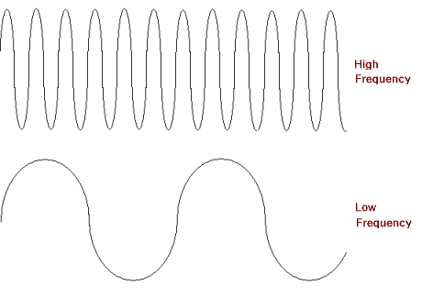
More on Transverse Waves

Slide 14
Math – Frequency and Wavelength
Frequency and Wavelength are inversely related
Frequency has units of 1/s or s⁻¹ or Hertz (Hz)
Wavelength has a unit of meters (m)

Slide 15
Math – Frequency and Wavelength
Velocity of a wave is calculated by multiplying wavelength by frequency
Velocity has units of meters/second (m/s)
V = λ x f

Slide 16
Example Problem #1
A wave is generated in a wave pool at an amusement park. The wavelength is 3.2 m and the frequency is 0.60 Hz. What is the velocity of the wave?

Slide 17
Example Problem #2
Earthquakes can produce three types of waves. One of these is transverse wave called an “s” wave. A typical s wave travels at 5000 m/s. Its wavelength is 417 m. What is its frequency?

Slide 18
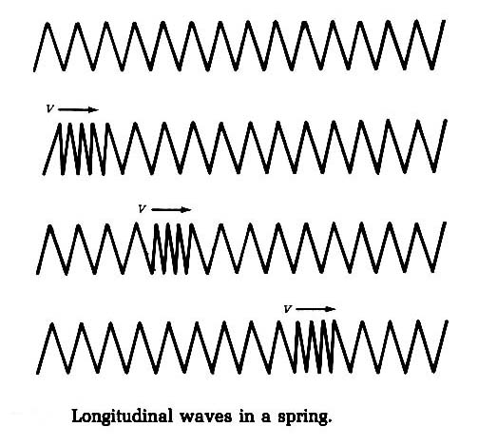
Compression/Longitudinal Wave
Motion of the medium is parallel to the direction of the wave movement
Examples: Sound waves, springs, coils

Slide 19
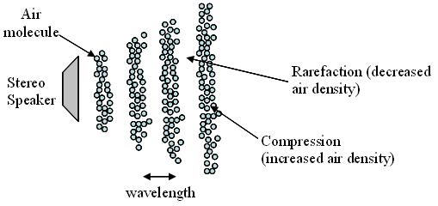
Compression/Longitudinal Wave
Compressions expand to an area that is less dense
Rarefaction: The less dense area in a compression wave

Slide 20
Compression/Longitudinal Wave
In order to have a compression wave, there must be a medium (matter)
Matter in a medium does not move forward. Instead the wave carries the energy forward.

Slide 21
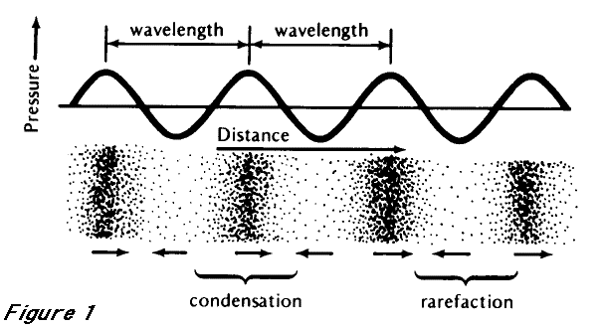
Compression/Longitudinal Wave
Wavelength (λ): One compression and one rarefaction
Frequency (f): Number of compressions that pass a point per second

Slide 22
Interactions of Waves

Slide 23
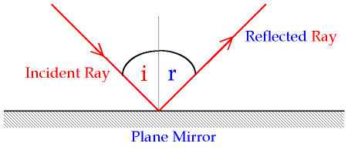
Reflection
Bouncing back of a wave after it strikes a surface
Incident ray – incoming wave
Reflected ray – reflected wave

Slide 24
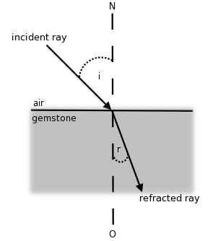
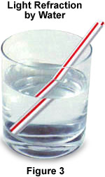
Refraction
Bending of a wave because of a change in medium

Slide 25
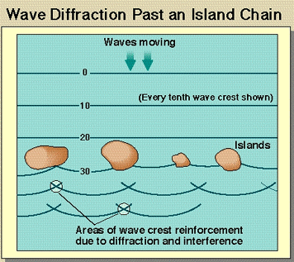
Diffraction
Bending of a wave around the edges of an obstacle
Waves move in a straight
line unless they
interact with an
obstacle

Slide 26
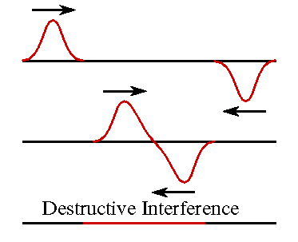
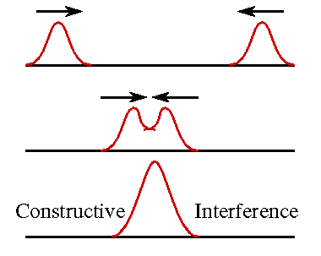
Wave interference
Interference – Interaction of waves that arrive at the same place at the same time
Constructive Interference Destructive Interference

