Slide 1
Common Lab Equipment
7th grade Physical Science

Slide 3
Lab Equipment We Should Already Know
Electronic Scale/ Balance
Graduated Cylinder
Beaker
Dropper
Test Tube
Erlenmeyer Flask

Slide 4
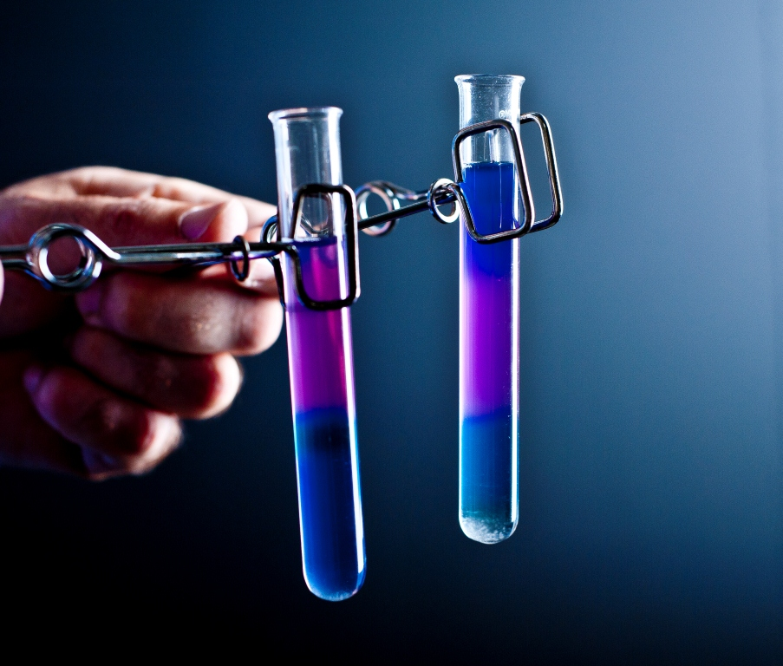
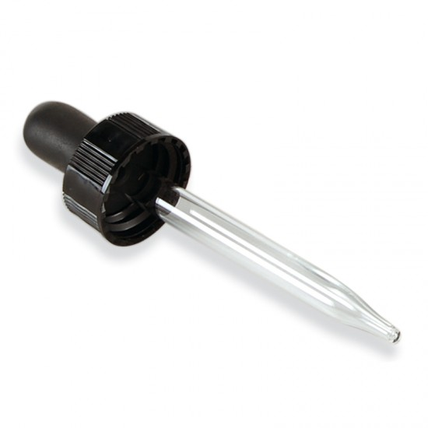
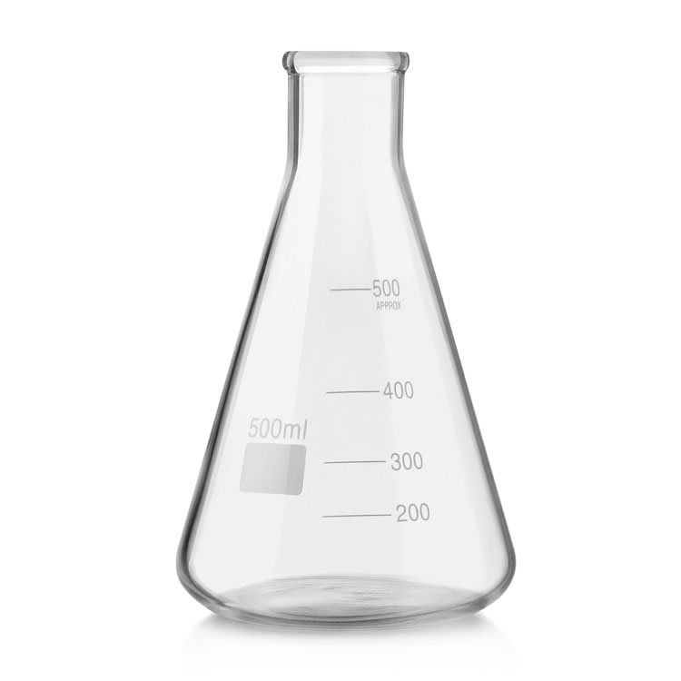
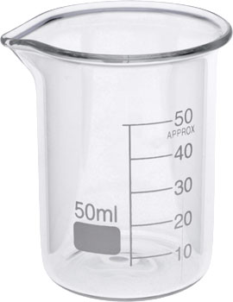
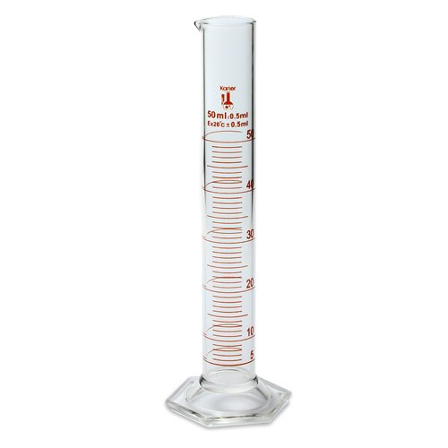

Slide 5
Lab Equipment That May Be New
Tongs
Watch Glass
Test tube Rack and test tube holder
Buret
Ring Stand
Utility Clamp
Wire Gauze
Spatula/ Scoopula
Evaporating Dish
Bunsen Burner
Flint Starter
Funnel
Water bottle
Thermometer
Hot Plate
Pipette

Slide 6
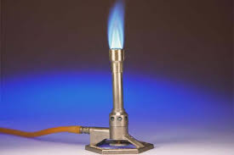
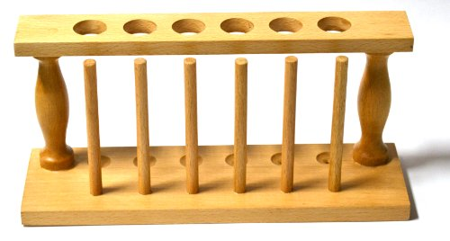
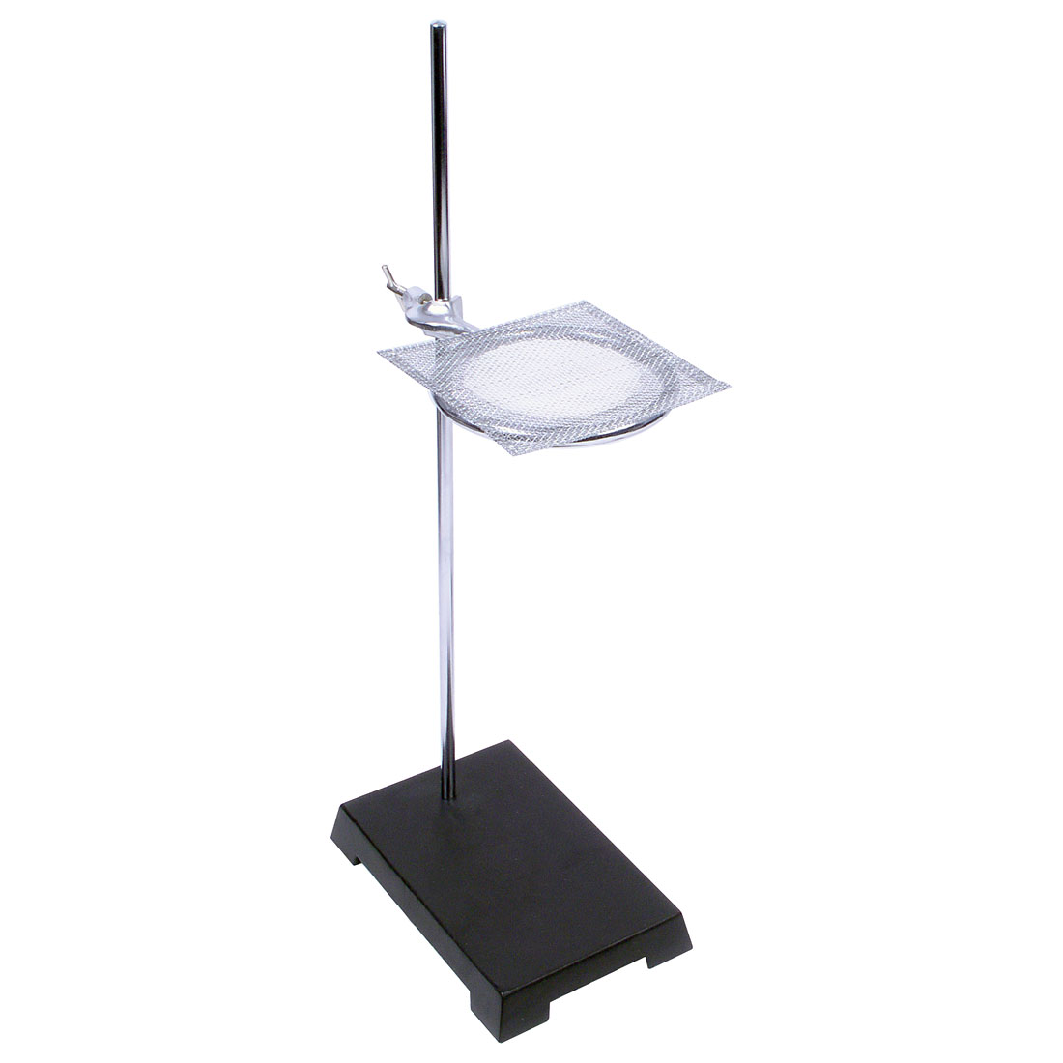
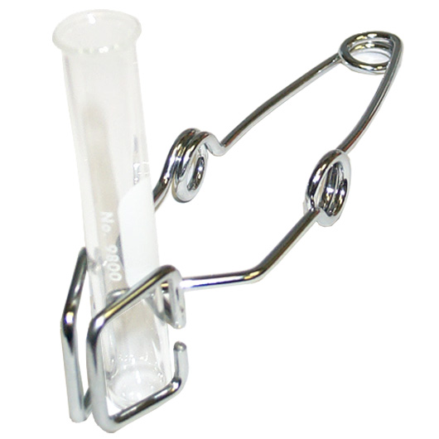
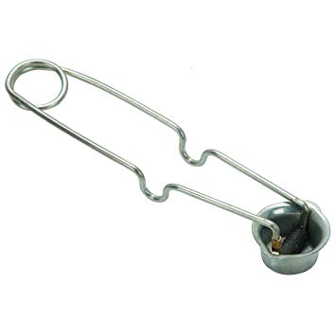

Slide 7
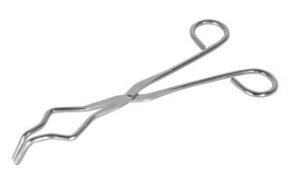
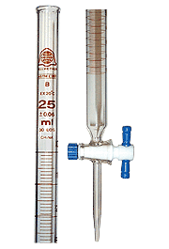
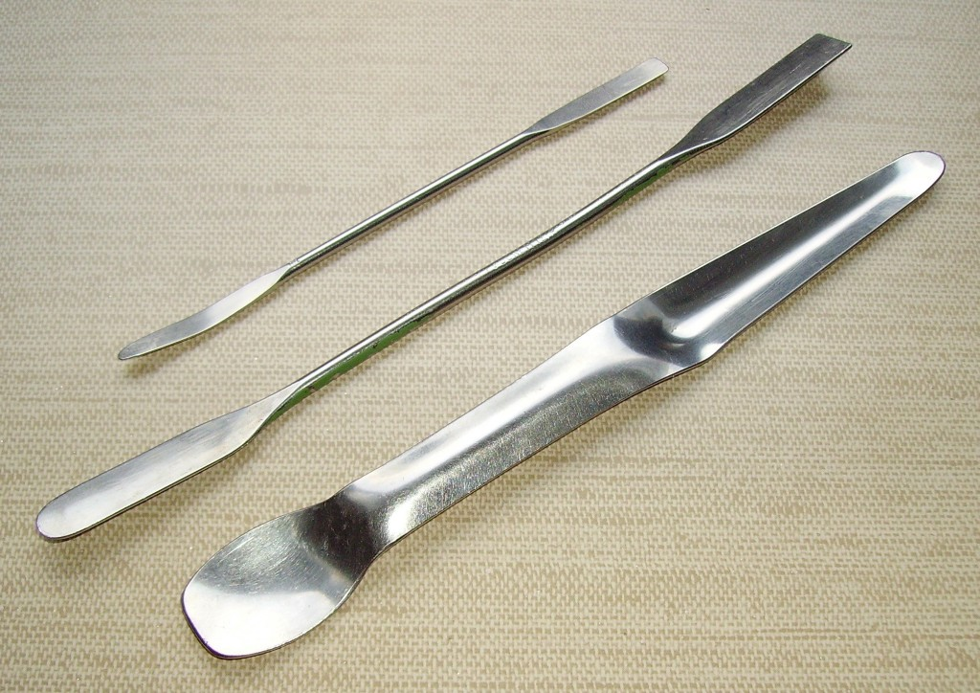
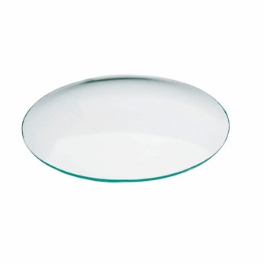

Slide 8
