Slide 1
Compounds and Chemical Reactions
Chapter 11 in Novare textbook

Slide 2
Chemical Reactions
As we watch the following video, write down your observations and be prepared to discuss with the class.
http://www.youtube.com/watch?v=66kuhJkQCVM

Slide 3
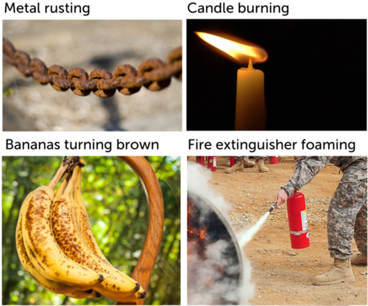
Chemical Reaction
No doubt you’ve seen changes like those pictured in Figure below. What do all these changes have in common? They are all chemical changes in matter. In a chemical change, matter changes into a different substance with different properties. Chemical changes occur because of chemical reactions.
A chemical reaction is a process in which some substances change into different substances.

Slide 4
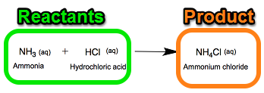
Reactants and Products
Reactants are the ingredients that go into a chemical reaction (they are on the left side of a chemical equation). Reactants are pure substances, either elements or compounds.
Products are the new substances formed by a chemical reaction (they are on the right side of chemical equation). Products are also pure substances, either elements or compounds.
“Yields”

Slide 5
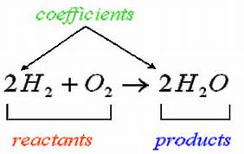
Chemical Equation
A chemical equation is a way of showing the reactants and the products in chemical reactions. Chemical equations look like algebraic equations and illustrate the action(s) taking place in a chemical reaction.
There are two kind of symbols to know when reading/balancing chemical equations. They are subscripts and coefficients.
subscripts

Slide 6
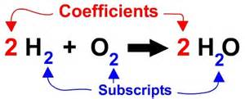
Chemical Equation
Coefficients- indicate the proportions of the different reactants and products involved in the reaction.
Example from previous slide would read: Two molecules of hydrogen react with one molecule of oxygen to yield two molecules of water.
Subscripts-are a part of the chemical formula of the elements and compounds in a reaction. They also indicate the proportions of ions in a compound.

Slide 7
Chemical Equation Symbols
Yield
Reacts with (reactants) or it means and (products) +
Solid (s)
Liquid (l)
Gas (g)
Aqueous Solution- a solution of a compound dissolved in water (aq)

Slide 8
Chemical Reactions
Many chemical reactions involve ions.
Ions are charged atoms. It is an atom that has either lost or gained one or more electrons.
If an atom loses electrons and has less electrons than protons it is positively charged. If it gains electrons and has more electrons than protons it is negatively charged.
The hydrogen ion is the most common ion involved in chemical reactions.

Slide 9
Chemical Reactions
In chemical reactions, bonds break in the reactants and new bonds form in the products.
Energy is stored in chemical bonds and energy is released when those bonds break.
The reactants and products contain the same atoms, but they are rearranged during the reaction.
As a result, the atoms are in different combinations in the products than they were in the reactants.

Slide 10
How do you know a chemical reaction has taken place???
The signs that a chemical reaction has taken place are listed below:
1. Color Change
2. Gas Production
3. Temperature Change
4. Formation of a Precipitate

Slide 11
Color change
When two substances are mixed and a color change results, this color change can be evidence that a chemical reaction has taken place.
A color change can mean that new molecules have been formed in a chemical reaction with different structures that produce different colors.

Slide 12
Gas production
The gas produced from mixing vinegar with baking soda is evidence that a chemical reaction has taken place.
Since the gas was produced by mixing a solid and a liquid together, the gas is a NEW substance formed by the reaction.

Slide 13
Temperature Change
A change in temperature of the reaction mixture is also a clue that a chemical reaction has taken place.
Temperature increases can increase the rate of the chemical reaction.
The rate of the chemical reaction is measured by how fast the reactants turn into products.
A catalyst, such as heat, can increase the rate of the reaction.

Slide 14
Formation of precipitate
If a solid is formed when two solutions are mixed, we call that a formation of a precipitate.
Formation of a precipitate is evidence that a chemical reaction has taken place.
The precipitate does not dissolve in solutions. That is why it is visible.

Slide 15
Types of Chemical Reactions

Slide 16
Synthesis Reactions
A synthesis reaction occurs when two or more reactants combine to form a single product.
A+B C

Slide 17
Synthesis Reaction Examples

Slide 18
Synthesis Practice -Which of the following illustrates a synthesis reaction?
P₄ +3O2 2P₂O₃
H₂ + O₂ → 2 H₂O
2 KCl → 2 K + Cl
2 Fe₂O₃ + 3 C → Fe + CO₂

Slide 19
Decomposition Reactions
One reactant breaks down into two or more products. It is the reverse of a synthesis reaction.
AB A + B

Slide 20
Decomposition Reaction Examples

Slide 21
Replacement Reactions
Elements switch places in compounds.
In a single replacement reaction, one element takes the place of another in a single compound.
In a double replacement reaction, two compounds exchange elements.

Slide 22
Replacement Reaction Examples

Slide 23
Combustion Reactions
When a substance reacts quickly with oxygen.
Combustion is commonly called “burning”.
Carbon Dioxide, water, and heat/light (it escapes) are all products of combustion.

Slide 24
Combustion Reaction Examples

Slide 25
Using your worksheet please fill in the missing information.
A = Red B = Blue C = Green D = Yellow
Type of Reaction | Definition | ★ Equation
Synthesis
Decomposition
Single Replacement
Double Replacement
Two or more elements or compounds combine to make a more complex substance
A + B → AB
AB → A + B
Compounds break down
into simpler substances
Occurs when one element replaces another one in a compound
AB + C → AC + B
Occurs when different atoms in two different compounds trade places
AB + CD → AC + BD

Slide 26
Identifying Chemical Reactions
S = Synthesis D = Decomposition SR = Single Replacement DR = Double Replacement
____ P + O₂ → P₄O₁₀ ____ Mg + O₂ → MgO
____ HgO → Hg + O₂ ____ Al₂O₃ → Al + O₂
____ Cl₂ + NaBr → NaCl + Br₂ ____ H₂ + N₂ → NH₃

Slide 27
____ Na + Br₂ → NaBr ____ CuCl₂ + H₂S → CuS + HCl
____ HgO + Cl₂ → HgCl + O₂ ____ C + H₂ → CH₄
____ KClO₃ → KCl + O₂ ____ S₈ + F₂ → SF₆
____ BaCl₂ + Na₂ SO₄ → NaCl + BaSO₄

Slide 28
Endothermic Vs. Exothermic Reactions
Exothermic-
Endothermic-
Examples:

Slide 29
Balancing Chemical Equations
Which of the following chemical equations is balanced?
Zn + HCl → ZnCl₂ + H₂
2 Zn + 2 HCl → ZnCl₂ + H₂
2 Zn + HCl → ZnCl₂ + H₂
Zn + 2 HCl → ZnCl₂ + H₂

Slide 30
Balancing chemical Equations Basics
Balancing a chemical equation involves a certain amount of trial and error
Steps:
Step 1: Count each type of atom in reactants and products. Does the same number of each atom appear on both sides of the arrow? If not, the equation is not balanced, and you need to go to step 2.
Step 2: Place coefficients, as needed, in front of the symbols or formulas to increase the number of atoms or molecules of the substances. Use the smallest coefficients possible. Warning! Never change the subscripts in chemical formulas. Changing subscripts changes the substances involved in the reaction. Change only the coefficients.
Repeat steps 1 and 2 until the equation is balanced.

Slide 31
Example
Q: Balance this chemical equation for the reaction in which nitrogen (N₂)
and hydrogen (H₂) combine to form ammonia (NH₃):
N₂ + H₂ → NH₃
A: First count the nitrogen atoms on both sides of the arrow. There are two nitrogen atoms
in the reactants so there must be two in the products as well. Place the coefficient 2
in front of NH₃ to balance nitrogen:
N₂ + H₂ → 2 NH₃
Now count the hydrogen atoms on both sides of the arrow. There are six hydrogen atoms
in the products so there must also be six in the reactants. Place the coefficient 3
in front of H₂ to balance hydrogen:
N₂ + 3 H₂ → 2 NH₃

Slide 32
Balancing Equations Video

Slide 33
More practice ☺
1. ____ NaBr + ____ H₃PO₄ → ____ Na₃PO₄ + ____ HBr
2. ____ Mg + ____ Fe₂O₃ → ____ Fe + ____ MgO
3. ____ Ca(OH)₂ + ____ Al₂(SO₄)₃ → ____ CaSO₄ + ____ Al(OH)₃
4. ____H₂SO₄ + ____ NH₄OH → ____ H₂O + ____ (NH₄)₂SO₄
5. ___ AgI + ___ Fe₂(CO₃)₃ → ___ FeI₃ + ___ Ag₂CO­₃

Slide 34
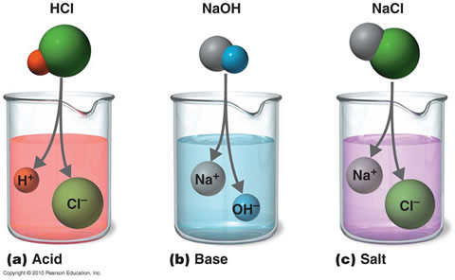
Acids and Bases
Acids are compounds that produce hydrogen ions (+1 charge) in aqueous solutions.
Bases are compounds that produce hydroxide ions (-1 charge) in aqueous solutions.
*Aqueous Solutions- a solution in water (something has dissolved in water, is mixed with water, etc.)

Slide 35
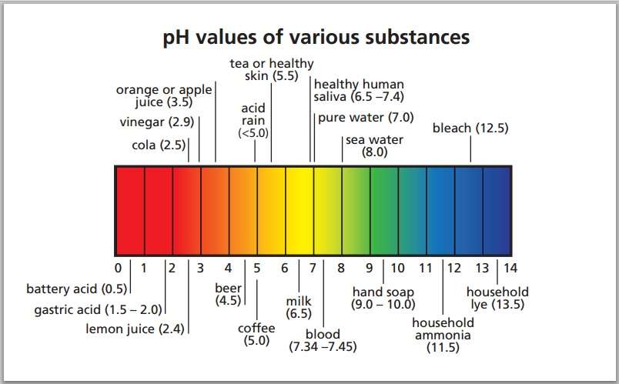
pH scale

