Slide 1
Bell Ringer 01/28/19
Classify each of the following as elements (E), compounds (C) or Mixtures (M).
____Diamond(C) ____Sugar (C₆H₁₂O₆) ____Milk
____Iron (Fe) ____Uranium (U) ____A dog
____Air ____Gasoline ____Krypton (K)
____Alcohol (CH₃OH) ____Salt (NaCl) ____Water (H₂O)
____Wood ____Pizza ____Gold (Au)

Slide 2
Bell Ringer 01/29/19
Description | Pure Substance or Mixture? | Classification?
1. Chocolate syrup is added to milk and stirred | Mixture | Homogenous mixture (solution)
2. Copper metal (used to make wires)
3. Sand is added to water
4. Distilled water
5. Tap water
6. Helium gas (used to inflate a balloon)
7. Table sugar
8. Table sugar added to a cup of coffee and stirred
9. The air we breathe

Slide 3
Bell Ringer 01/20/19
Please get out your mixtures and solutions classwork from the past two days. We will begin class by discussing our answers.

Slide 4
mixtures and solutions

Slide 5
Mixtures
Mixtures are NOT pure substances.
A mixture is when substances are combined and no chemical reaction occurs to change the composition of the substances.

Slide 6
Mixtures Continued
Heterogeneous Mixtures-you can see with your eyes or a microscope that at least two different substances are in the mixture. (examples: seasoning mix, salad, pizza, garden soil)
Homogeneous Mixtures-the substances in this mixture appear to be completely uniform (the same throughout). (examples: Gatorade, salt water, coffee with sugar, Kool-Aid)

Slide 7
Solutions
Another name for homogeneous mixtures are SOLUTIONS.
A solution is made when one substance, called the SOLUTE, is dissolved into another substance, called the SOLVENT.
Water is the MOST COMMON liquid solvent.
The process of dissolving does not involve a chemical reaction.

Slide 8
How a solute dissolves
http://www.youtube.com/watch?v=gN9euz9jzwc

Slide 9
Examples of Solutions
Solution | Solute | Solvent
Gas dissolved in gas Example: Earth’s atmosphere | oxygen (and other gases) | nitrogen
Gas dissolved in liquid Example: carbonated water | carbon dioxide | water
Liquid dissolved in gas Example: moist air | water | air
Liquid dissolved in liquid Example: vinegar | acetic acid | water
Solid dissolved in liquid Example: sweet tea | sugar | tea
Solid dissolved in solid Example: bronze | copper | tin

Slide 10
Rate of dissolving
Surface Area- For a given amount of solute, smaller particles have greater surface area. With greater surface area, there can be more contact between particles of solute and solvent.
Temperature- a solute dissolves faster in a warmer solvent than it does in a cooler solvent because particles have more energy of movement.
Stirring- it helps distribute the solute particles throughout the solvent.

Slide 11
Water is a polar molecule
What does that mean???
If a molecule is polar, they have an unequal sharing of electrons.
This means it has positively and negatively charged ends.

Slide 12
Solubility
Solutes that can dissolve in a given solvent, such as water, are said to be soluble in that solvent.
So many solutes are soluble in water that water is called the universal solvent.
Substances that do NOT dissolve in water are called insoluble.
“Like dissolves Like”
Solubility is the amount of solute that can dissolve in a given amount of solvent at a given temperature.

Slide 13
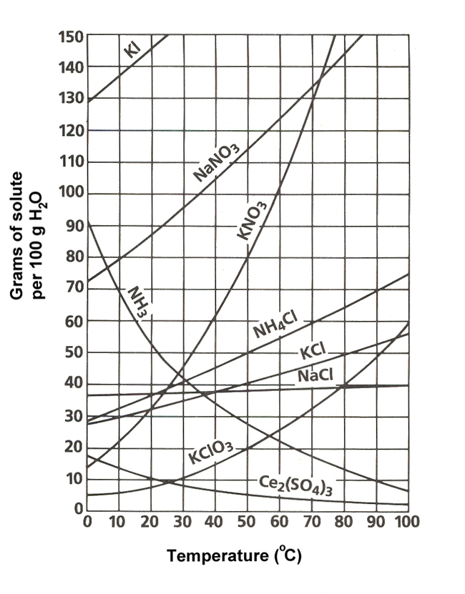
Solubility Curve
How to read a solubility curve:

Slide 14
Saturation
A solution that contains as much solute as can dissolve at a given temperature is called a saturated solution.
A solution that contains less solute than can dissolve at a given temperature is called an unsaturated solution.

Slide 15
Saturation Continued
A supersaturated solution contains more than the maximum amount of solute that can be dissolved at a given temperature.

Slide 16
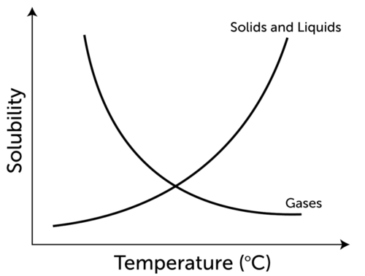
Factors that affect solubility

Slide 17
FACTORS THAT AFFECT SOLUBILITY
Temperature and pressure affects the solubility of a solute.
If a solute is a solid or liquid, increasing the temperature increases its solubility. For example, more sugar can dissolve in hot tea than in iced tea.
If a solute is a gas, increasing the temperature decreases its solubility. For example, less carbon dioxide can dissolve in warm ocean water than in cold ocean water.
Pressure is the amount of force pushing against a given area. Increasing the pressure on a gas increases its solubility.

Slide 18
Bell Ringer 02/06/19

Slide 19
Concentration
The concentration of a solution is the amount of solute in a given amount of solution.
A solution with little dissolved solute has a low concentration. It is called a dilute solution.
A solution with a lot of dissolved solute has a high concentration. It is called a concentrated solution.

Slide 20
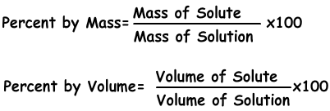
HOW TO CALCULATE CONCENTRATION

Slide 21
Concentration Examples
For example, if a 100 g solution of salt water contains 3 g of salt, then its concentration is:
Concentration=(3g/100g) ×100%=3%

Slide 22
Properties of Solutions
When a solute dissolves in a solvent, it changes the physical properties of the solvent.
Properties that change when a solute is added are the freezing and boiling points.

Slide 23
Adding Salt to Icy Roads
Salting icy roads and walkways lowers the freezing point of the water that forms ice which leads to melting and prevents falling snow or rain from being able to freeze.
Though salt can be effective, it does have some negative impacts on the environment. Can you think of any???

Slide 24
Salt and Ice Video
https://www.youtube.com/watch?v=6V_AVe3zWu8

Slide 25
Acids
An acid is an ionic compound that produces positive hydrogen ions (H⁺) when dissolved in water.
An example is hydrogen chloride (HCl). When it dissolves in water, its hydrogen ions and negative chloride ions (Cl⁻) separate, forming hydrochloric acid.
This can be represented by the equation:
HCl → H⁺ + Cl⁻

Slide 26
Properties of Acids
Acids have a sour taste.
Acids conduct electricity.
Acids are reactive with metals.

Slide 27
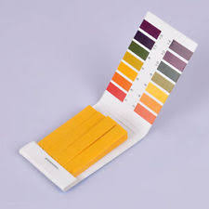
Detecting Acids
Certain compounds, called indicators, change color when acids come into contact with them. They can be used to detect acids. An example of an indicator is a compound called litmus. It is placed on small strips of paper that may be red or blue. If you place a few drops of acid on a strip of blue litmus paper, the paper will turn red.

Slide 28
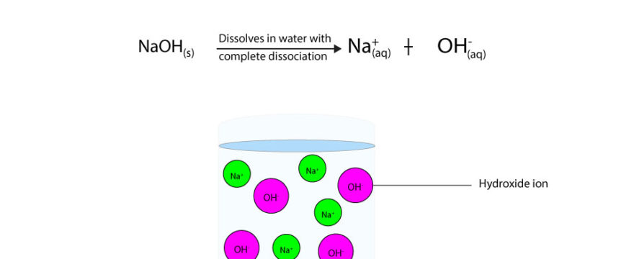
Bases
A base is an ionic compound that produces negative hydroxide ions (OH⁻) when dissolved in water.
For example, when the compound sodium hydroxide (NaOH) dissolves in water, it produces hydroxide ions and positive sodium ions (Na⁺).

Slide 29
Base Properties
Bitter Taste
Slippery Texture
Like acids, bases conduct electricity because they consist of charged particles in solution

Slide 30
Strength of Acids and Bases
The acid in vinegar is weak enough to safely eat on a salad. The acid in a car battery is strong enough to eat through skin. The base in antacid tablets is weak enough to take for an upset stomach. The base in drain cleaner is strong enough to cause serious burns. What causes these differences in strength of acids and bases?

Slide 31
Concentration of Ions
The strength of an acid depends on the concentration of hydrogen ions it produces when dissolved in water. A stronger acid produces a greater concentration of ions than a weaker acid. For example, when hydrogen chloride is added to water, all of it breaks down into H⁺ and Cl⁻ ions.
The strength of a base depends on the concentration of hydroxide ions it produces when dissolved in water. For example, sodium hydroxide completely breaks down into ions in water, so it is a strong base.

Slide 32
pH Scale
The strength of acids and bases is measured on a scale called the pH scale.
pH stands for “power of hydrogen.”
The symbol pH represents acidity, or the concentration of hydrogen ions (H⁺) in a solution. Pure water, which is neutral, has a pH of 7.
With a higher concentration of hydrogen ions, a solution is more acidic, but has a lower pH.
Therefore, acids have a pH less than 7, and the strongest acids have a pH close to zero. Bases have a pH greater than 7, and the strongest bases have a pH close to 14.

Slide 33
