Slide 1
Earthquakes
Earth Science Unit 4

Slide 2
Bell Ringer 10/21/19
What is an earthquake?
Have you ever experienced one? Explain.

Slide 3
1906 San Francisco Earthquake
Notes:
https://earthquake.usgs.gov/earthquakes/events/1906calif/18april/ more information about the earthquake from the USGS

Slide 4
1906 San Francisco Earthquake
https://www.loc.gov/item/00694425/
https://earthquake.usgs.gov/earthquakes/events/1906calif/18april/images/sf06.city.html
Notes:
April 18, 1906 5:12 AM magnitude 7.9 (megaquake) the worst of the earthquake were the fires that were triggered by the shaking. The water mains were shut down and firefighters were unable to put the fires out due to the lack of water. 28,000 building were damaged and an estimated 3000 people died. Provided great insight into future quakes. How to prepare, build, etc.

Slide 5
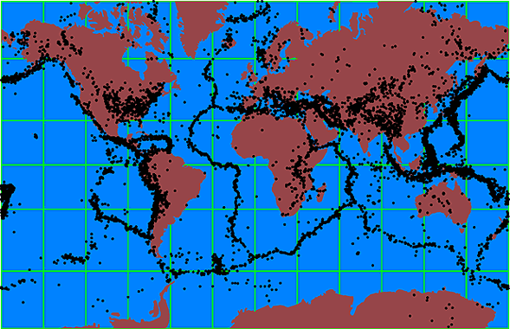
Recorded Earthquakes Around The World

Slide 6
Notes:
Yellow is populated cities more than a million and red is a magnitude of 5.0 or greater

Slide 7
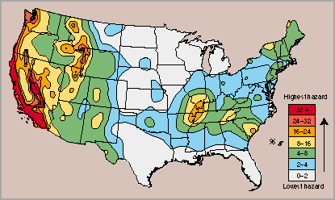
Potential Earthquakes in US

Slide 8
Stress is the force applied to the rock.
Stress can cause rock to change shape or break.
3 Types of Stress:
Tension: pulls rocks apart. Tension causes rocks to lengthen or break apart.
Compression: squeezes rocks together. Compression causes rocks to fold or fracture.
Shear: when forces slide past each other and can cause rock to slip.
Notes:
Ask them about different types of boundaries with each type of stress.

Slide 9
Graded Bell Ringer 10/22/19
Please make sure your full name, date, and period are on your paper.
Answer the following:
In your own words explain to me what causes an earthquake?
As we discussed yesterday, reference the 1906 San Francisco Earthquake and explain how an earthquake can create a chain reaction of events. Use examples solidify your responses.

Slide 10
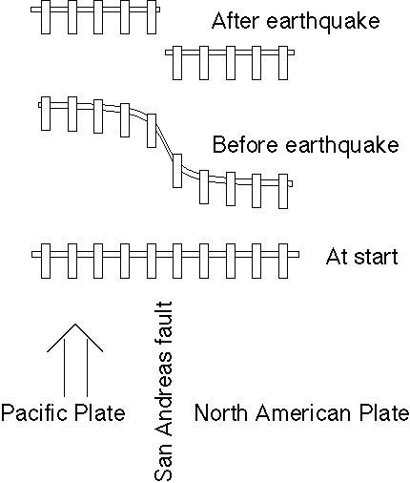
Elastic Rebound Theory
The diagram illustrates the process. Start at the bottom. A straight fence is built across the San Andreas fault. As the Pacific plate moves northwest, it gradually distorts the fence. Just before an earthquake, the fence has an "S" shape. When the earthquake occurs the distortion is released and the two parts of the fence are again straight; but now there is an offset.
Notes:
If a stretched rubber band is broken or cut, elastic energy stored in the rubber band during the stretching will suddenly be released. Similarly, the crust of the earth can gradually store elastic stress that is released suddenly during an earthquake.

Slide 11
Elastic Rebound Theory
Explains how energy is stored in rocks:
Rocks bend until the strength of the rock is exceeded
Rupture occurs and the rocks quickly move
Energy is released in waves that radiate outward from the fault
Notes:
This gradual accumulation and release of stress and strain is now referred to as the "elastic rebound theory" of earthquakes. Most earthquakes are the result of the sudden elastic rebound of previously stored energy.

Slide 12
Notes:
This picture, taken near Bolinas in Marin County (NW of San Fran) by G.K. Gilbert, shows a fence that was offset about 8.5 feet along the trace of the fault

Slide 13
Further Understanding of the Elastic Rebound Theory
https://www.iris.edu/hq/inclass/video/elastic_rebound_demonstration_using_a_yardstick#videoPlayer

Slide 14
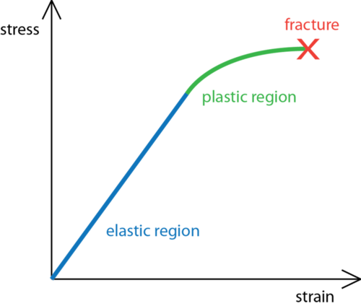
Stress vs. Strain
Stress is…
Strain is…
Stress causes strain.
Notes:
Stress is the force applied to an object. In geology, stress is the force per unit area that is placed on a rock
When stress causes a material to change shape, it has undergone strain or deformation. (think about the different faults that are created as a result of stress)
Rocks have three possible responses to increasing stress (illustrated in figure 3):
elastic deformation: the rock returns to its original shape when the stress is removed.
plastic deformation: the rock does not return to its original shape when the stress is removed.
fracture: the rock breaks

Slide 15
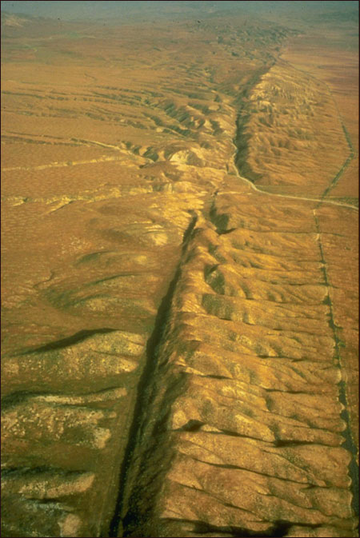
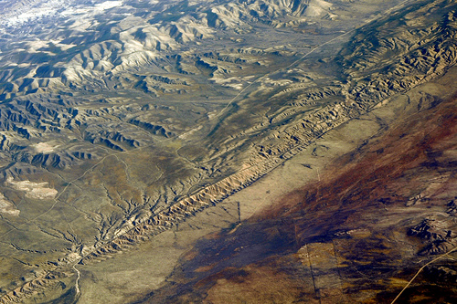
Faults
Fracture in the earth where movement has occurred.

Slide 16
Notes:
Tension leads to normal faults. Compression leads to reverse or thrust faults. Horizontal shear leads to strike-slip faults
https://www.usgs.gov/faqs/what-a-fault-and-what-are-different-types?qt-news_science_products=0#qt-news_science_products

Slide 17
What are Earthquakes?
The shaking or trembling caused by the sudden release of energy.
Usually associated with faulting or breaking of rocks.
Continuing adjustment of position results in aftershocks.

Slide 18
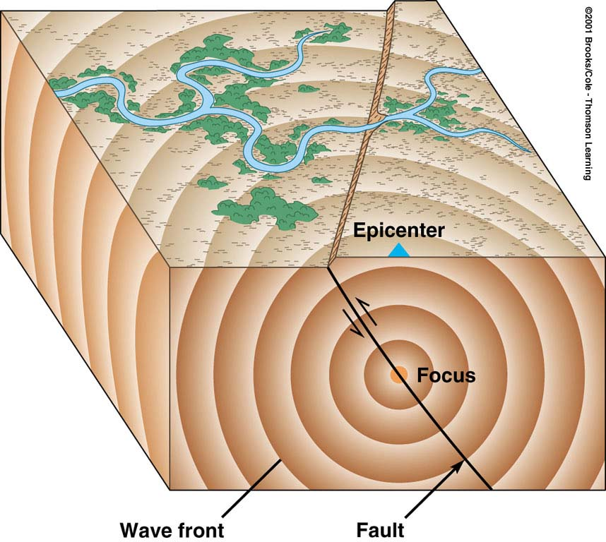
The Focus and Epicenter of an Earthquake
Focus- The point within Earth where faulting begins is the focus, or hypocenter
Epicenter-The point directly above the focus on the surface is the epicenter

Slide 19
Foreshock(s)
-Earthquake(s) generated at or very near the focus of the main earthquake prior to the main shock
-smaller magnitude than the main shock and precede main quake by a short or substantial time interval

Slide 20
Main shock
-is the main earthquake disturbance generated at the focus
Aftershock(s)
-Earthquake(s) generated at or very near the focus of the main earthquake following the main shock
-smaller in magnitude than the main shock. Follow the main earthquake by a short or substantial time interval

Slide 21
Bell Ringer 10/24/19
Please take out both the reading and wkst on faults. You have the first five minutes to try to complete the assignment.
Be ready to participate. I will be calling on each and every one of you to provide responses to the questions asked.

Slide 22
Where Do Earthquakes Occur and How Often?
~80% of all earthquakes occur in the Pacific belt
most of these result from convergent margin activity
15% occur in the Mediterranean-Asiatic belt
remaining 5% occur in the interiors of plates and on spreading ridge centers
more than 30,000 quakes strong enough to be felt are recorded each year

Slide 23
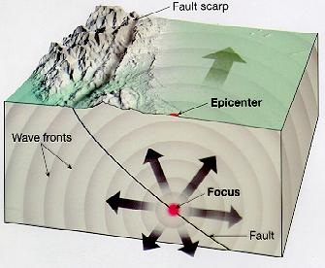
Earthquakes

Slide 24
Recording Earthquakes
Earthquakes are recorded by an instrument called a seismograph.
Every earthquake is going to give off three different seismic waves.
To find the location of an earthquake, readings from three different locations (seismic stations) are needed.
Notes:
150 seismic stations in the global network even more are being added…not sure if most are in the US, but assume so

Slide 25
What We Learn From a Seismogram
Seismograms contain a lot of information about an earthquake: its strength, length and distance.
Wave height is used to determine the magnitude of the earthquake.
The seismogram shows the different arrival times of the seismic waves The first waves are P-waves since they are the fastest. S-waves come in next and are usually larger than P-waves. The surface waves arrive just after the S-waves.
If the earthquake has a shallow focus, the surface waves are the largest ones recorded.
Notes:
A seismogram may record P-waves and surface waves, but not S-waves. This means that it was located more than halfway around the Earth from the earthquake. The reason is that Earth's outer core is liquid. S-waves cannot travel through liquid. So the liquid outer core creates an S-wave shadow zone on the opposite side of the Earth from the quake.

Slide 26
Types of Seismic Waves (Review)
P Waves: the fastest moving wave and can travel through solids and liquids
S Waves: Can only travel through solids and are the second wave to arrive
L Waves: Slowest moving seismic wave, but causes the most damage.
-Love Wave- these waves move side-to-side (horizontal motion) and are the fastest of the surface waves.
-Rayleigh Wave-these waves roll like ocean waves. They move up and down and side-to-side in the same direction that the wave is going. These waves are what we feel in the form of shaking/trembling on the surface.
Notes:
http://www.geo.mtu.edu/UPSeis/waves.html

Slide 27
Seismometer/ Seismograph

Slide 28
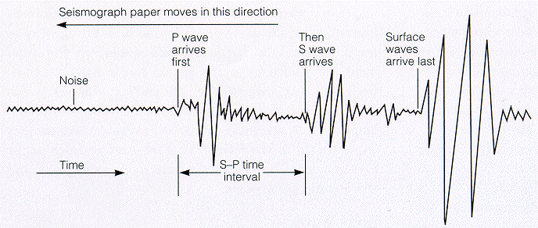

Slide 29
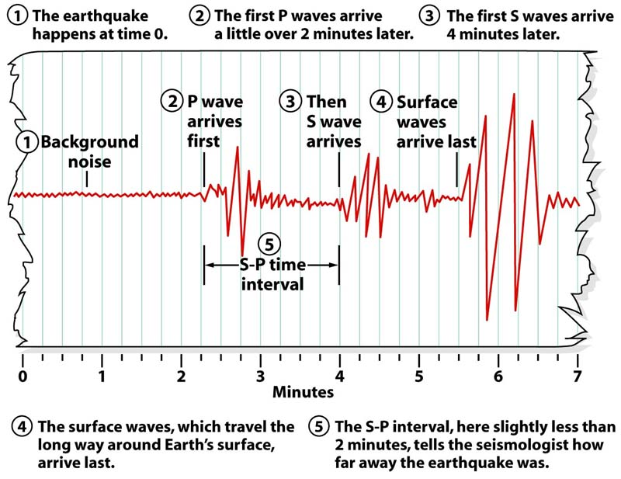

Slide 30
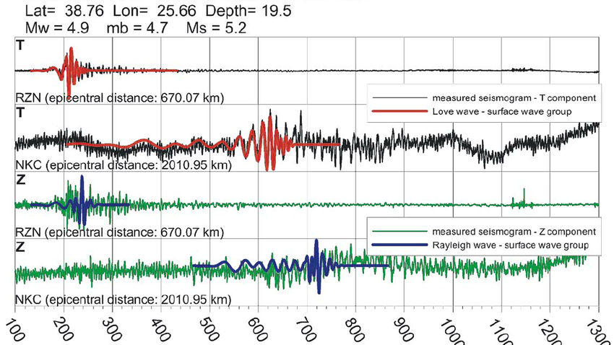

Slide 31
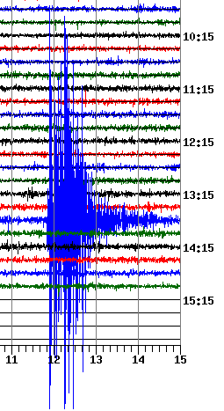

Slide 32
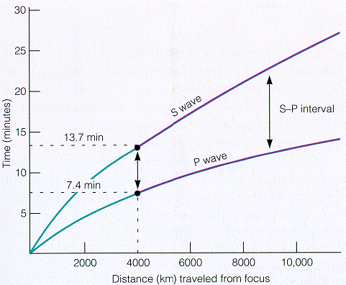
Notes:
With increasing distance from the earthquake, the time difference between the arrival of the P waves and the arrival of the S waves increases. Put more simply, the higher the time between the S and P waves (the S-P interval), the farther the distance. This helps us determine the location of the epicenter.

Slide 33
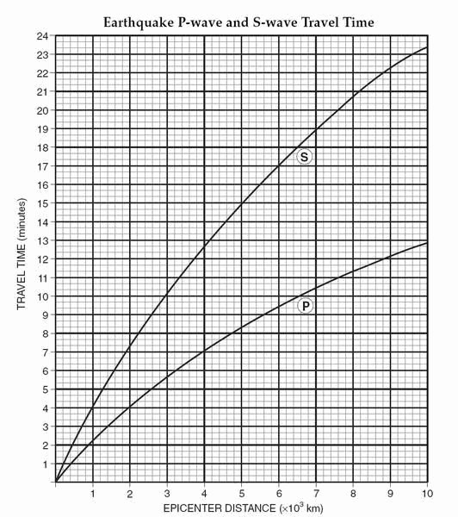
Notes:
Use a scrap piece of paper to find differences

Slide 34
Triangulation
In order to locate the epicenter of an earthquake the following must be done:
First, seismologists calculate the arrival time difference. Then they know the distance to the epicenter from that seismograph.
Next, the seismologists try to determine the location of the earthquake epicenter. To do this they need the distances to the epicenter from at least three seismographs.
Let’s say that they know that an earthquake’s epicenter is 50 kilometers from Raleigh. They draw a circle with a 50 km radius around that seismic station. They do this twice more around two different seismic stations. The three circles intersect at a single point. This is the earthquake’s epicenter,

Slide 35
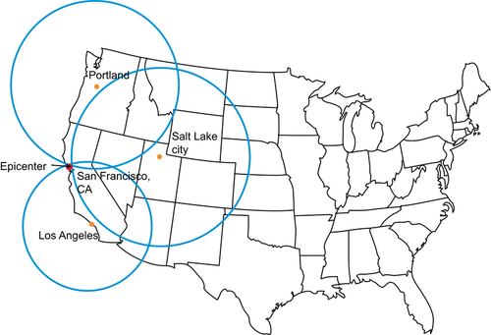

Slide 36
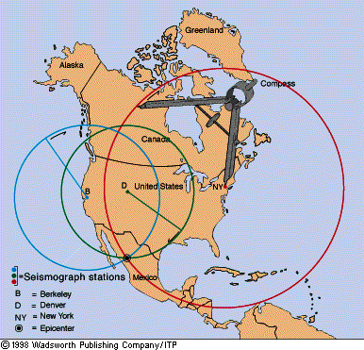

Slide 37
Richter Scale
The Richter scale measures magnitude of an earthquake
Magnitude is a measurement of the energy released by an earthquake
Each whole number increase in magnitude is an increase of 31.7 times more energy

Slide 38
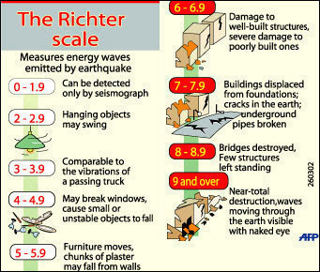

Slide 39
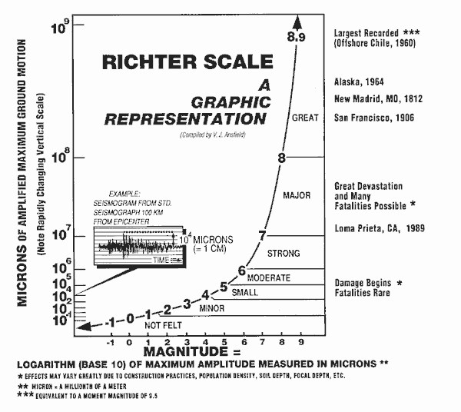

Slide 40
Mercalli Scale
A measurement of the intensity of an earthquake

Slide 41
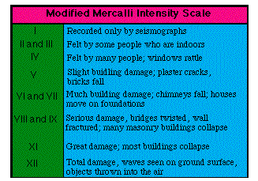

Slide 42
