Slide 1
ENERGY PART 1
MRS. MASTIN PHYSICAL SCIENCE 2016

Slide 2
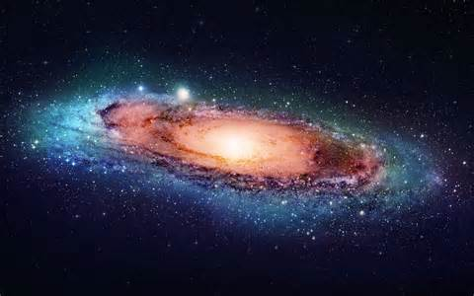
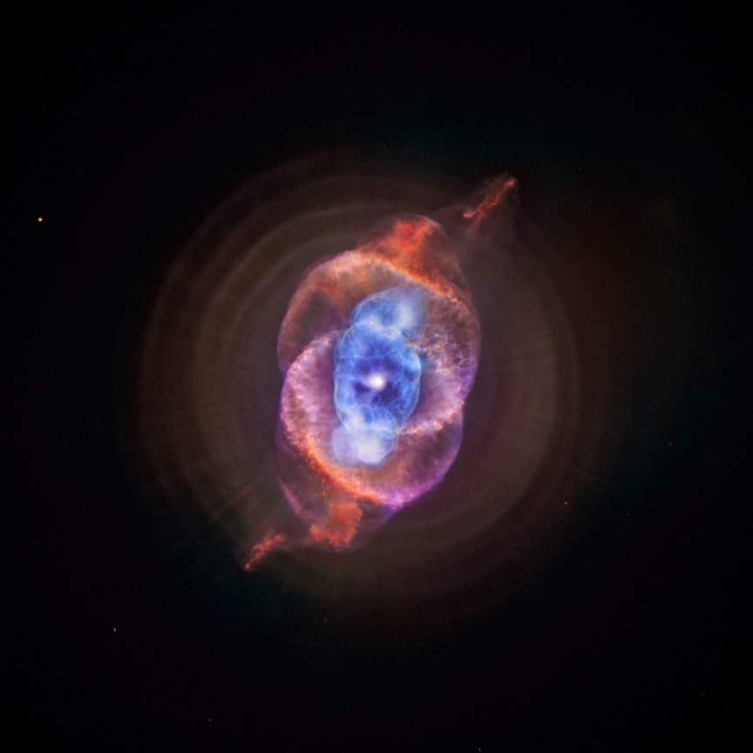
God’s creation

Slide 3
What is energy???
Energy is the ability to do work.
The largest source of energy on Earth comes from the Sun.

Slide 4
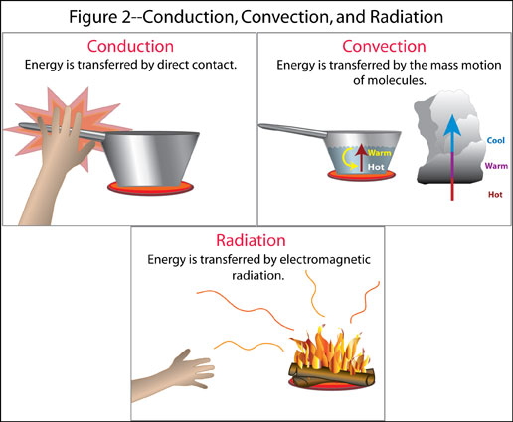
How is Heat (energy) transferred?
Convection
Conduction
*Radiation

Slide 5
conduction
Energy is transferred by DIRECT CONTACT.

Slide 6
convection
Energy is transferred by the mass motion of molecules.

Slide 7
Radiation
Energy is transferred by electromagnetic radiation (energy travels in waves).
Electromagnetic radiation (light)- electric and magnetic disturbances, traveling through space as waves.

Slide 8
Radiation Continued
Visible Light- the limited range of all the various wavelengths of electromagnetic radiation that is seen by the human eye.
Electromagnetic Spectrum- all types of electromagnetic radiation arranged according to wavelength and frequency.

Slide 9
Electromagnetic Spectrum

Slide 10
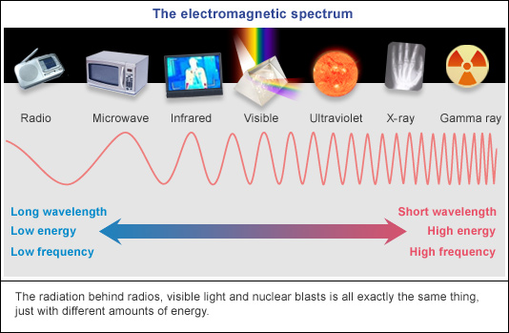
Electromagnetic Spectrum

Slide 11
How to Interpret the Electromagnetic Spectrum?
Wavelength- is the distance between peaks on a wave.
Frequency- what is the number of waves occurring per second.
C=λf
C=Speed of light (3.0 x 10^8 m/s)
f=frequency λ= Wavelength

