Slide 1
Forces and fields
Chapters 5 and 10 Physical science

Slide 2
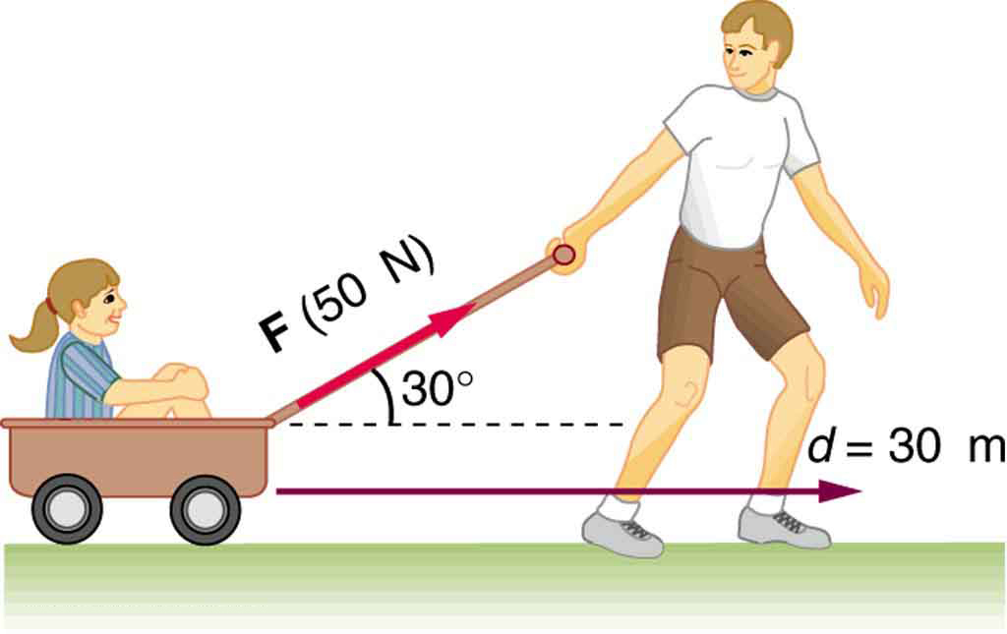
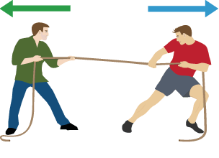
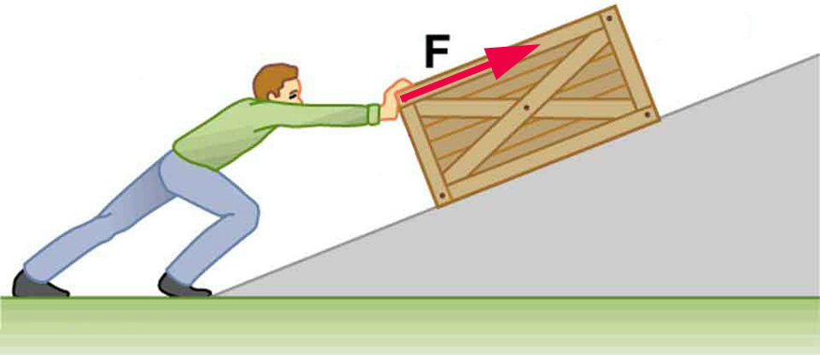
What is a force?
A force is any push or pull on an object in a particular direction.
Examples???

Slide 3
Sir Isaac Newton
In 1687 Sir Isaac Newton published his Law of Universal Gravitation.
Newton proposed that everything in the universe that had mass (all matter) exerted a gravitational force on everything else in the universe that had mass.

Slide 4
Newton’s Laws of Motion:
First Law of motion: “Law of Inertia”
In the absence of a force, an object will remain in its present state of motion—either at rest, or moving at a constant speed.
2. The acceleration of an object is proportional to the force acting on it.
Force=mass x acceleration
3. When one object pushes on another with a certain force, the second object pushes back on the first one with equal force.
For every action there is an opposite and equal reaction.

Slide 5
Velocity
When thinking about motion, one of the first things we need to discuss is how fast an object is moving.
Velocity/speed is the term(s) used when describing how fast an object is moving.
Velocity not only describes how fast an object is moving, but what direction the object is moving in.
V=d/t (v=velocity, d=distance, t=time)
*velocity equation for objects moving at a constant velocity.

Slide 6
Velocity continued
If an object travels a greater distance, it is moving with a higher velocity.
Distance is measured in meters and time is measured in seconds, so the units for velocity are m/s.
Practice:
1. Determine the velocity of an object that moves 3.5 feet in 14 seconds at a constant velocity. State your answer in cm/s. Use your conversion factor table.

Slide 7
More practice
2. A car drives for 45 minutes with the cruise control set at 65mph. Determine how far the car traveled in that time. State your answer in km.
3. if a certain sprinter can run at a constant speed of 10.02 m/s, how far will the sprinter run in 4.5 s? state your answer in feet.
4. light from the sun travels at 300,000,000 m/s through space and reaches earth in 8.33 minutes. How far is the earth from the sun? state your answer in miles.

Slide 8
Practice continued
5. a bullet fired from a high-speed rifle requires 77.5 ms to travel 100 yards. Calculate the speed of this bullet, and state your result in m/s.
6. a civil engineer measures the water flow in a long drainage pipe. If the velocity she measures is 8.66 ft/s, how far will the water travel in 1.5 minutes? State your answers in meters.

Slide 9
acceleration
https://www.youtube.com/watch?v=4CWlNoNpXCc

Slide 10
Acceleration
Acceleration is defined as the rate at which an object changes its Velocity. An object is accelerating if it is changing its velocity.
DELTA = Change

Slide 11
Acceleration Continued
Acceleration may reflect a change in speed, a change in direction, or both.
Since acceleration includes both speed and direction, it is a vector.
People think acceleration is only an increase in speed, however a decrease in speed is also acceleration.
Negative acceleration is commonly referred to as deceleration, however in physics we refer to it as negative acceleration.
Negative acceleration=an object slowing down.

Slide 12
Acceleration calculations
When struck by a golf club, a golf ball can accelerate from rest to 110 mph in about 0.5ms. Determine the acceleration of such a golf ball.
A football quarterback throws a pass and accelerates the ball from rest to 36ft/s in 225ms. Determine the acceleration of the football while it is being accelerated by the quarterback’s throwing arm.
*REMEMBER TO DO CONVERSIONS*

Slide 13
More acceleration practice
3. An m1A2 Abrams tank gun accelerates a shell at a rate of about 23,920m/s². Assuming the shell is accelerated for 0.065s, what is the velocity of the shell as it exits the gun?
4. In October, 2012, felix Baumgartner set a world record for the highest free fall jump by jumping from a height of about 128,000ft above the earth. He reached a velocity of 482 mph in 24 s. This was early in the jump and there was not much air resistance, so his acceleration was nearly uniform. Calculate Baumgartner’s acceleration for the first 24 seconds of his fall.
https://video.search.yahoo.com/yhs/search;_ylt=A0LEVjWZU9pYBAgAk.knnIlQ?p=felix+baumgartners+free+fall&fr=yhs-mozilla-002&fr2=piv-web&hspart=mozilla&hsimp=yhs-002#id=4&vid=8e2b24eb5a0659da21de2ed71f646db2&action=view

