Slide 1
Matter: The basics
Physical Science (7th Grade) Mastin

Slide 2
Matter
Matter is anything that has mass and takes up space (it has volume).

Slide 3
States of Matter
solid- fixed volume and shape that results from particle arrangement
liquid- fixed volume but not a fixed shape; flows and takes shape of container
gas- neither fixed volume nor fixed shape; weakly attract one another and move at high speed; fill container they occupy

Slide 4
States of Matter contd.

Slide 5
Measuring Matter
Mass- quantity of matter in an object. The mass of an object is the same no matter where you measure it (lbm, kg)
Weight-gravitational pull on an object. Gravity can differ from place to place (lbf, N).
Volume- the space an object occupies (cm³, L, mL)-different units of volume are used for different states of matter.

Slide 6
What do we use to measure volume?
Units of measurement for volume are cm³ and ml.
1 cm³ = 1 ml
A common tool for measuring the volume of a regularly shaped solid is a metric ruler of meter stick (l x w x h).
A common tool for measuring liquid volume is the graduated cylinder. The volume is measured at the bottom of the meniscus, or curve of the liquid in the cylinder.

Slide 7
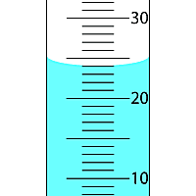
Graduated Cylinder
Meniscus

Slide 8
Density
Density is the amount of matter in a given space. D= m/v
Notes:
Mass and weight are different. How? Weight is a measure of the pull or acceleration of gravity on an object’s mass (w=mg, weight equals mass times the acceleration of gravity). The acceleration of gravity near Earth’s surface is 9.8 m/sec². The weight of an object can change if gravity changes. The amount of matter in an object does not. Mass is not going to change, but weight will.

Slide 9
Changes of State
Melting-solid to liquid (heat speeds up the movement of particles, so they separate)
Freezing-liquid to solid (opposite happens when something cool, it loses momentum)
Boiling- boiling points are dependent on air pressure and kind of liquid
Evaporation-liquid to gas, the warmer the liquid the faster it evaporates (below boiling point temp)
Condensation-gas to liquid (colder temps bring vapor particles together)

Slide 10
Change of State Continued
Sublimation-solid to a vapor without becoming a liquid first (ex. Icecubes in freezer, moth balls).
Deposition- particles in the vapor state collect on cool surfaces, forming the solid state, without becoming a liquid first. (ex. frost)

Slide 12
Phase Diagram

Slide 13
Phase Diagram

Slide 14
Heating Curve

Slide 15
What makes up matter???
Atoms!!!
Atoms are the smallest units that make up matter. Atoms are referred to as the building blocks of matter.

Slide 16
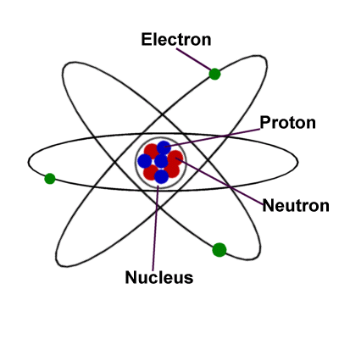
The Atom
Protons- in the nucleus, positive charge.
Neutrons-in the nucleus, neutral.
Electrons-outside the nucleus, negative charge.
The Atomic Mass-Protons (+) Neutrons
Atomic Number- Number of Protons/ Number of Electrons

Slide 17
Protons, Neutrons, and Electrons
Protons and Neutrons within the nucleus of the atom have the most mass. The majority of the atom’s mass is found within the nucleus.
Electrons are much less massive.
Electrons and protons balance the charges of the atom out. There most be an equal amount of protons and electrons.

Slide 18
IONS
If there are more electrons than protons than the atom is negatively charged.
If there are fewer electrons than protons than the atom is positively charged.
If an atom has a charge (negative or positive) it is called an ion. Ions are electrically charged particles.

Slide 19
Electrons
Electrons are arranged outside of the nucleus within the atom based on how much energy they have.
The electron cloud is where they are located and within that cloud are orbitals.
Orbitals are categorized based on the amount of energy the electrons have. Electrons having the same amount of energy go into the same orbitals.

Slide 20
Development of the atomic theory
Democritus
Dalton
Thompson
Rutherford
Bohr
Chadwick

Slide 21
Early Ideas of the Atomic Model
Democritus
Dalton
Ancient Greek philosopher in the 5th century BC.
Proposed that everything was made of tiny, “indivisible” particles.
In 1803 English scientist, John Dalton,
Published the first fully scientific model of the atom.
Reaffirmed that everything is made of small, indivisible particles.
Atoms combine together in whole-number ratios to form compounds.
Atoms are neither created, nor destroyed during chemical reactions.
Every atom of a given element is identical

Slide 22
Dalton and Democritus

Slide 23
Atomic Theory developments
J.J. Thompson
Ernest Rutherford
1897
“Plum pudding model”
“Watermelon model”
A cloud of positively charged material with thousands of negatively charged particles embedded in it.
Essentially he discovered the electrons.
1909
“Gold foil experiment”-fired small, positively charged particles at a thin foil made of gold.
Concluded that all the positive charge in the atom was concentrated in the center of the atom
He discovered the nucleus of the atom.
He also concluded that the electrons were outside the nucleus and most of the atom contained empty space.

Slide 24
Thompson and Rutherford

Slide 25
Niels Bohr
James Chadwick
1913 Danish Physicist proposed that electrons were orbiting the nucleus like planets orbiting the sun.
The orbits represented different energy levels for electrons.
Lower energies were closer to the nucleus and higher energies were further away.
1932 English scientist discovered the neutron.
All of the mass of the atom is concentrated inside the nucleus.
Neutrons and Protons have relatively the same mass, neutrons are slightly more massive.

Slide 26
Bohr and Chadwick

Slide 27
Development of the atomic theory

