Slide 1
Plate Boundaries Map
Key Geological Features

Slide 2
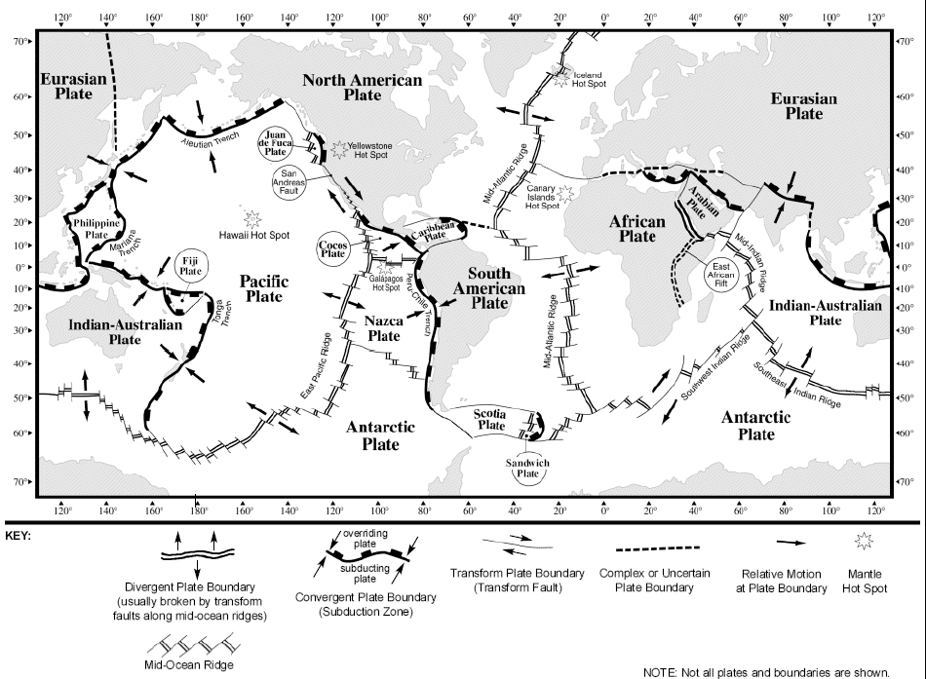

Slide 3
Longitude and latitude practice

Slide 4
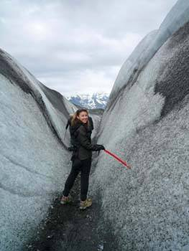
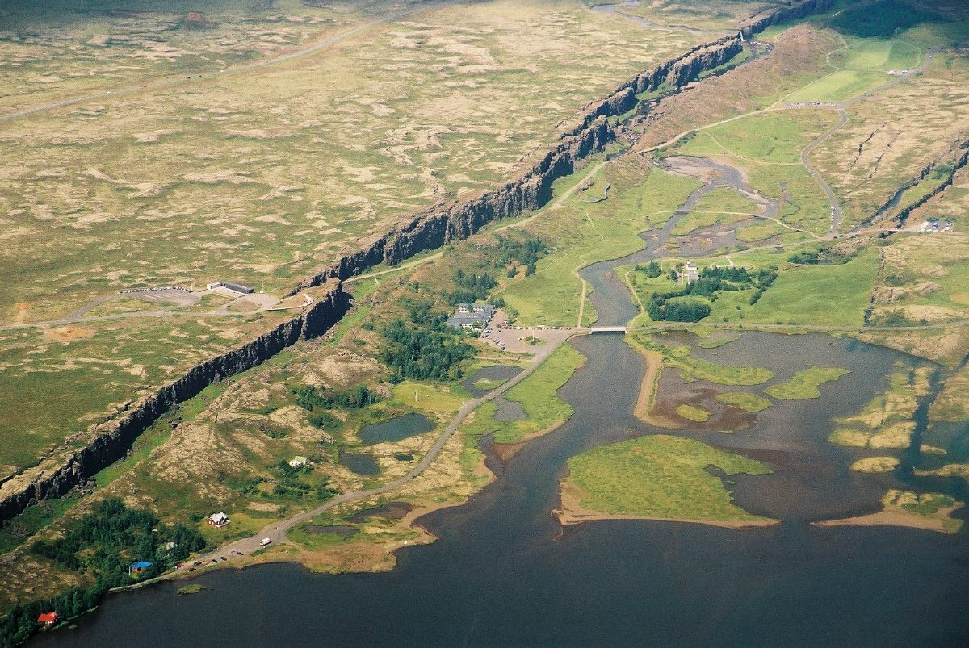
Mid-atlantic ridge
Diverging Oceanic Plates result in ridge formation

Slide 5
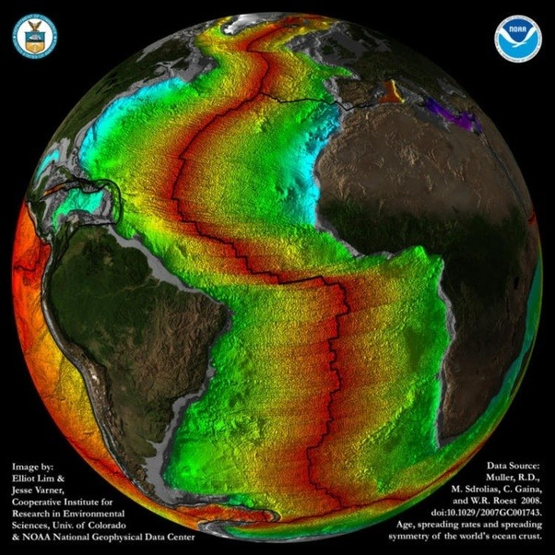

Slide 6
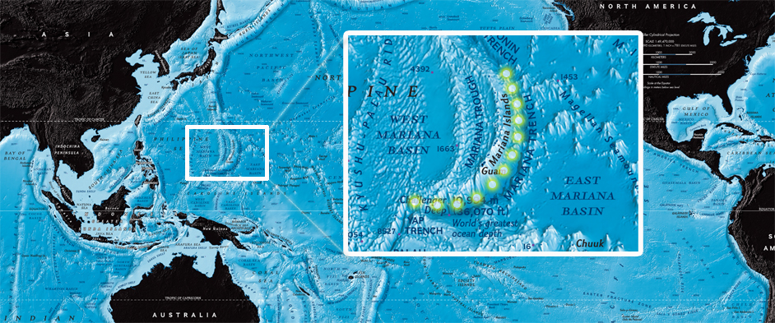
Marianas Trench
Converging oceanic plates form trenches.

Slide 7
Hawaiian hotspot
A hotspot is a type of intraplate activity where convection currents are at work in the upper part of the mantle. Here the convection current transfers enough energy to melt rock into magma and a mantle plume is generated.
As plates move over the mantle plume, volcanic eruptions take place on the overlying crust, where the magma will cool and solidify and create new crust.
The Hawaiian Islands are believed to have formed in this very way.
https://www.nationalgeographic.org/encyclopedia/hot-spot/
Notes:
A hotspot is theorized to form as one of Earth's outer tectonic plates moves over an unusually hot part of the Earth's mantle and large amounts of magma rise up, piercing through the plates and producing large volcanic eruptions at the Earth’s surface. Hotspot volcanism would thus be unique because it does not occur at the boundaries of Earth’s tectonic plates, where other volcanism occurs.
The mantle plumes that form hotspots are thought to be relatively stationary, while tectonic plates are not. As the plates continue to move away from oceanic volcanoes, the volcanoes cool and subside, producing older islands, atolls, and seamounts. As continental volcanoes move away from a hotspot, they cool, subside, and become extinct. In this way, hotspots can produce lines of volcanoes, known as hotspot tracks.
A seamount might stay volcanically active for two or three million years while it is above a hotspot: lava streams out of its summit and down its flanks, building up a volcanic mountain. As the volcano is carried away by the moving tectonic plate, its volcanic activity begins to wane and eventually goes quiet, only to be replaced by volcanic activity at a new seamount being born on the ocean floor that has moved on top of the hotspot.

Slide 8
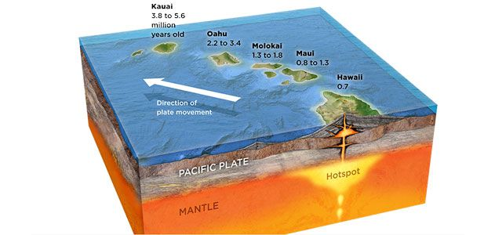

Slide 9
Mountain ranges

Slide 10
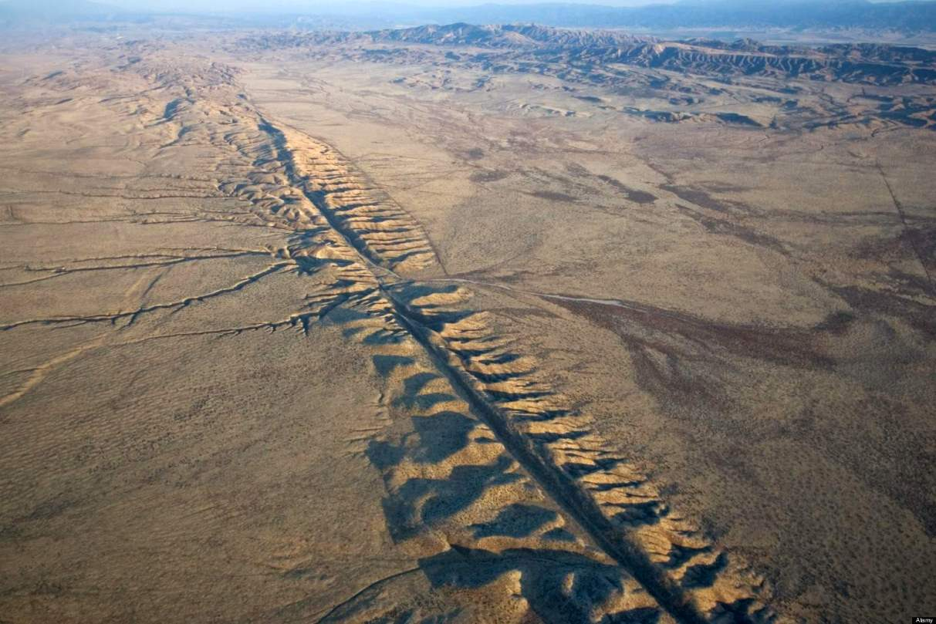
Fault Lines

Slide 11
Mountain Belts

