Slide 1
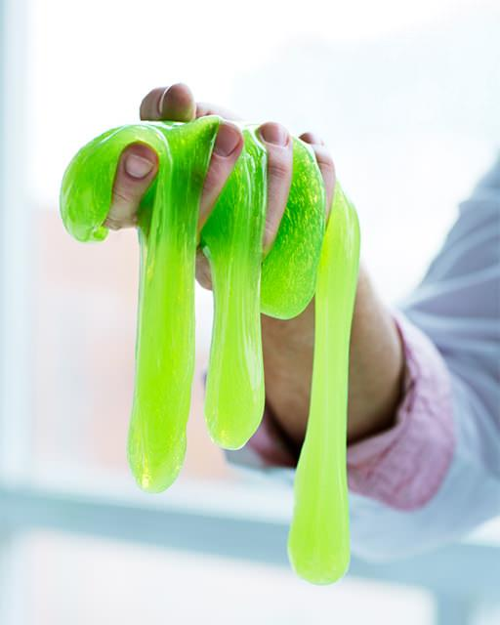
SLIME LAB
CLASS DISCUSSION

Slide 2
Non Newtonian fluid
Slime shares properties of both liquids and solids and thus is considered a non-Newtonian fluid.
A non-Newtonian fluid is a “strange” fluid that does not follow Newton’s law of viscosity.
Viscosity is a fluid’s resistance to flow. How fast or slow it flows is dependent on its viscosity.

Slide 3
Viscosity and temperature
Normally viscosity is affected by temperature.
The colder the temperature the more viscous a liquid may be and the warmer the temperature the less viscous a liquid may be.
Example: Maple syrup at room temp. and heated up
Newtonian fluids, like water, oil, and alcohol, for example, behave and pour in this way.
Non-Newtonian fluids behave in different ways, and their viscosity is affected by other factors than temp.

Slide 4
Non-Newtonian fluids and shear stress
The viscosity of a non-Newtonian fluid can be affected by the application of shear stress (squeezing, stirring, agitating, etc.).
Shear thinning- these non-Newtonian fluids decrease viscosity when a shear stress is applied. Examples: ketchup, honey, shaving cream.
Shear thickening-these non-Newtonian fluids increase viscosity when a shear stress is applied. Examples: quicksand, silly putty, synovial fluid in the joints of your elbows and knees, and some military vests.

Slide 5
Non-Newtonian Fluids in Action
https://www.youtube.com/watch?v=RIUEZ3AhrVE

