Slide 1
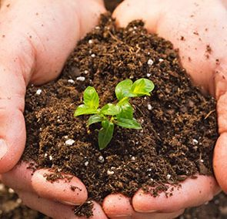
Soil
Unit 7

Slide 2
Soil—Definition:
Loose covering of broken rock particles and decaying organic matter, overlying Earth’s bedrock
Composition
Texture
Structure
The result of erosion and deposition.

Slide 3
Types of Soil
Determined by climate, types of plants/animals living in soil, topography, length of time soil has been developing
Polar: frozen and thin
Temperate: varies greatly among regions of Earth
Desert: dry but nutrient rich
Tropical: wet and nutrient depleted

Slide 4
Soil Composition
Made of 4 major components (Inorganic vs. Organic):
Mineral Matter (broken-down rock)
Organic Matter (humus)
Glue, food, protection, nutrient source and disease protection
Water
Air
Water and air allow pore spaces in soil (porosity).

Slide 5
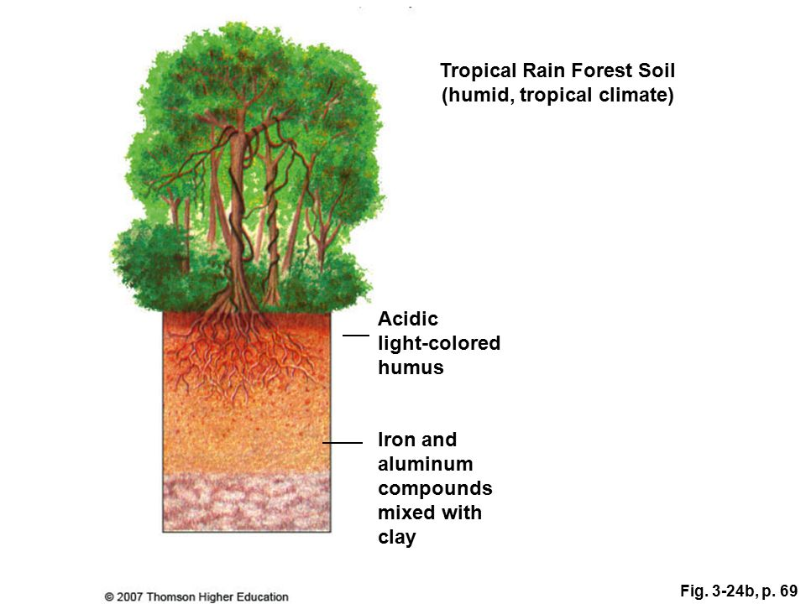
Tropical Soil

Slide 6
Polar Soil

Slide 7
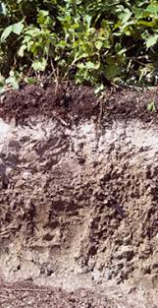
Temperate Soil

Slide 8
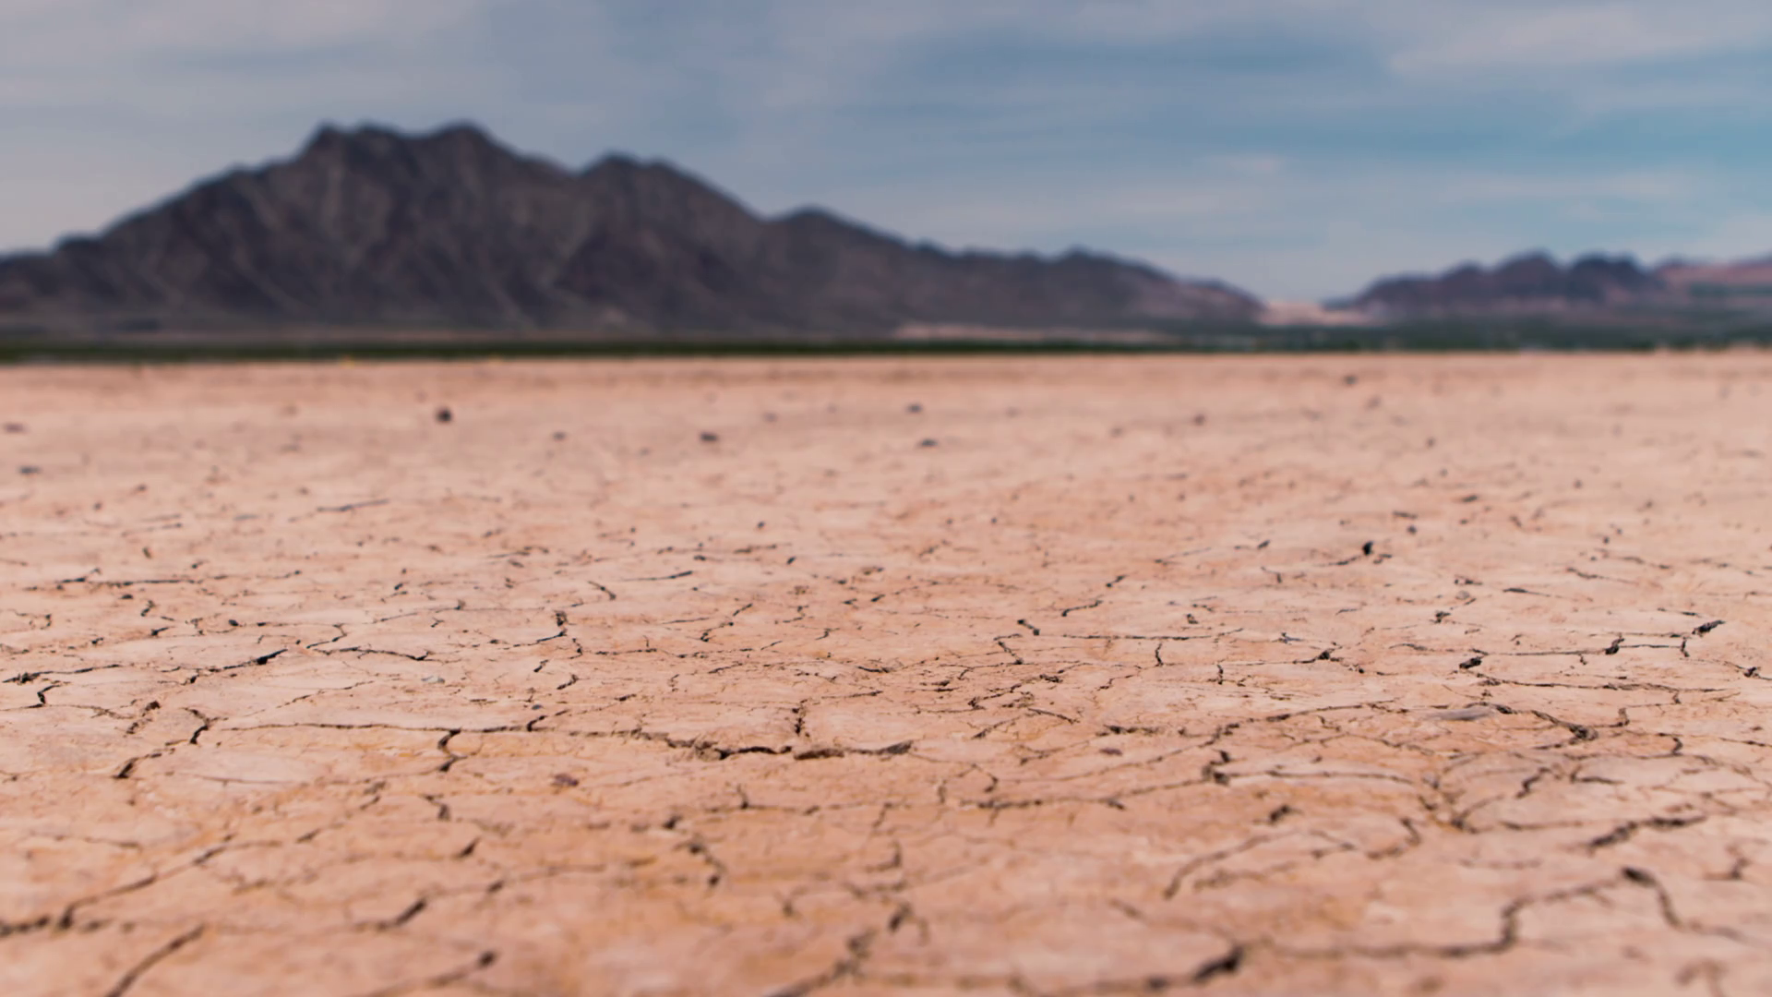
Desert Soil

Slide 9
Soil Texture & Structure
Soils are composed of clay, silt and sand in different proportions
Where there is no dominant type, the soil is called loam.
Texture influences the soil’s ability to support plant life.
Plants struggle in clay and silt
Structure: particles form clumps that give structure

Slide 10
Soil Texture
Particle size is important because it tells how much room there is for air, water, bacteria and other living things, like plant roots.
Also tells if soil will be a good storage house for water and nutrients
Sand=large→lots of room for air and water, however there is nothing to trap the water, slides right through
Clay=tiny→no room, plants feel tight, no room
Great for lining ponds or garbage dump

Slide 11
Soil Color
Scientists study three things when looking at soil color:
Hue: the actual color of the soil
Red: Lots of iron from parent material, found in humid environments with long periods of dry weather.
Yellow: Like red but remain wet and humid, very old and found in tropics
Gray: Found in wet and colder environments such as swamps/forested areas
Brown to dark black: better for growing b/c of organic matter content

Slide 12
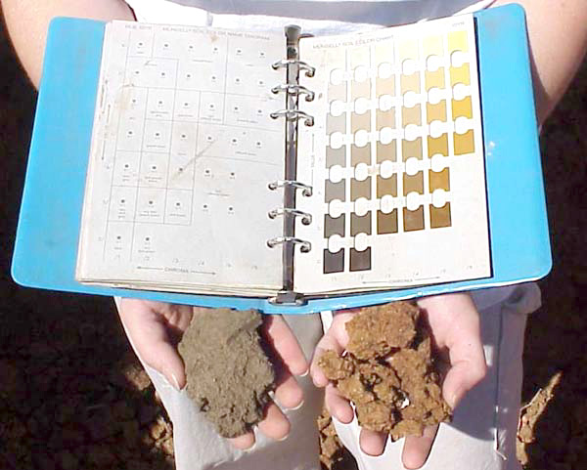
Soil Color
2. Value: the richness of that color or how much light is reflected
Chroma: the purity of the color
*pure=rare
*cloudy=more common

Slide 13
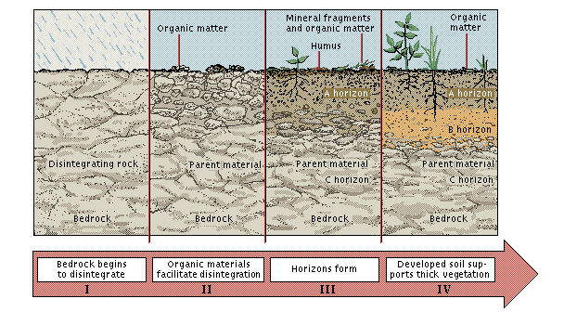
Soil Formation
Determined by parent material, time, climate, organisms and slope.

Slide 14
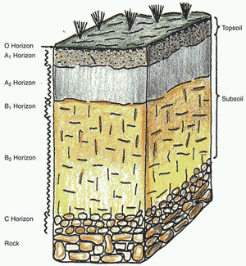
The Soil Profile
Composition
Diagram
O Horizon: humus
Surface litter (leaves, stems, fruits, seeds) and decomposed plant matter. Major energy source
A Horizon: topsoil
Mostly organic matter & microorganisms. Mix of leached mineral soil and organic matter
E Horizon: Zone of Leaching
Less humus and minerals, resistant to leaching, paler in color

Slide 15
The Soil Profile
Composition
Diagram
B Horizon: subsoil
Accumulation of leached minerals such as fine clay particles, iron, aluminum oxide, calcium, washed out of A (red/yellow color), lower limit of plant roots and animal structures
C Horizon: between B and parent material
Contains partially weather parent material, glacier deposits, volcanic ash. Little effects on biological or chemical processes
R Horizon: bedrock

Slide 16
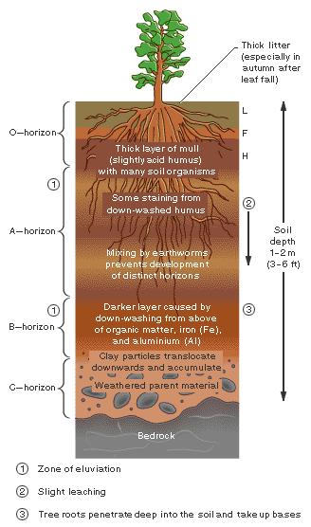

Slide 17
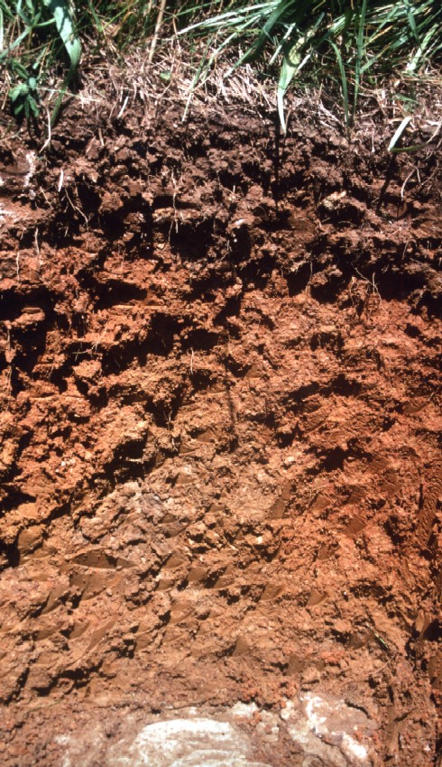
The Soil Profile
What layers do you see in this soil sample?

Slide 18
Soil & Plant Growth
#1: Mineral Content:
Phosphorus
Potassium
Calcium
All must be available to plant’s roots via weathering, but that can be too slow for normal plant growth
Leaching: Nutrients are washed out of soil as water moves through
Decreases soil fertility, flushes pollutants into waterways
Nutrient-holding capacity: Hold on to the nutrients until the plant needs them

Slide 19
Soil & Plant Growth
Because of the removal of nutrients…must use something else to replace nutrients.
Fertilizers: replace nutrients that are leached in soil
Organic fertilizers:
Plant/Animal Wastes—manure, compost
Leguminous fallow crops—alfalfa, clover
Food crops—lentils, peas (fix atm. N)
Inorganic fertilizers: chemical formulations, more prone to leaching

Slide 20
Soil & Plant Growth
#2: Water Holding Capacity: Plant’s ability to hold onto water/moisture
A field of corn transpires the area of water 17 in deep
See drawing
#3: Aeration: roots need to breath, need to diffuse O2 into and CO2 out of, *texture*
Overwatering: prevents/fills in spaces
Compaction: packing soil → occurs with excessive foot and vehicular traffic
Decreases infiltration//increases runoff
#4: pH: stay neutral 7
#5: Salt/Water uptake: Too much salt in soil makes it hard to take in H2O (cell shrinkage)

Slide 21
Soil Erosion
Depends on soil characteristics and climate, slope and type of vegetation
When soil erodes, sediment is deposited, clogging up waterways
River ways are dredged to keep clear for shipping
Controlled by planting windbreaks, terracing hillsides, plowing along contours of hills and rotating crops

Slide 22
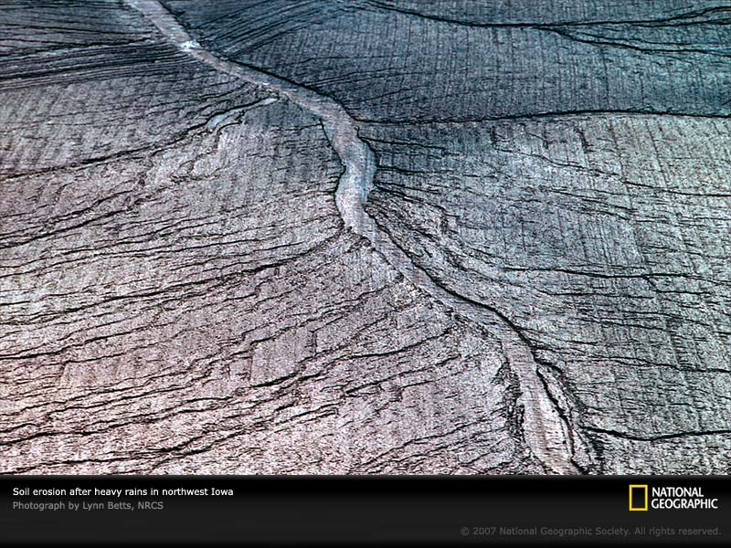

Slide 23
Desertification
Formation and expansion of degraded areas of soil and vegetation cover in arid, semiarid, and seasonally dry areas (drylands)
Drylands cover 41% of Earth’s land area—defined by precipitation
Reasons:
Natural climate change that causes prolonged drought
Human activities that reduce or degrade topsoil
Moderate, severe, very severe
Area the size of Brazil has been desertified in the past 50 years
Fixes:
Reduce overgrazing, deforestation, destructive forms of planting/irrigation and mining
Plant trees and grasses that will anchor soil, hold water, help reduce threat of global warming by increasing uptake of carbon dioxide from the atmosphere

Slide 24
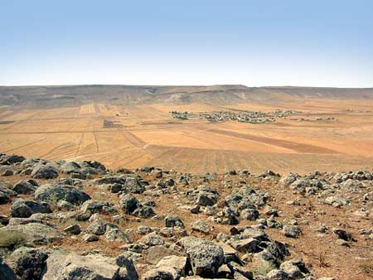
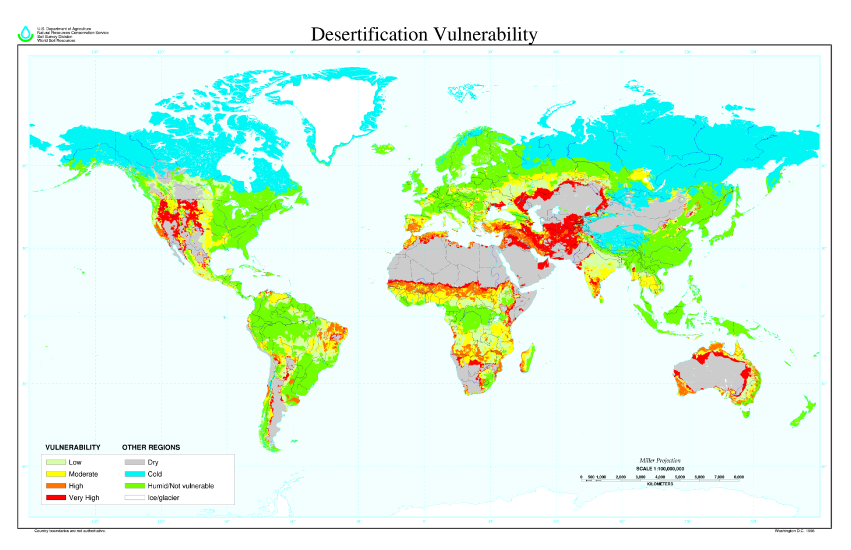

Slide 25
Salinization
Even the freshest irrigation water has 200-500 ppm of salt content in it. As water evaporates, salt is left behind as precipitate
Stunts crop growth, lowers crop yields, eventually kills plants and ruins the land
There has been 3.7 million acres lost to salinization and waterlogging
US has lost $30 million/year (lower Colorado River)
Fix? Use more water to leach out salts…but what about the water shortages?

Slide 26
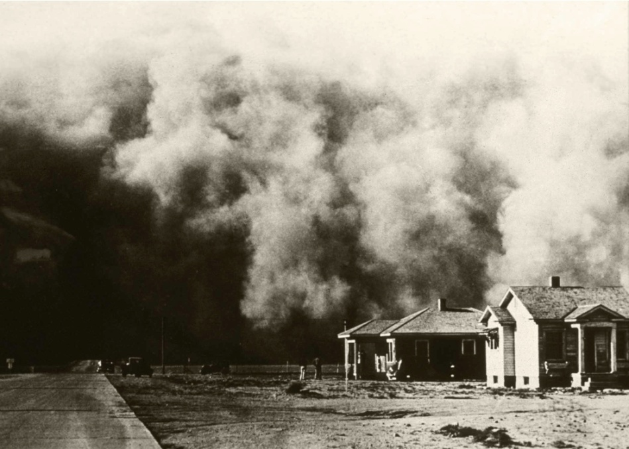
Dust Bowl Case Study
Occurred during 1930’s/Great Depression in United States
Causes: drought & bad farming practices
Overgrazing
Plowed prairies—destroyed root systems
Land left bare between harvests
Drought 1926-1934
1934 dust cloud traveled 1500 miles and covered eastern U.S.

Slide 27
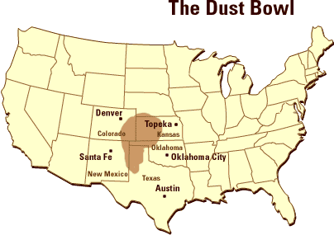
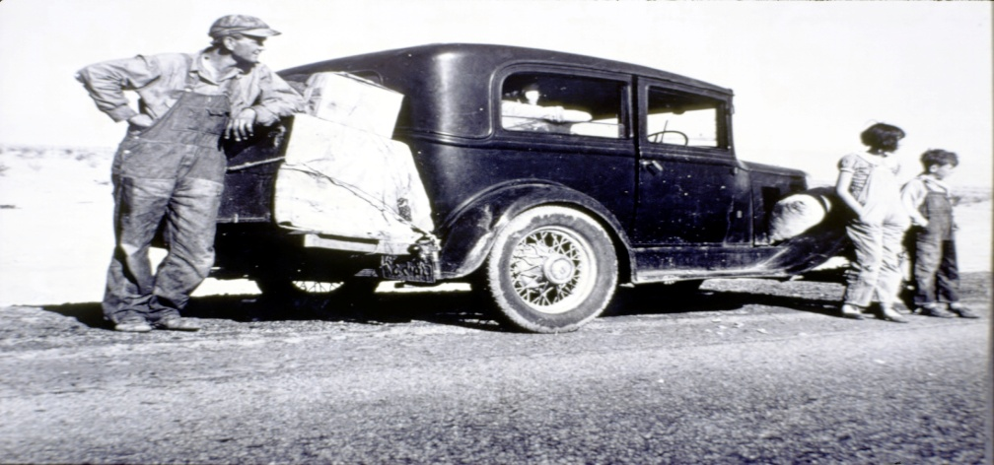
Dust Bowl Case Study
Forced internal migration
1935 Soil Erosion Act: established soil conservation service
Could happen again due to cyclical droughts & climatic changes.

Slide 28
Bell Ringer 01/23/19
Please get your Active Reader out from yesterday on Soil Conservation.
We will go over this as a class. Be prepared to share your answers.

Slide 29
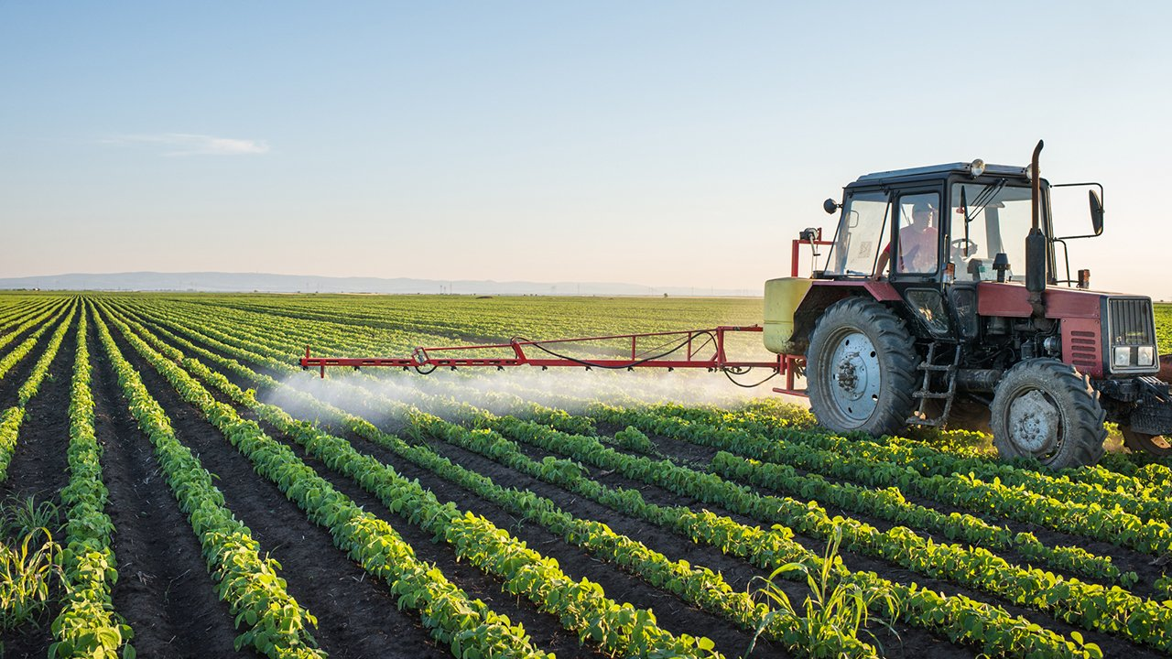
Agriculture

Slide 30
Agriculture
Agriculture is defined as the cultivation and exploitation of animals, plants (including fungi) and other forms of organic life for human use including food, fiber, medicines, fuel and anything else.
It is, and has been since there was an agricultural market, one of the largest employers of people; in the USA today, agriculture represents 20% of the US economy. Before organized agriculture, it is believed that the food supply could provide for just 4 million people globally.

Slide 31
The History of Agriculture
For most of our existence, humans were hunter-gatherers. This means that people lived a nomadic lifestyle, moving with the seasons to follow the food supply.
Hunter-gatherer societies would have known which crops were best to exploit with each season.

Slide 32
The History of Agriculture
Traditional Agriculture- Used in most developing countries today. It is an ancient way of farming (utilized for thousands of years).
Traditional agriculture supplements energy from the sun with the labor of humans and animals to produce enough crops for a farm family’s survival. Very little left over to sell to supply income.
Farmers do not specialize in just one crop, but instead grow many different crops (fruits/veggies), in addition to raising livestock. They also use organic fertilizers (manure/compost)
Polyculture- is when two or more crops are grown together.
Monoculture- is growing only one crop at a time.

Slide 33
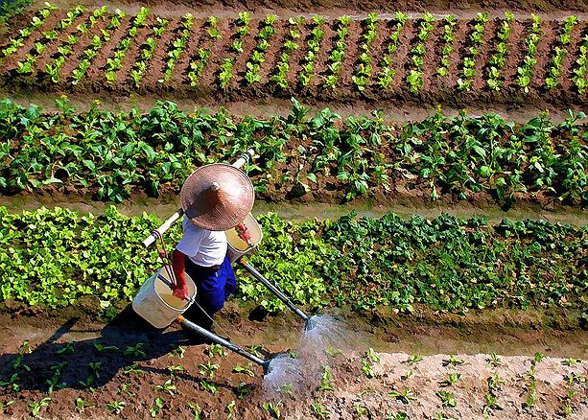
Traditional Agriculture

Slide 34
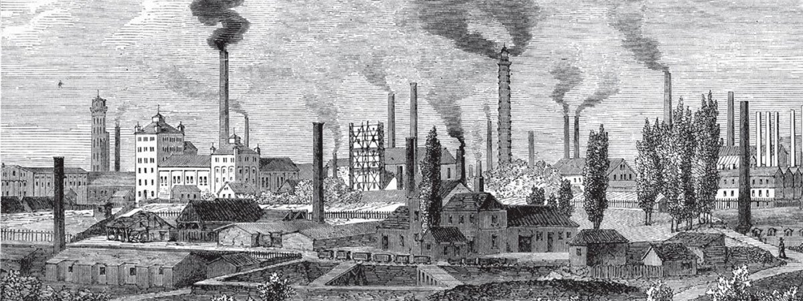
The History of Agriculture
With the Industrial Revolution in the late 1800’s, agriculture boomed.
The Industrial Revolution coincided with Industrialized Agriculture (Referred to as the Green Revolution).
Farmers were producing higher crop yields (using monoculture) in record time, due to the inventions of new machinery powered by fossil fuels (tractors, plows, seed drills, harvesters, etc.)
Genetically Engineered High-Yield varieties of key crops such as, wheat, rice, and corn.
Use of inorganic fertilizers and pesticides and high inputs of water.

Slide 35
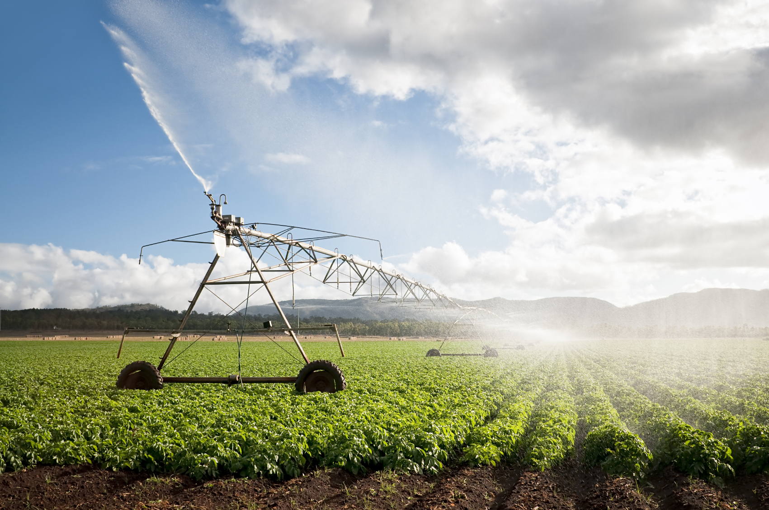
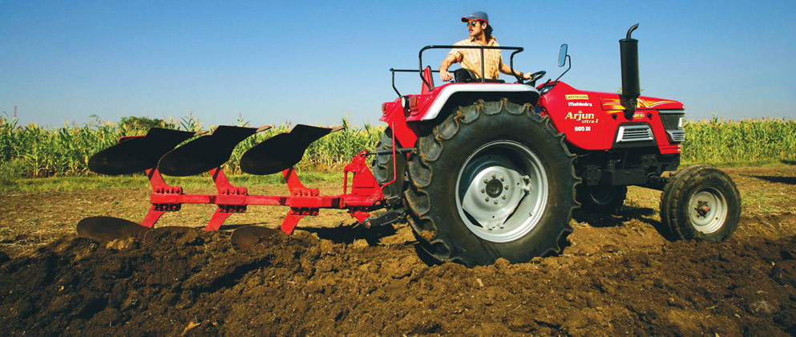
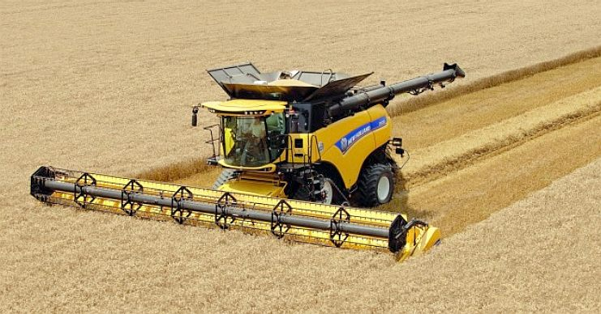
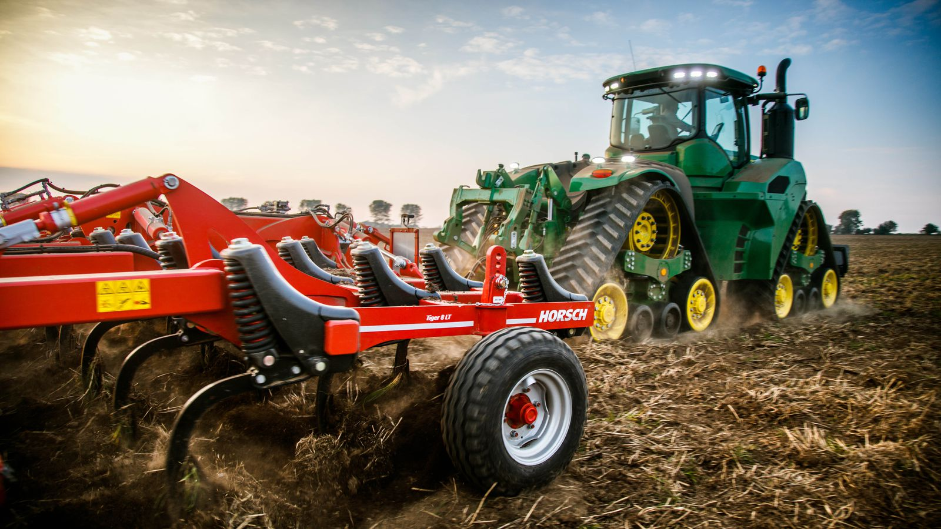
Industrial Agriculture

Slide 36
Organic Farming
Emphasizes prevention of soil erosion and the use of organic fertilizers such as animal manure and compost.
Employs crop rotation and biological pest control.
No GMO’s
Reduces fossil fuel use and increases the usage of renewable energy systems (solar, wind, etc.)
Regionally and locally oriented (Buy and sell locally).

Slide 37
Sustainable Practices
Soil Conservation
Managing Topography
Contour Plowing - Plowing across slope to slow flow of water.
Strip Farming - Planting different crops in alternating strips along land contours.
Terracing - Shaping land to create level shelves of earth to hold water and soil.
Providing Ground Cover
Annual row crops cause highest rates of erosion because they leave soil bare for much of the year.
Leave crop residue after harvest.
Plant cover crops after harvest.

Slide 38
