Slide 1
Sound Waves

Slide 2
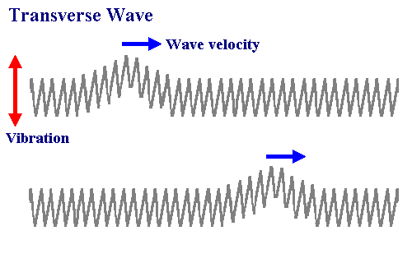
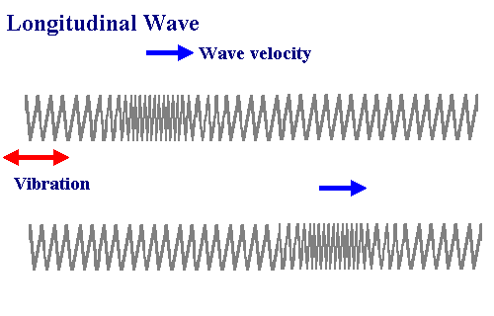
Wave Review
Two main types of waves
Transverse
Compression/Longitudinal

Slide 3
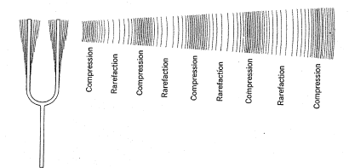
Sound Waves
Sound waves are compression (longitudinal) waves
Sound is produced when matter vibrates

Slide 4
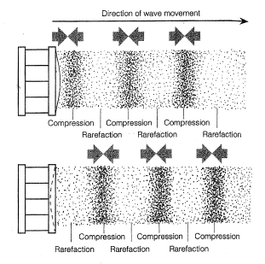
Sound Waves
Compression: Region of waves where particles are close together
Rarefaction: Region where the particles are spread out

Slide 5
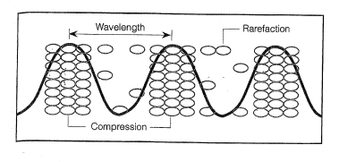
Sound Waves
By drawing a wave with crests in compression regions and troughs in rarefaction regions, we can get info about the wavelength of a sound wave.

Slide 6
Sound Waves - Speed
Sound waves need a medium to travel through
Can sound travel in a vacuum?
The speed of sound waves depends on
The density of the medium
The temperature

Slide 7
Sound Waves - Speed
Sound waves travel fastest …
In more dense material
At higher temperatures

Slide 8
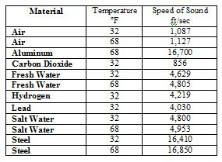
Sound Waves - Speed

Slide 9
Properties of Sound - Pitch
Pitch: Highness or lowness of a sound
Depends on the frequency of the wave
High frequency = high pitch
Low frequency = low pitch

Slide 10
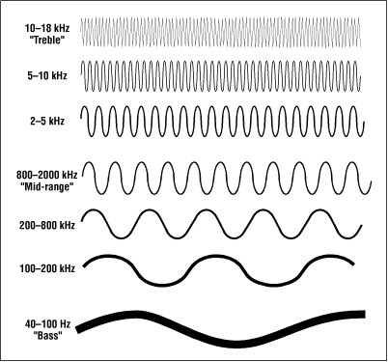
Properties of Sound - Pitch
Ultrasonic: frequency > 20,000 Hz
Infrasonic: frequency < 20 Hz

Slide 11
Properties of Sound - Pitch
Human hearing range
20-20,000 Hz
Maximum frequencies
Dogs = 35,000 Hz
Cats = 65,000 Hz
Dolphin = 150,000 Hz

Slide 12
Properties of Sound - Intensity
Intensity: Loudness
Related to the amplitude of a wave
Larger amplitude = higher intensity = louder
Unit is decibels (dB)

Slide 13
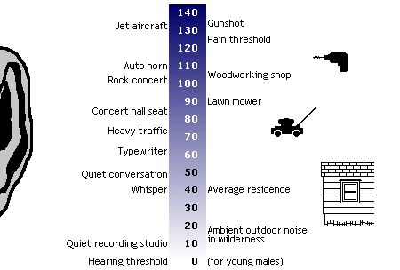
Properties of Sound - Intensity

Slide 14
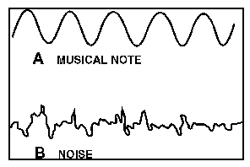
Sound - Music vs. Noise
Music: has rhythm, definite pitch, pleasing quality
Noise: No identifiable pitch, no pleasing quality

Slide 15
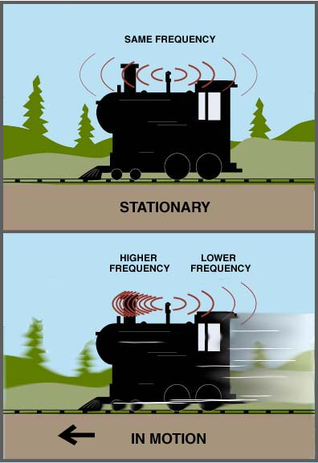
Sound – Doppler Effect
Change in wave frequency caused by a moving wave source
Moving toward you - pitch sounds higher
Moving away from you - pitch sounds lower

Slide 16
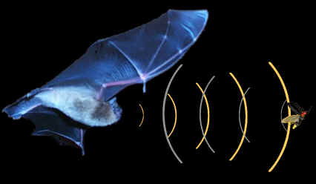
Sound - Uses
Echolocation: used to locate objects by emitting sounds and interpreting sound waves that are reflected back

Slide 17
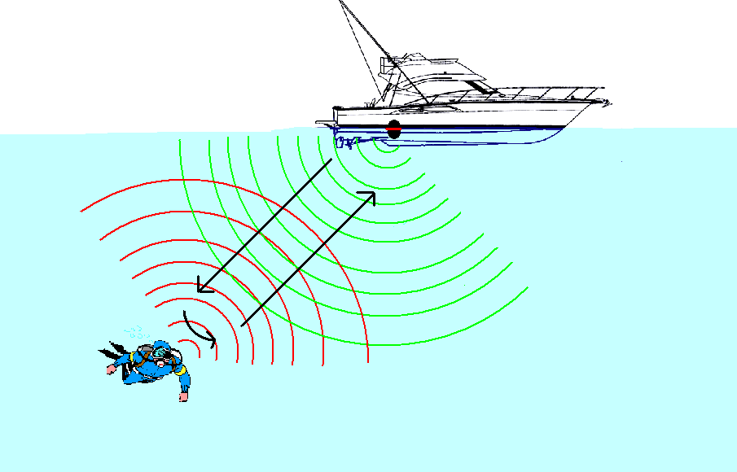
Sound - Uses
SONAR (Sound Navigation And Ranging)
Used by boats like echolocation is used by bats
Sonar measures the time delay to determine distance

Slide 18
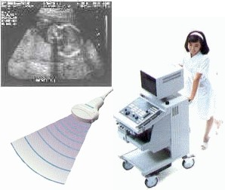
Sound - Uses
Ultrasound: uses reflected sound waves to create images of internal structures.

Slide 19
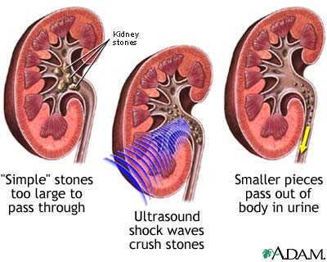
Sound - Uses
Ultrasonic treatments: use high frequency sound waves to break up kidney stones and gallstones with vibrations.

Slide 20
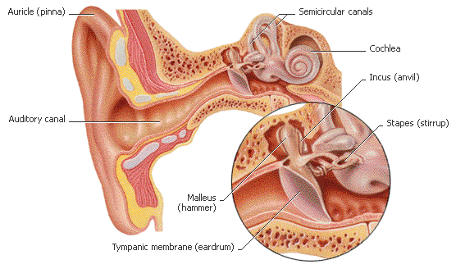
How Humans Hear
Sound wave enters ear canal
Vibrates the ear drum
Amplified by bones
Converted to nerve impulses in cochlea

Slide 21
How Humans Hear

