Slide 1
Thermochemistry Unit 10
Honors Chemistry

Slide 2
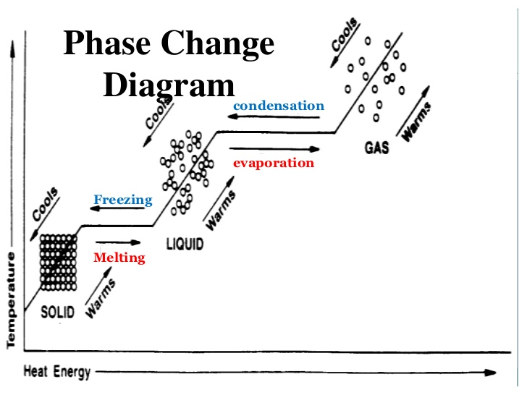
Let’s Review Phase Changes
In the graphic to left, heating and cooling curves are represented.
Notes:
Phases= solid, liquid, gas
Particle arrangement
Transitions from one phase to the other is a phase change.
Phase changes= melting, freezing, condensing, evaporating, sublimation, deposition.
Vaporization= both boiling and evaporation- evaporation is on the surface, boiling is throughout the liquid. Boiling needs a heat source, evaporation gets its energy from its surroundings. Boiling there is bubbles, no bubbles with evaporation. Boiling is a fast process, evaporation is a slow process.
Sublimation- changing from a solid state to a gaseous state (top of mountains when snow pack turns to vapor, skips liquid phase)
Deposition- changing from a gaseous state to a solid state (water vapor turns to frost, skips liquid phase)

Slide 3
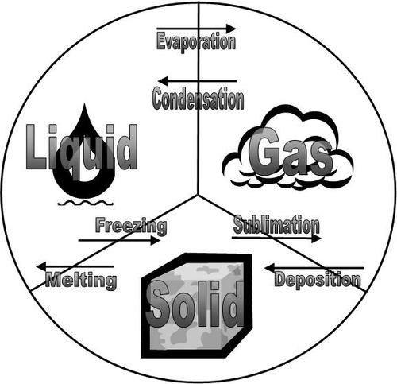
Changes of State
Notes:
Freezing is the opposite of melting and represent the equilibrium of between the solid and liquid states
Evaporation is the opposite of condensation and represent the equilibrium between the liquid and gaseous states
Sublimation is the opposite of deposition and represent the equilibrium between the solid and gaseous states

Slide 4
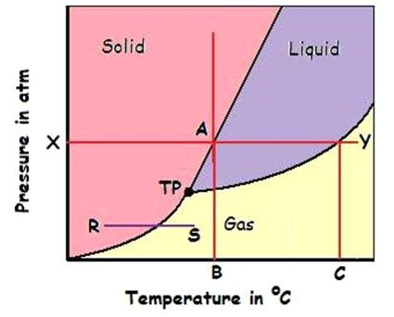
Phase Diagrams
A phase diagram is a graphical way to summarize the conditions under which equilibria exist between different states of matter. It also allows us to predict the phase of a substance that is stable at any given temperature and pressure.

Slide 5
Phase Diagrams
The curves on a phase diagram indicate the conditions of temperature and pressure under which “equilibrium” between different phases of a substance can exist. BOTH PHASES EXIST ON THESE LINES.
Triple Point- The only temp. and pressure pairing at which the solid, liquid, and gaseous states of a substance can all coexist at equilibrium.
Critical Point- Occurs at the highest temperature at which the substance is capable of existing in the liquid state.

Slide 6
Thermochemistry
Is the study of energy changes and transfers that occur during chemical reactions

Slide 7
Heat and Work
Energy is the ability to do work.
Chemical Potential Energy is the energy stored in chemical bonds of a substance.
Example: Car uses gasoline to move the car. The gasoline is chemical potential energy and when it is burned it releases that energy to move the car (perform work), as well as releases heat energy, making the engine of a car very hot.
*The energy changes of a system occur as either heat or work, or some combination of both.

Slide 8
Heat and Temp.
Heat- is energy that is transferred from one object to another because of a difference in temperature between them.
Heat always flows from an object at a higher temperature to an object at a lower temperature.
Temperature- a measurement of the average kinetic energy of particles within a substance.

Slide 9
Thermochemistry
During chemical reactions, energy (heat) can either be consumed by the reaction or released by the reaction.
Energy is stored in chemical bonds and released when bonds are broken.
As a result of the rearrangement of atoms, the total chemical potential energy of the system increases or decreases.
Endothermic (absorbed energy) vs. Exothermic (released energy)

Slide 10
Endothermic Reactions
If heat is absorbed by the system ( from the surroundings.
The system gains heat from the surroundings, so the temp. of the surroundings decreases.

Slide 11
Exothermic Reactions
If heat is released by the system into the surroundings.
The surroundings are gaining heat from the system, so the temp. of the surroundings increases.

Slide 12
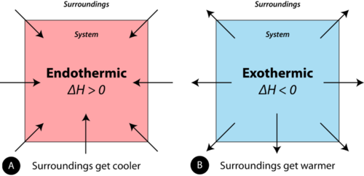
Endothermic vs. Exothermic

Slide 13
Specific Heat
Specific Heat- the amount of heat required to raise the temperature of one gram of a substance by 1ºC.
The amount of heat transferred depends on the substance, the mass, and the size of the temperature change.

Slide 14
Specific Heat Practice Problems
Specific Heat Formula: q=mC_{p}∆T
q= heat (amount of heat absorbed or released)
Units: Joules (J)
m= mass
Units: grams (g)
C_{p}= specific heat (amount of heat required to raise 1g 1ºC) at constant pressure
Units: J/ºC or J/g . K
∆T= Change in temp. (T_{Final}- T_{Initial})
units: K or ºC

Slide 15
Specific Heat Practice Problems
Example 1: Determine the energy of a 35g sample with a specific heat of 0.069J/ g.K that was heated from 293K to 313K?

Slide 16
Continued
Example 2: A piece of copper alloy of 85.0 g is heated 30ºC to 45ºC. It absorbs 523 J of heat. What is the specific heat of the copper alloy?

Slide 17
Conversions you need:
1 calorie (cal) = 4.184 Joules (J)
1000 calories (cal) = 1 kilocalorie (kcal)
1 kilocalorie (kcal) = 1 Calorie (Cal) (dietary calorie)
calorie- is the amount of energy required to increase the temperature of one gram of pure water by one degree Celsius.
joule- is a smaller unit of energy than a calorie; one joule of heat can only raise the temperature of one gram of water by 0.239 degrees Celsius.

Slide 18
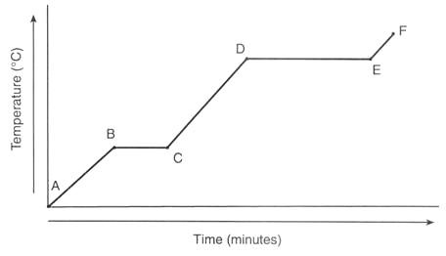
Heating Curve Practice Problems
∆H=mH_{f} or ∆H=mH_{v}

Slide 19
Water Cooling Curve

Slide 20
Calorimetry
Calorimetry is the measurement of the transfer of heat into or out of a system during a chemical reaction or physical process.
A calorimeter is an insulated container that is used to measure heat changes.

Slide 21
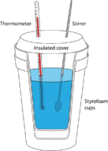
-q system = q surroundings

Slide 22
Calorimetry Practice Problems
A 2.50 g sample of Zinc is heated and then placed into a calorimeter containing 65.0 g of water. The temperature of water increases from 20.00ºC to 22.50ºC. The specific heat of Zinc is 0.0390 J/g ºC. What was the initial temperature of Zinc?

