Slide 1
Unit 11
Chemical Kinetics

Slide 2
Chemical Kinetics: The Basics
Is the study of the rates of chemical reactions.
Chemical reactions vary in the rates that they occur
Rate is another term for speed
Speed = distance/ time

Slide 3
Reaction Rates
A reaction rate is the change in concentration of a reactant or product with time.
The behavior of the reactant atoms, molecules, or ions is responsible for the rates of a given chemical reaction.

Slide 4
Collision Theory
Collision theory is a set of principles based around the idea that reactant particles form products when they collide with one another, but only when those collisions have enough kinetic energy and the correct orientation to cause a reaction.
Effective vs. Ineffective Collisions

Slide 5
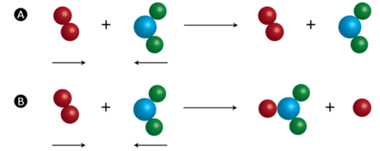
Notes:
(A) An ineffective collision is one that does not result in product formation. (B) An effective collision is one in which chemical bonds are broken, and a product is formed.

Slide 6
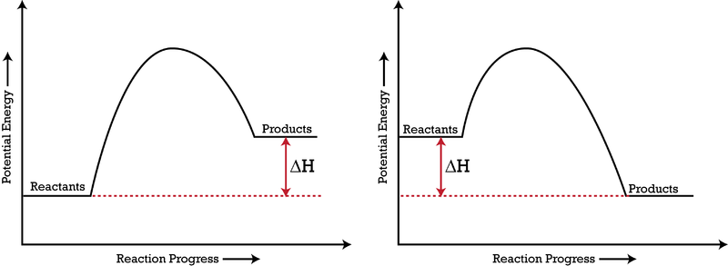
Potential Energy Diagrams
A potential energy diagram shows the change in the potential energy of a system as reactants are converted into products.

Slide 7
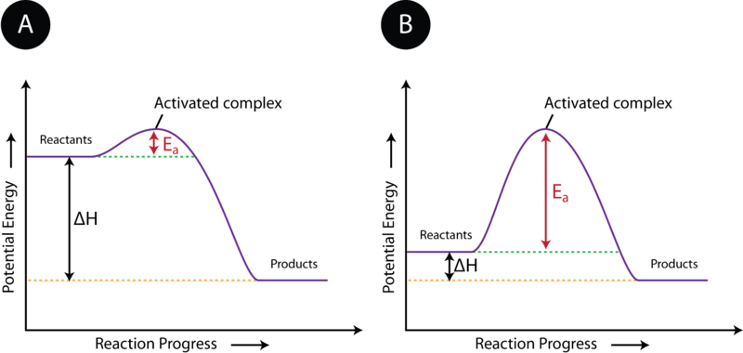
Potential Energy Diagrams

Slide 8
Activated Complex
The state of the particles that is in between the reactants and products is called the activated complex. An activated complex is an unstable arrangement of atoms that exists momentarily at the peak of the activation energy barrier.

Slide 9
Rate of Reactions and Collision Theory
1. Concentration- Increasing the concentration of one or more of the reacting substances generally increases the reaction rate.
2. Pressure-When the pressure of a gas is increased, its particles are forced closer together, decreasing the amount of empty space between them. Therefore, an increase in the pressure of a gas is also an increase in the concentration of the gas.
3. Surface area- An increase in the surface area of a reactant increases the rate of a reaction. Surface area is larger when a given amount of a solid is present as smaller particles.

Slide 10
Continued
4. Temperature-Raising the temperature of a chemical reaction results in a higher reaction rate. When the reactant particles are heated, they move faster and faster, resulting in a greater frequency of collisions. It also increases the effectiveness of the collisions.
5. Catalyst-A catalyst is a substance that increases the rate of a chemical reaction without being used up in the reaction. It accomplishes this task by providing an alternate reaction pathway that has a lower activation energy barrier. After the reaction occurs, a catalyst returns to its original state, so catalysts can be used over and over again.

Slide 11
The activation energy for a reaction is the minimum energy that colliding particles must have in order to undergo a reaction.

Slide 12
Fast and slow reactions
The smaller the activation energy, the faster the reaction will occur regardless if exothermic or endothermic.
If there is a large activation energy needed, that means that more energy (and therefore, time) is being used up for the successful collisions to take place.

Slide 13
Activation Energy Animation
Energy is needed to start a reaction. The energy needed to raise the reactants from their starting energy past the reaction equilibrium point is called ACTIVATION ENERGY.

Slide 14
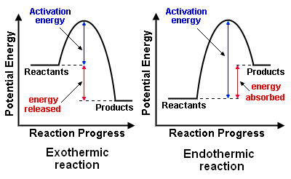
Endo. Vs. Exo Activation Energy

Slide 15
Let’s Practice
http://www.kentchemistry.com/links/Kinetics/PEDiagrams.htm

