Slide 1
Unit 1: Matter and Math Basics
Mastin 11th Grade Chemistry

Slide 2
08/04/17 Bell Ringer
What is Density?
What is the formula for Density?
Work out the following problem:
A substance has a density of 1.84g/cm³. What is the mass of 6.9cm³ of this substance?

Slide 3
08/07/17 Bell Ringer
Scientific Notation Practice:
*put the following values in scientific notation
7500_______
87890_______
456.3________
999850000_________

Slide 4
Density
Density is the amount of matter in a given space. D= m/v
What is matter? What is mass? What is volume?
Matter is anything that has mass and takes up space.
Mass is the amount of matter in an object.
Volume is the space that matter occupies or takes up.
Notes:
Mass and weight are different. How? Weight is a measure of the pull or acceleration of gravity on an object’s mass (w=mg, weight equals mass times the acceleration of gravity). The acceleration of gravity near Earth’s surface is 9.8 m/sec². The weight of an object can change if gravity changes. The amount of matter in an object does not. Mass is not going to change, but weight will.

Slide 5
What do we use to measure volume?
Units of measurement for volume are cm³ and ml.
-1 cm³ = 1 ml
A common tool for measuring the volume of a regularly shaped solid is a metric ruler of meter stick (l x w x h).
A common tool for measuring liquid volume is the graduated cylinder. The volume is measured at the bottom of the meniscus, or curve of the liquid in the cylinder.

Slide 6
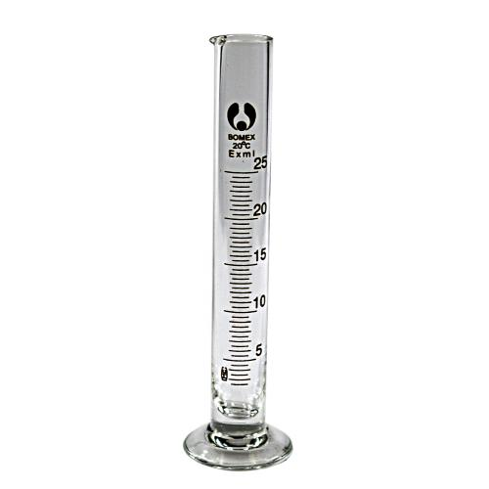
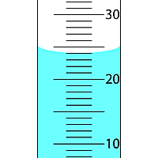
Graduated Cylinder
Meniscus

Slide 7
Water Displacement (liquid volume)
The volume of an irregular substance can be measured using a graduated cylinder containing a known amount of water.
When the object is lowered into the cylinder, it will displace a volume of water equal to the volume of the object.
We use this method with irregularly shaped objects.

Slide 8
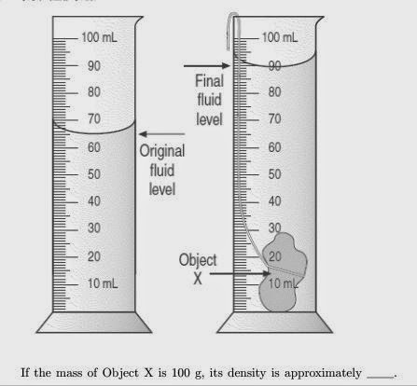
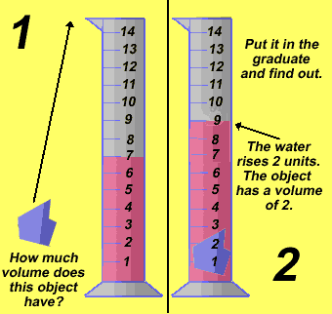
Examples of Water Displacement

Slide 9
Scientific Notation
In scientific notation, very large and very small numbers are expressed as the product of a number between 1 and 10 multiplied by some power of 10.
Example: 6.02 x 10²³ (Avogadro’s Number)
Notes:
There are very large and very small numbers that scientists have to deal with on a daily basis that writing them completely out wastes lots of time. Scientific Notation is an easier way to express these substantial values.

Slide 10
Scientific Notation Examples:
The number 9,000,000 for example, can be written as the product of
9 times 1,000,000 and 1,000,000 can be written as 10⁶.
Therefore, 9,000,000 can be written as 9×10⁶.
In a similar manner, 0.00000004 can be written as 4×1/10⁸ or 4×10⁻⁸

Slide 11
Scientific Notation Practice:
1. 0.00000000000975 ______________
2. 7.21________________
3. 8,340_________________
4. 0.014_________________
5. 0.000000008_________________
6. 95,672____________________

Slide 12
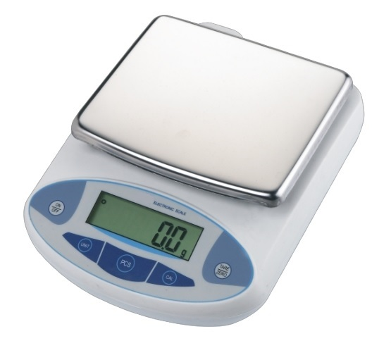
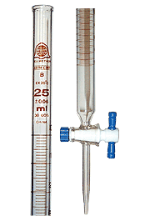
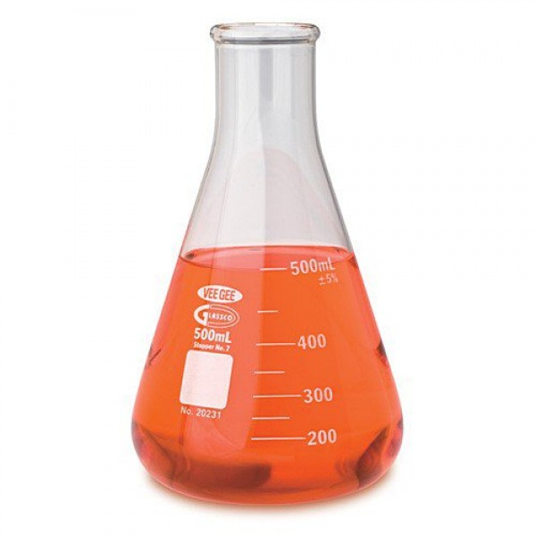
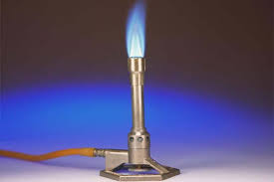
08/08/17 Lab Equipment Bell Ringer
Please describe below the function of each piece of lab equipment pictured?
Notes:
Electric Balance-mass substances
Bunsen Burner-used to heat substances, sterilize, combustion
Buret- used for dispensing measured amounts of liquids or solutions (usually small amounts).
Erlenmeyer Flask-used to hold liquids. Wide base skinny neck, can put a stopper in it.

Slide 13
08/09/17 Sig Figs Bell Ringer
For the following numbers below provide the correct number of sig figs:
1.7800000000_________ 4. 26.5__________
2. 2560004_________ 5. 1.003__________
3. 400__________ 6. .00045___________
Notes:
Talk about importance of significant figures!

Slide 14
Why do we use this???
A number can only be as accurate as the measurement tool we use to find it.
An answer can only be as accurate as the numbers used in a problem.
Notes:
We want to be as accurate or precise as possible in our measurements and calculations!

Slide 15
Significant Figures (Sig Figs) Rules:
A. Read from the left and start counting sig figs when you encounter the first non-zero digit
1. All non zero numbers are significant (meaning they count as sig figs)
Ex. 613 has three sig figs
Ex. 123456 has six sig figs

Slide 16
Rules Continued
2. Zeros located between non-zero digits are significant (they count).
Ex. 5004 has four sig figs
Ex. 602 has three sig figs
Ex. 6000000000000002 has 16 sig figs!

Slide 17
Rules Continued
3. Trailing zeros (those at the end) are significant only if the number contains a decimal point; otherwise they are insignificant (they don’t count).
Ex. 5.640 has four sig figs
Ex. 120000. has six sig figs
Ex. 120000 has two sig figs

Slide 18
More Rules
4. Zeros to left of the first nonzero digit are insignificant (they don’t count); they are only placeholders!
Ex. 0.000456 has three sig figs
Ex. 0.052 has two sig figs
Ex. 0.000000000000000000000000000000000052 also has two sig figs!

Slide 19
And More…
B. Rules for addition/subtraction problems
Your calculated value cannot be more precise than the least precise quantity used in the calculation. The least precise quantity has the fewest digits to the right of the decimal point. Your calculated value will have the same number of digits to the right of the decimal point as that of the least precise quantity.
In practice, find the quantity with the fewest digits to the right of the decimal point. In the example below, this would be 11.1 (this is the least precise quantity).
Ex. 7.939 + 6.26 + 11.1 = 25.299 (this is what your calculator spits out)
In this case, your final answer is limited to one sig fig to the right of the decimal or 25.3 (rounded up).

Slide 20
Is it over???
NOPE! Last Rule
C. Rules for multiplication/division problems The number of sig figs in the final calculated value will be the same as that of the quantity with the fewest number of sig figs used in the calculation.
In practice, find the quantity with the fewest number of sig figs. In the example below, the quantity with the fewest number of sig figs is 27.2 (three sig figs). Your final answer is therefore limited to three sig figs.
Ex. (27.2 x 15.63)  1.846 = 230.3011918 (this is what you calculator spits out)
In this case, since your final answer it limited to three sig figs, the answer is 230. (rounded down)

Slide 21
Sig Fig Practice
1. Provide the number of sig figs in each of the following numbers:
(a) 0.0000055 g _____ (c) 1.6402 g _____ (e) 16402 g ______
(b) 3.40 x 103 mL ______ (d) 1.020 L _____ (f) 1020 L _______
2. Perform the operation and report the answer with the correct number of sig figs.
(a) (10.3) x (0.01345) = ___________________
(b) (10.3) + (0.01345) = ______________________
(c) [(10.3) + (0.01345)]  [(10.3) x (0.01345)] ____________________________

Slide 22
Metric Conversions
Factor Label Method
Dimensional Analysis
Train Tracks/Railroad Tracks

Slide 23
Metric Conversion
What is a metric conversion?
A metric conversion is when we re-express a quantity into an equivalent quantity with different units of measure.

Slide 24
Metric Prefixes (multipliers)
These are the prefixes that we will use the most:
Centi- 1/10² Mega- 10⁶
Milli- 1/ 10³ Kilo- 10³
Micro- 1/10⁶ (quantities larger than base unit)
Nano- 1/10⁹
Pico- 1/10¹²
(quantities smaller than base unit)

Slide 25
Train Tracks Method Example

Slide 26
How to use it
Draw your railroad tracks (it looks like a “T”)
Always start with what you are given (have to include units from the beginning). Have to always have units you want to cancel on opposite sides of the track.
The last tie on the railroad should contain the units you want to convert to (where you are going).
Examples:
235 cg ________kg
34.5 mL ________L
25 km _________ mm

Slide 27
08/15/17 Bell Ringer
What is an element?
What is a compound?
What is a molecule?
What is an atom?

Slide 28
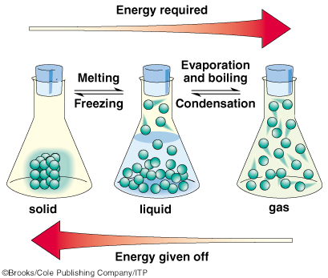
States of Matter
Notes:
Solid, Liquid, Gas- know the arrangement of molecules, when energy is applied and released during which phase change, and the processes associated with each phase change.

Slide 29
Changes of State
Melting-solid to liquid (heat speeds up the movement of particles, so they separate)
Freezing-liquid to solid (opposite happens when something cool, it loses momentum)
Boiling- boiling points are dependent on air pressure and kind of liquid
Evaporation-liquid to gas, the warmer the liquid the faster it evaporates (below boiling point temp)
Condensation-gas to liquid (colder temps bring vapor particles together)

Slide 30
Matter Continued
Matter that comes from living things is called ORGANIC MATTER.
Matter that comes from nonliving things is called INORGANIC MATTER

Slide 31
Pure Substances
These are materials made of just ONE kind of particle (gold, pure water, and pure oxygen).

Slide 32
Mixtures
Are combinations of two or more pure substances or other mixtures.
Parts of mixtures can be separated relatively easily by filtering, evaporation, etc.

Slide 33
Mixtures Continued
Homogenous-contains only ONE kind of element or compound, the same throughout, uniform.
Examples: sugar water, salt water
Mixtures can be Heterogenous- not uniform, does not have the same composition or properties throughout.
Examples: Granite, concrete

Slide 34
ATOMS
The smallest building block of matter is an ATOM.
It used to be thought that atoms were “indivisible.” In fact, atoms are made up of smaller particles called subatomic particles.
These subatomic particles are: protons, neutrons, and electrons.

Slide 35
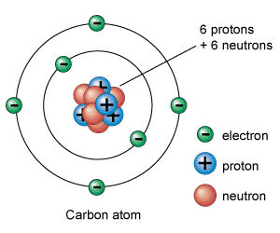
Atomic Model

Slide 36
Atomic Model Explained
Center of the atom contains the nucleus. The nucleus of the atom contains the positively charged protons and the neutral (no charge) neutrons.
Protons have a relatively large mass and neutrons are slightly more massive.
The nucleus of the atom has nearly all the mass of the atom.

Slide 37
Electrons
Electrons are negatively charged and are located in the electron cloud outside of the nucleus.
The number of electrons has to equal the number of protons. The negative and positive charges balance each other out. Opposite charges attract.

Slide 38
Mole Town
What is a mole?
A mole is the number of particles in a substance
Notes:
Using the term mole is very similar to using the term dozen.

Slide 39
Avogadro’s Constant
6.022 x 10^{23 particles/mole}
Particles can be atoms, molecules, or compounds.
Molar mass vs. atomic mass
Molar mass (g/mol)

