Slide 1
Unit 5 Chemical Bonding

Slide 2
Bell Ringer 11/13/18
What are valence electrons?
What is the difference between a Bohr Model and a Lewis Dot Structure?
Draw both the Bohr Model and Lewis Dot Structure for Lithium.

Slide 3
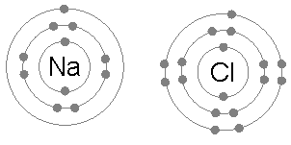
Review – What are Valence Electrons?
Valence electrons are the electrons in the outer shell.
The group number of the periodic table tells us the number of valence electrons an element has.

Slide 4
Making Compounds
Many elements exist around you in their uncombined forms, but elements can unite chemically to form compounds when conditions are right
Compounds unite by sharing electrons or transferring electrons in a chemical bond.

Slide 5
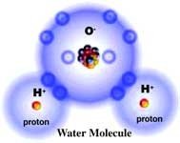
Making Compounds

Slide 6
Making Compounds
Compounds often have unique, different properties than the individual elements that make up the compound.

Slide 7
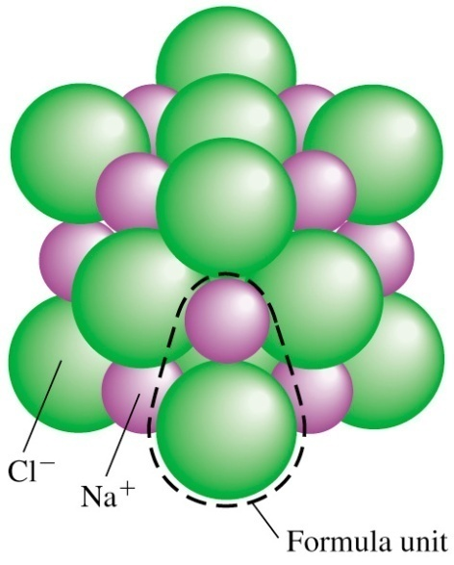
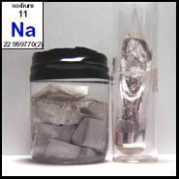
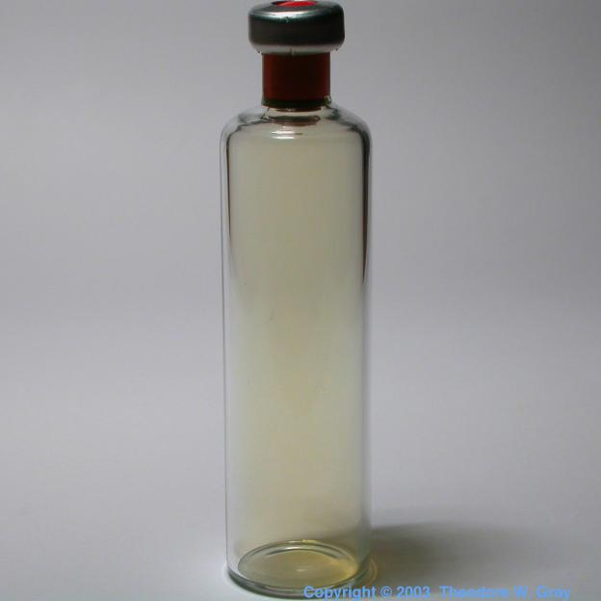
Making Compounds
Consider NaCl
+
=

Slide 8
Chemical Formulas
NH₃
A chemical formula tells us what elements a compound contains and the exact number of atoms of each element in a unit of the compound

Slide 9
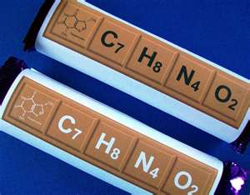
Chemical Formulas
A subscript is written after and below the element’s symbol
Subscripts tell how many atoms are in each unit of a compound
(ex. C₆H₁₂O₆ )

Slide 10
Chemical Formulas
Ex. How many of each atom are in H₂O?
Ex. How many of each atom are in Li₃PO₄?

Slide 11
Atomic Stability
REMEMBER: An atom is chemically stable when its outer energy level is complete (like the Noble Gases)

Slide 12
Atomic Stability
Elements will form chemical bonds in order to become stable!

Slide 13
Atomic Stability
The Octet Rule says that atoms tend to combine so they have eight electrons in their outer energy level

Slide 14
Atomic Stability
Atoms can gain, lose, or share electrons to complete their outer energy levels and become stable
Gaining, losing, and sharing electrons forms a chemical bond between atoms

Slide 15
Kinds of Bonds

Slide 16
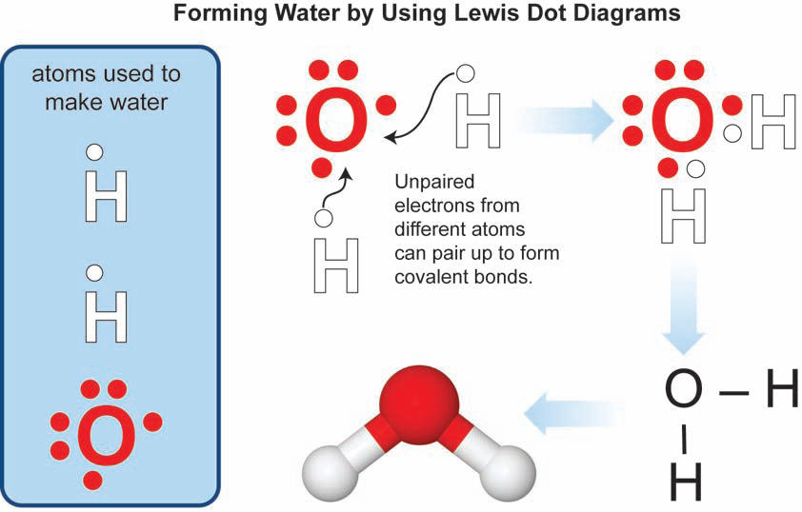
Chemical Bonding
Chemical Bonds are formed when atoms gain, lose, or share electrons

Slide 17
Ionic Bonding
An ion is a charged particle – it has a different number of electrons than protons
An ionic bond is the attractive force between the opposite charges of the ions

Slide 18
Ionic Bonding
This type of bonding occurs when a cation and an anion are attracted to each other (metal and a nonmetal).
Typically metals lose electrons and become positive, and nonmetals gain electrons and become negative.
This attraction between positive and negative charges is often referred to as “electrostatic attractions.”

Slide 19
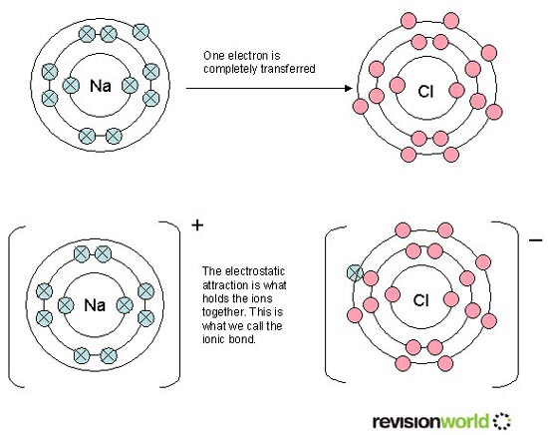
Ionic Bonding

Slide 20
Properties of Ionic Compounds
The combination of atoms that results from an ionic bond is referred to as a compound.
The ionic bond itself is very strong.
Ionic compounds tend to have very high melting and boiling points.
Conductive in aqueous solution or when molten.
Hard and brittle. Usually solid at room temperature.

Slide 21
Ionic bonding Review
Ionic bonding occurs between a metal and a non metal
One element will lose electrons while the other gains electrons

Slide 22
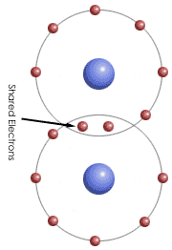
Covalent Bonding
A covalent bond forms when atoms share electrons
A single bond contains one pair of electrons, but atoms can share multiple pairs of electrons.

Slide 23
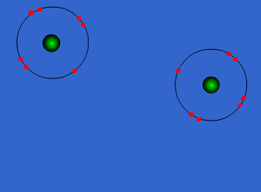
Covalent Bonds

Slide 25
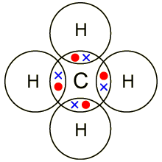
Covalent Bonding
This type of bonding occurs when electrons are shared amongst atoms.
Typically this happens between atoms of nonmetals.
Covalent bonds form molecules which are not held together as tightly as ionic compounds.

Slide 26
Properties of Molecules
Molecules are non-conductive.
Very low melting and boiling points.
They can be solid, but usually are liquids or gases at room temperature.

Slide 27
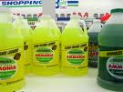
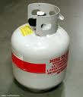
Examples
C₁₂H₂₂O₁₁ (Sugar)
NH₃ (Ammonia)
C₃H₈ (Propane)

Slide 28
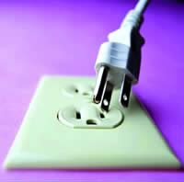
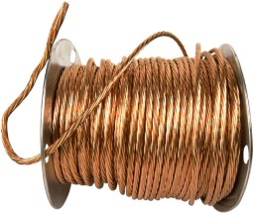
Metallic Bonds
A metallic bond involves an attraction between metal atoms that loosely involves many electrons.
We call this a “Sea of Electrons”

Slide 29
Metallic Bond, A Sea of Electrons

Slide 30
Metallic Bonds
Many electrons are moving around the metal which makes the metal highly conductive to heat and electricity.

Slide 31
Oxidation/“Magic” Numbers
Atoms gain / lose electrons to form an ionic bond to get to the magic number of 0 or 8
Oxidation is how many electrons you will gain or lose to get to 0 or 8. (basically it’s the charge!!!)

Slide 32
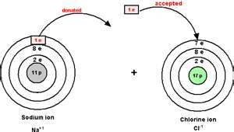
Oxidation/“Magic” Numbers

Slide 33
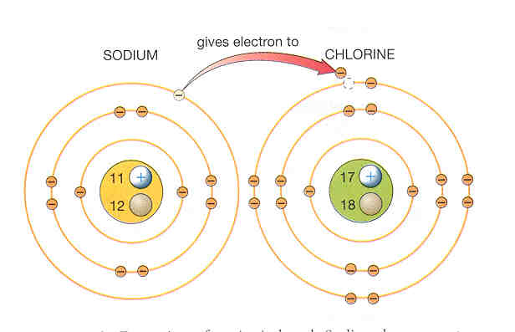
Oxidation Numbers
If an atom gains electrons, it has a negative oxidation number.
If an atom loses electrons, it has a positive oxidation number.

Slide 34
Oxidation Numbers
For Bonding:
Oxidation means CHARGE!!!!!!

Slide 35
What is the oxidation number (charge) of:
H Ba
S F
Na Si

Slide 36
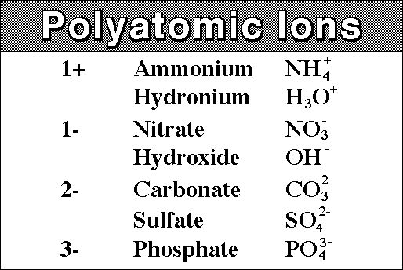
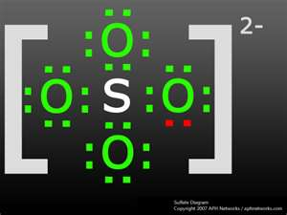
Polyatomic Ions
A polyatomic ion is a covalently bonded group of atoms with either a positive or negative charge

