Slide 1
Unit 11 Forces
7th Grade Physical Science

Slide 2
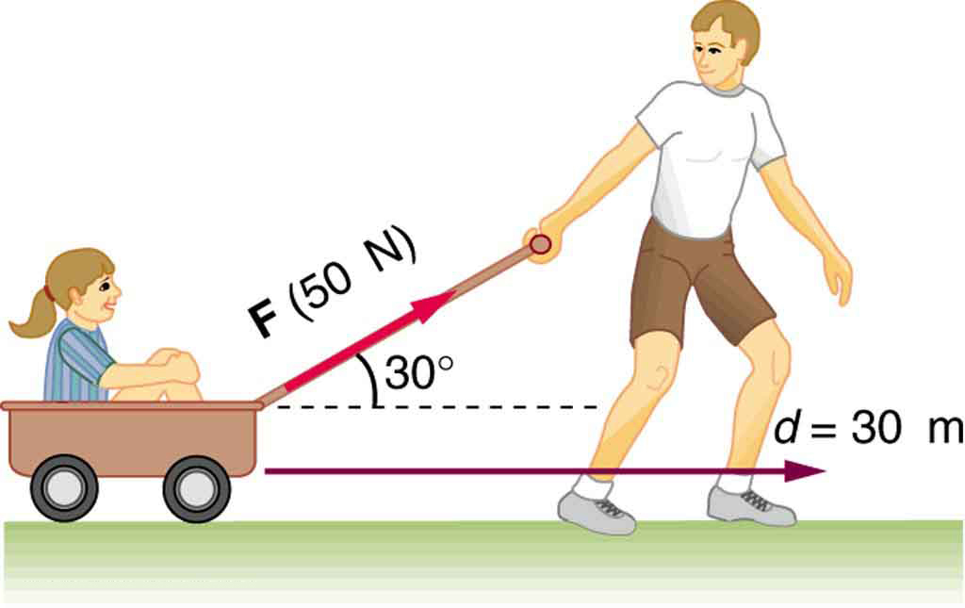
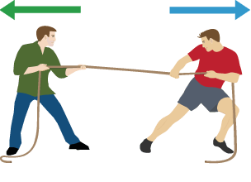
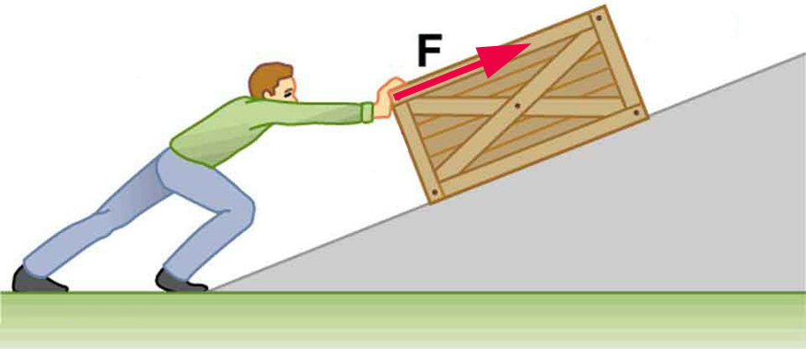
What is a force?
A force is any push or pull on an object in a particular direction.
Examples???

Slide 3
Force as a vector
Force is a vector because it has both size and direction.
The length of the arrow represents the strength of the force, which is also referred to as magnitude.
The arrow represents the direction of the force.

Slide 4
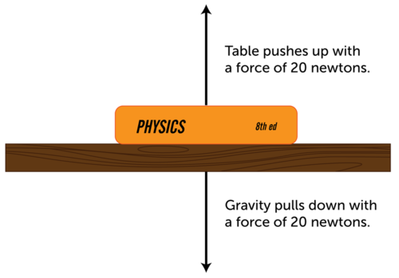
Combining forces
More than one force can act on an object at the same time.
Combined forces acting on any object is referred to as the net force.

Slide 5
Forces acting in opposite directions
When two forces act on an object in opposite directions, like the book on the table, the net force is equal to the difference between the two forces.
In other words, one force is subtracted from the other to calculate the net force.
If the opposing forces are equal in strength, the net force is zero.

Slide 6
Opposing forces

Slide 7
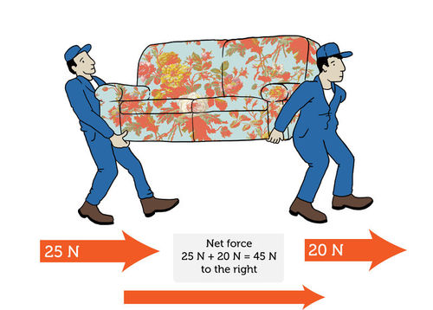
Forces acting in the same direction
When two forces act in the same direction, the net force is equal to the sum of the forces. This always results in a stronger force than either of the individual forces alone.

Slide 8
You try it ☺

Slide 9
friction

Slide 10
What is friction
A force that opposes motion between two surfaces that are in contact.
Friction can cause a moving object to slow down and to eventually stop. It can work for or against us.
Examples:
Putting sand on an icy sidewalk increases friction so you are less likely to slip.
Too much friction between moving parts in a car engine can cause the parts to wear out.

Slide 11
Friction

Slide 12
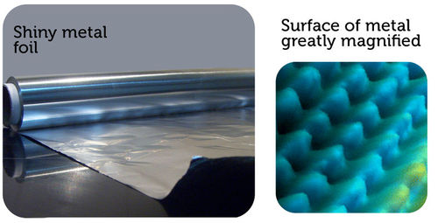
Why friction occurs
Friction occurs because no surface is perfectly smooth. Even surfaces that look smooth to the unaided eye appear rough or bumpy when viewed under a microscope.
All those mountains and valleys catch and grab the mountains and valleys of any other surface that contacts the metal. This creates friction.

Slide 13
Factors that affect friction
Rougher surfaces have more friction between them than smoother surfaces.
Heavier objects also have more friction because they press together with greater force.

Slide 14
Types of friction

Slide 15
Types of friction
Static Friction (Group 1)
Rolling Friction (Group 2)
Sliding Friction (Group 3)
Fluid Friction (Group 4)

Slide 16
Types of Friction Activity
You will be divided into 4 groups of 6.
Each group will be assigned a type of friction.
You and your group will design a demo to illustrate the assigned type of friction to the class.
Every person in the group must be included in the demo.
As the demo is carried out, you will be required to thoroughly explain the type of friction you and your group are portraying.
You have 10 minutes to design your demo. Demos cannot exceed 5 minutes.

Slide 17
Static friction
When a force is applied to an object but does not cause the object to move, static friction occurs. The word static means “not moving.” The object does not move because the force of static friction balances the force applied. Static friction can be overcome by applying a large enough force. Static friction disappears as soon as an object starts moving, and then kinetic friction immediately occurs.

Slide 18
Rolling friction
Rolling friction is friction that acts on objects when they are rolling over a surface. Rolling friction is much weaker than sliding friction or static friction.

Slide 19
Sliding friction
Sliding friction is friction that acts on objects when they are sliding over a surface. Sliding friction is weaker than static friction.

Slide 20
Fluid friction
Fluid friction is friction that acts on objects that are moving through a fluid. A fluid is a substance that can flow and take the shape of its container.
Fluids include liquids and gases.
Fluid pressure with the air is called air resistance. The faster or larger a moving object is, the greater is the fluid friction resisting its motion.

Slide 21
gravity
Continuation of Forces Unit

Slide 22
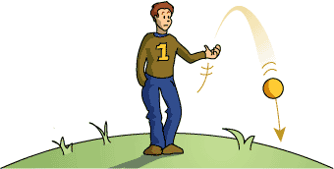
What is gravity?
Ben is throwing a ball below. What is happening to the ball? What is happening to Ben?

Slide 23
What is gravity?
Gravity has traditionally been defined as a force of attraction between two masses.
According to this conception of gravity, anything that has mass, no matter how small, exerts gravity on other matter.
The effect of gravity is that objects exert a pull on other objects. Unlike friction, which acts only between objects that are touching, gravity also acts between objects that are not touching. In fact, gravity can act over very long distances.

Slide 24
Earth’s Gravity
You are already very familiar with Earth’s gravity. It constantly pulls you toward the center of the planet. It prevents you and everything else on Earth from being flung out into space as the planet spins on its axis. It also pulls objects above the surface, from meteors to skydivers, down to the ground. Gravity between Earth and the moon and between Earth and artificial satellites keeps all these objects circling around Earth. Gravity also keeps Earth moving around the sun.

Slide 25
Earth’s Gravity

Slide 26
Gravity and weight
Weight measures the force of gravity pulling on an object. Because weight measures force, the SI unit for weight is the newton (N).
Mass is the measure of the amount of matter in an object. This seems similar to weight, but it is not. MASS DOES NOT CHANGE when gravitational forces change. Mass is measured in kilograms or grams (kg/ g).

Slide 27
Mass verse weight

Slide 28
Newton’s law of universal gravitation
Newton was the first one to suggest that gravity is universal and affects all objects in the universe. That’s why his law of gravity is called the law of universal gravitation.
Universal gravitation means that the force that causes an apple to fall from a tree to the ground is the same force that causes the moon to keep moving around Earth.
Universal gravitation also means that while Earth exerts a pull on you, you exert a pull on Earth. In fact, there is gravity between you and every mass around you — your desk, your book, your pen. Even tiny molecules of gas are attracted to one another by the force of gravity.

Slide 29
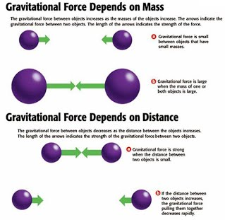
Factors that influence the strength of gravity
Objects with greater mass have a stronger force of gravity.
Objects that are closer together have a stronger force of gravity.

Slide 30
Acceleration due to gravity
When gravity pulls objects toward the ground, it causes them to accelerate. Acceleration due to gravity equals 9.8 m/s².
In other words, the velocity at which an object falls toward Earth increases each second by 9.8 m/s. Therefore, after 1 second, an object is falling at a velocity of 9.8 m/s. After 2 seconds, it is falling at a velocity of 19.6 m/s (9.8 m/s × 2), and so on.

Slide 31
Acceleration due to gravity
You might think that an object with greater mass would accelerate faster than an object with less mass. After all, its greater mass means that it is pulled by a stronger force of gravity. However, a more massive object accelerates at the same rate as a less massive object. The reason? The more massive object is harder to move because of its greater mass. As a result, it ends up moving at the same acceleration as the less massive object.

Slide 32
Velocity of falling objects
V_{final} = g x t
V= final velocity in meters per second
g= acceleration due to gravity (9.8 m/s²)
t= time in seconds

Slide 33
Example problem
If a rock took 7 seconds to hit the ground, how fast was it falling when it hit the ground?

Slide 34
How does air resistance affect falling objects?
Air resistance is the force that opposes motion of falling objects.
How much air resistance will affect an object depends on the size, shape, and speed of the object.
More surface area will increase the amount of air resistance.
Force of gravity is stronger than the force of air resistance, that is why it will still be brought down to the ground.

Slide 35
Air resistance

Slide 36
Terminal velocity
As the speed of a falling object increases, air resistance also increases.
The upward force of air resistance increases until it is equal to the downward force of gravity.
At this point, the total force on the object is zero, so the object stops accelerating.
Even though the object stops accelerating, it does not stop moving. It falls at a constant velocity, which is called terminal velocity.
Terminal velocity is the speed of an object when the force of air resistance equals the force of gravity.

Slide 37
Projectile motion
Earth’s gravity also affects the acceleration of objects that start out moving horizontally, or parallel to the ground. Look at the Figure to the left. A cannon shoots a cannon ball straight ahead, giving the ball horizontal motion. At the same time, gravity pulls the ball down toward the ground. Both forces acting together cause the ball to move in a curved path. This is called projectile motion
https://phet.colorado.edu/en/simulation/projectile-motion

Slide 38
Orbital motion
The moon moves around Earth in a circular path called an orbit. Why doesn’t Earth’s gravity pull the moon down to the ground instead? The moon has enough forward velocity to partly counter the force of Earth’s gravity. It constantly falls toward Earth, but it stays far enough away from Earth so that it actually falls around the planet. As a result, the moon keeps orbiting Earth and never crashes into it.
file:///C:/Users/kmastin/AppData/Local/Temp/gravity-and-orbits_en.html

