Slide 1
Bell ringer 03/25/20
Please answer the following questions using complete sentences. Make sure you are providing original ideas and thoughts when creating your response. Please do not repeat what others have posted before you.
1. What is an example of motion in everyday life?

Slide 2
Unit 10: Motion
7th Grade Physical Science

Slide 3
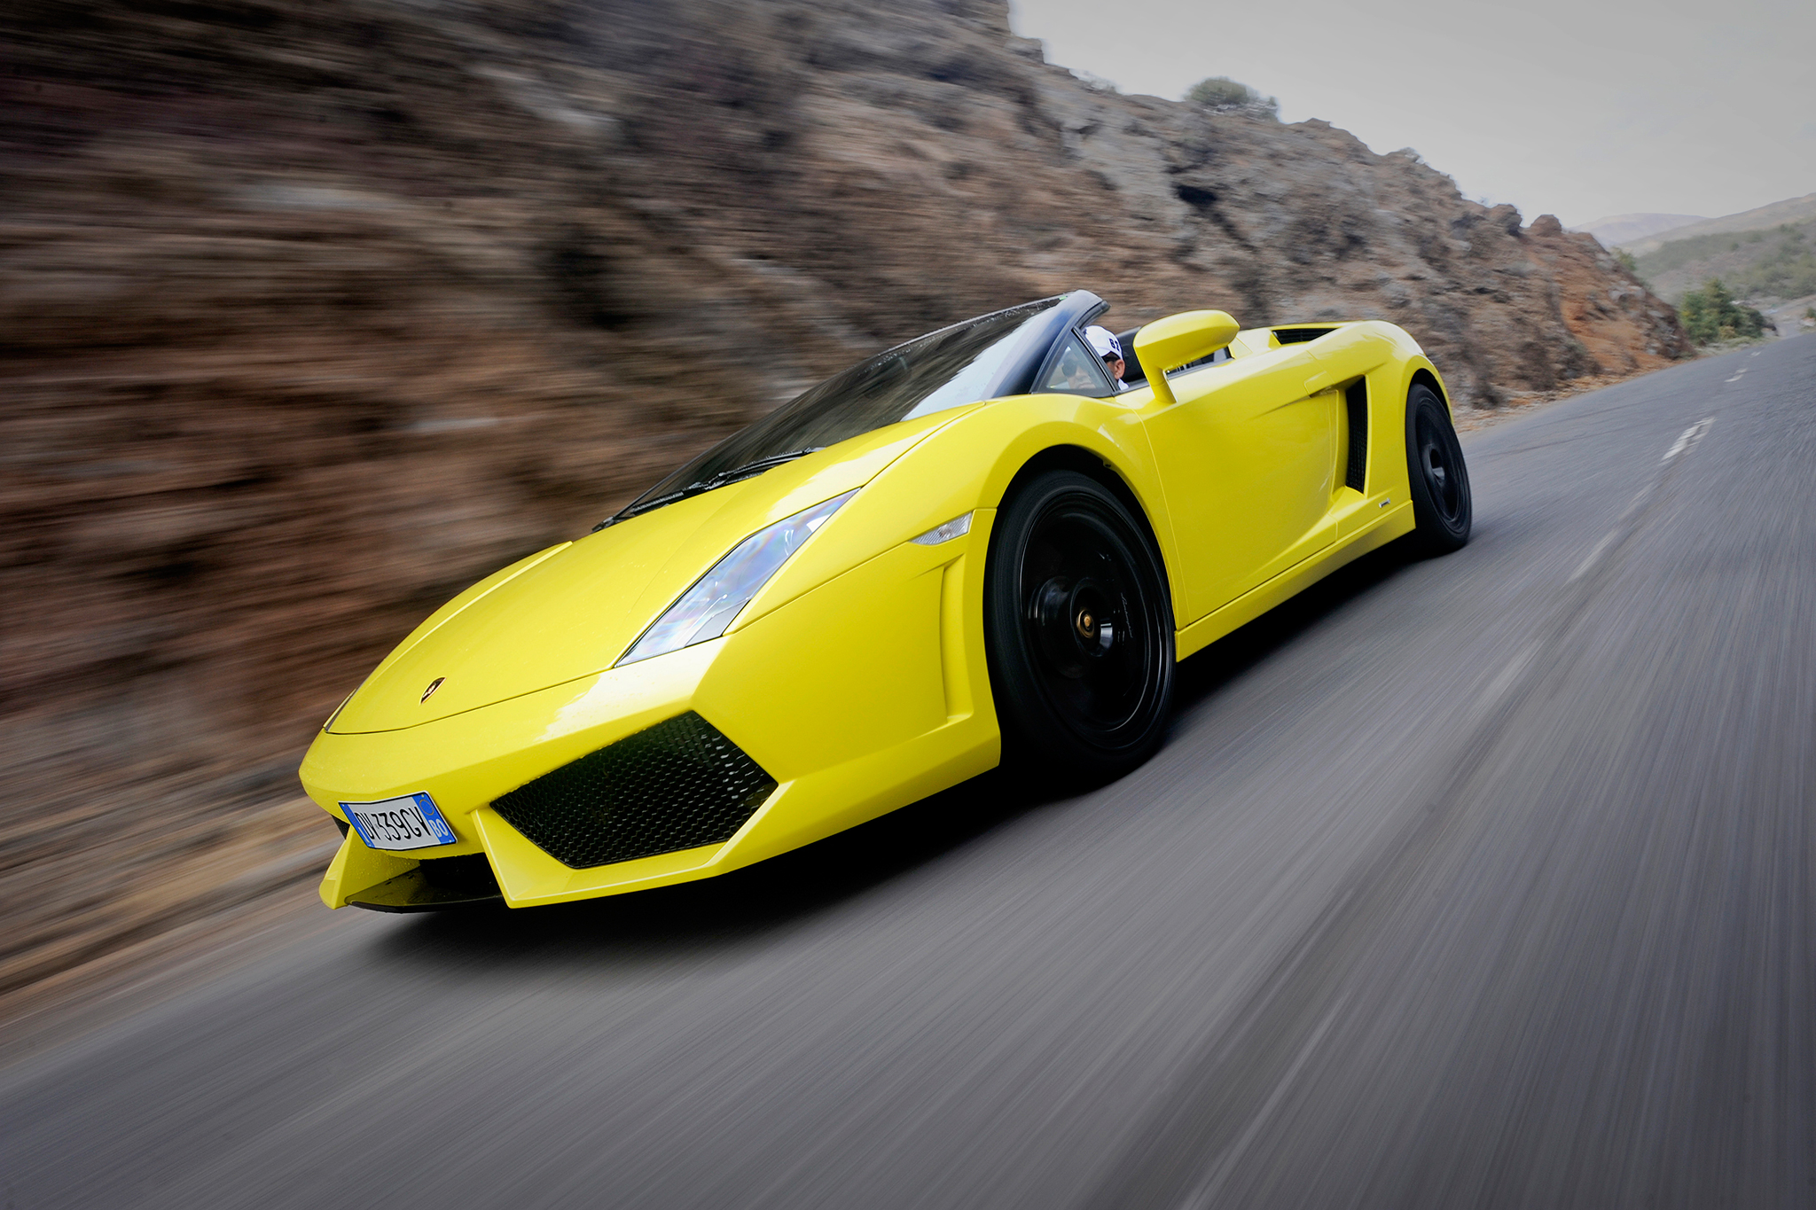
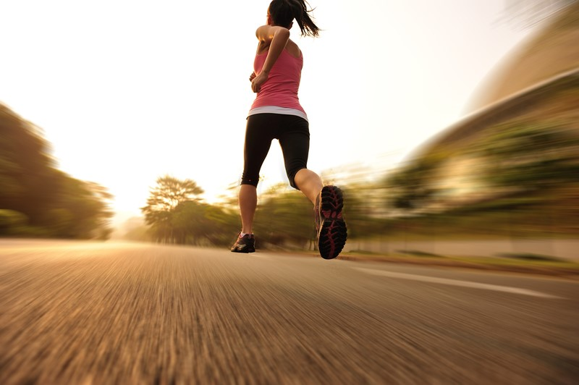
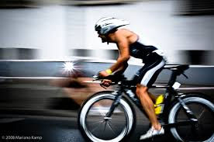
What is Motion?

Slide 4
Motion
Motion is simply defined as a change in position.
How we perceive motion depends on our frame of reference.
Frame of reference refers to something that is not moving with respect to an observer that can be used to detect motion.

Slide 5
distance
Distance is the length of the route between two points.
Example: The length of the route in a race is the distance between the starting and finishing lines.
The SI unit for distance is the meter (1 m = 3.28 ft). Short distances may be measured in centimeters (1 cm = 0.01 m). Long distances may be measured in kilometers (1 km = 1000 m).
***remember conversions and SI stands for International System of Units.
Mass= grams
Volume= liters
Length/distance= meters

Slide 6
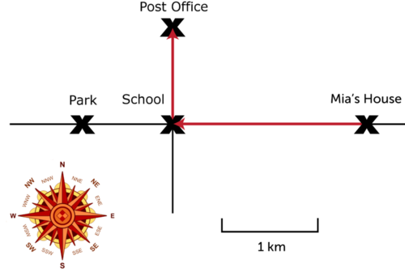
direction
Things do not always move in straight lines. Sometimes they change direction as they move.
Example:
To find the total distance of a route that changes direction, you must add up the distances traveled in each direction. From Mia’s house to the school, for example, the distance is 2 kilometers. From the school to the post office, the distance is 1 kilometer. Therefore, the total distance from Mia’s house to the post office is 3 kilometers.

Slide 7
vectors
When both distance and direction are considered, motion is a vector.
A vector is a quantity that includes both size and direction. A vector is represented by an arrow. The length of the arrow represents distance. The way the arrow points shows direction.

Slide 8
Bell ringer Thurs. 03/26/20
Please solve the following problems below. Remember to always setup your problem accordingly. First, write the formula. Second write out your known variables. Third, plug in the known variables into the formula. SHOW ALL WORK (I know you probably cannot show this to me when responding to the Bell Ringers via Google Classroom, so it’s on your honor ☺). The last step is writing your correct answer with the correct units. If you are handwriting your answers to turn in make sure you either circle or box your final answer.
1. What is the speed of a jet plane that travels 528 meters in 4 seconds?
2. How far (in meters) will you travel in 3 minutes running at a rate of 6 m/s?
***I have a tutorial video of how to complete speed problems on my website. Feel free to review it if needed ☺

Slide 9
speed
What is speed? How do we measure it?
Speed is an important aspect of motion. It is a measure of how fast/ slow an object is moving.
Speed is dependent on how far something travels and the time it takes to travel that far.
Speed = distance/ time
SI unit for speed = m/s

Slide 10
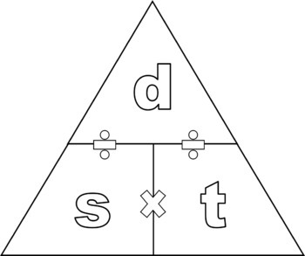
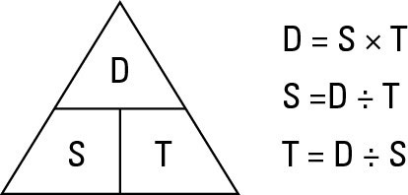
Speed memory triangle

Slide 11
Speed continued
For example, if a car makes a trip that covers 120 miles and it takes 3 hours to make the trip, then the car’s speed is???

Slide 12
Instantaneous VS. Average Speed
Instantaneous speed is the speed of a moving object at a given instant. It is inconsistent and very hard to calculate.
Average speed is the total distance traveled divided by the total time it took to travel that distance.

Slide 13
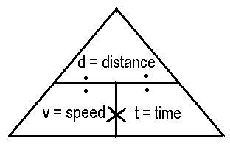
velocity
The measure of both speed and direction.
Velocity is a vector that can be represented by an arrow. The length of the arrow represents speed and the point of the arrow represents direction.
V=d/t with direction

Slide 14
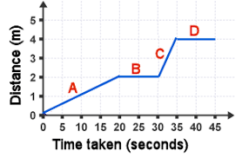
Distance-time graph
The motion of an object can be represented by a time-distance graph like the one to the right.
It shows how the distance from the starting point changes over time.
The speed of the object is represented by the slope/steepness of the graph line. If the line is straight, then the speed is constant.
The average speed can be calculated from the graph by taking the change in distance ( ∆d ) and dividing it by the change in time ( ∆t ).
Speed = ∆d / ∆t

Slide 15
Bell Ringer fri. 03/27/20
Please answer the following question using complete sentences. Make sure you are providing original ideas and thoughts when creating your response. Please do not repeat what others have posted before you.
Please provide an example of acceleration in everyday life. Be thorough and provide specific details within your response to illustrate your understanding.

Slide 16
acceleration
*Changes in speed or direction are called acceleration.
*Acceleration is a measure of the change in velocity of a moving object.
*It shows how quickly velocity changes. Acceleration may reflect a change in speed, a change in direction, or both.
Notes:
Acceleration is a vector- has both size and direction

Slide 17
Acceleration continued
Acceleration can be either speeding up or slowing down. Most people think it is just an increase in speed, but it is not.
If acceleration is negative it is called deceleration.
Remember anytime that speed, direction, or both change, acceleration has taken place.

Slide 18
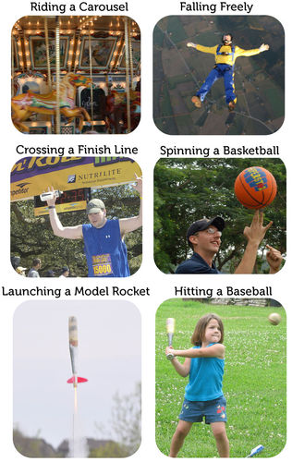
Examples of Acceleration

Slide 19
Calculating acceleration
Acceleration = ∆v/ ∆t (SI unit m/s²)
*when only speed changes and not direction
Example:
A cyclist speeds up as he goes downhill on a straight trail. His velocity changes from 1 meter per second at the top of the hill to 6 meters per second at the bottom. If it takes 5 seconds for him to reach the bottom, what is his acceleration, on average, as he flies down the hill?

