Slide 1
Work, power, energy
Unit 12

Slide 2
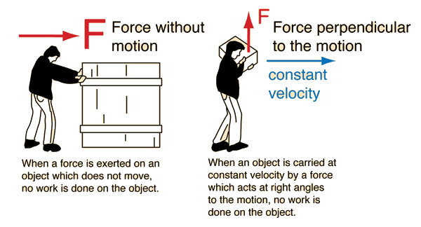
What is work?
When is work being done in the picture below?

Slide 3
What is work?
Work is directly related to both the force applied to an object and the distance the object moves.
Work is defined as the use of force to move an object.
It can be represented by the equation:
Work= Force×Distance
This equation shows that the greater the force that is used to move an object or the farther the object is moved, the more work that is done.

Slide 4
Who is doing more work?
For example, assume that one of the weight lifters lifts a weight of 400 Newtons over his head to a height of 2.2 meters off the ground. The amount of work he does is:
Work=400 N×2.2 m= 880 N⋅m
Notice that the unit for work is the newton ⋅ meter. This is the SI unit for work, also called the joule (J). One joule equals the amount of work that is done when 1 newton of force moves an object over a distance of 1 meter.

Slide 5
practice
Problem: Lara lifted a 100 N box 1.5 meters above the floor. How much work did she do?

Slide 6
power
Power is a measure of the amount of work that can
be done in a given amount of time.
Power can be represented by the equation:
Power=Work/Time

Slide 7
Power
Work is measured in joules and time is measured in seconds, so power is expressed in joules per second (J/s).
This is the SI unit for work, also known as the watt (W).
Compared with a less powerful device, a more powerful device can either do more work in the same time or do the same work in less time.
For example, compared with a low-power microwave, a high-power microwave can cook more food in the same time or the same amount of food in less time.

Slide 8
example
Problem: An electric mixer does 2500 joules of work in 5 seconds. What is its power?
Solution: Use the equation:
Power=Work/ Time.
Power= 2500J/ 5s
=500 J/s, or 500 W

Slide 9
practice
How much work can be done in 30 seconds by a 1000-watt microwave?

Slide 10
horsepower
Sometimes power is measured in a unit called the horsepower. One horsepower is the amount of work a horse can do in 1 minute. It equals 746 watts of power.
The horsepower was introduced by James Watt, who invented the first powerful steam engine in the 1770s. Watt’s steam engine led to a revolution in industry and agriculture because of its power. Watt wanted to impress people with the power of his steam engine, so he compared it with something familiar to people of his time: the power of workhorses. Watt said his steam engine could produce the power of 20 horses, or 20 horsepower.
The most powerful engines today may produce more than 100,000 horsepower! How many watts of power is that?

Slide 11
horsepower

Slide 12
Practice problems for review
Jana lifted a 200-newton weight over her head to a distance of 2 meters above the ground. How much work did she do?
Pieter picked up a 20-newton book from the floor. Then he passed it to Ahmad, who carried it for 20 meters. How much work did Ahmad do?
If an electric mixer does 10,000 joules of work in 10 seconds, what is its power?

Slide 13
Bell ringer 05/06/19
What is energy?
Provide at least two examples of when energy is observed.

Slide 14
energy
Unit 12

Slide 15
What is energy?
Energy can also be defined as the ability to do work.
Work is done whenever a force is used to move matter.
When work is done, energy is transferred from one object to another.
Energy is measured in Joules (J) or Newton-meter (N∙m).

Slide 16
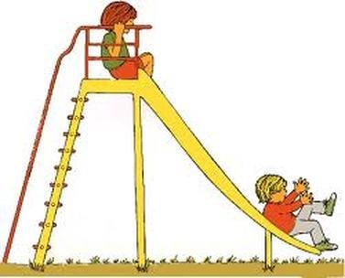
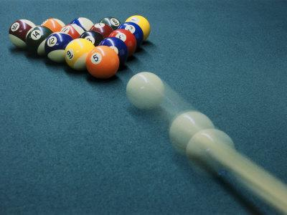
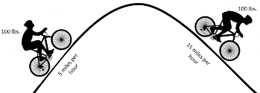
Kinetic energy
Kinetic energy is the energy of moving matter.
Anything that is moving has kinetic energy — from the atoms in matter to the planets in solar systems. Things with kinetic energy can do work.

Slide 17
Kinetic energy
The amount of kinetic energy in a moving object depends on its mass and velocity. An object with greater mass or greater velocity has more kinetic energy. The kinetic energy of a moving object can be calculated with the equation:
KE(kinetic energy) = ½m(mass)v²(velocity)
KE= ½mv²
Velocity affects kinetic energy more than mass does. Why???
Problem: Juan has a mass of 50 kg. If he is running at a velocity of 2 m/s, how much kinetic energy does he have?
Problem: Juan’s dad has a mass of 100 kg. How much kinetic energy does he have if he runs at a velocity of 2 m/s?

Slide 18
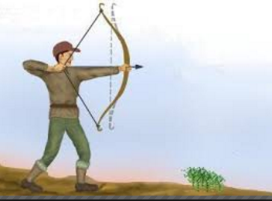
Potential energy
Potential energy is stored energy.
An object has potential energy because of its position or shape. For example leaves on trees have potential energy because they could fall due to the pull of gravity.

Slide 19
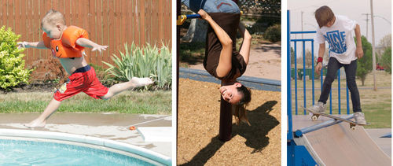
Gravitational potential energy
Potential energy due to the position of an object above Earth is called gravitational potential energy. Like the leaves on trees, anything that is raised up above Earth’s surface has the potential to fall because of gravity.

Slide 20
Gravitational potential energy
Gravitational potential energy depends on an object’s weight and its height above
the ground. It can be calculated with the equation:
Gravitational potential energy (GPE)= weight×height

Slide 21
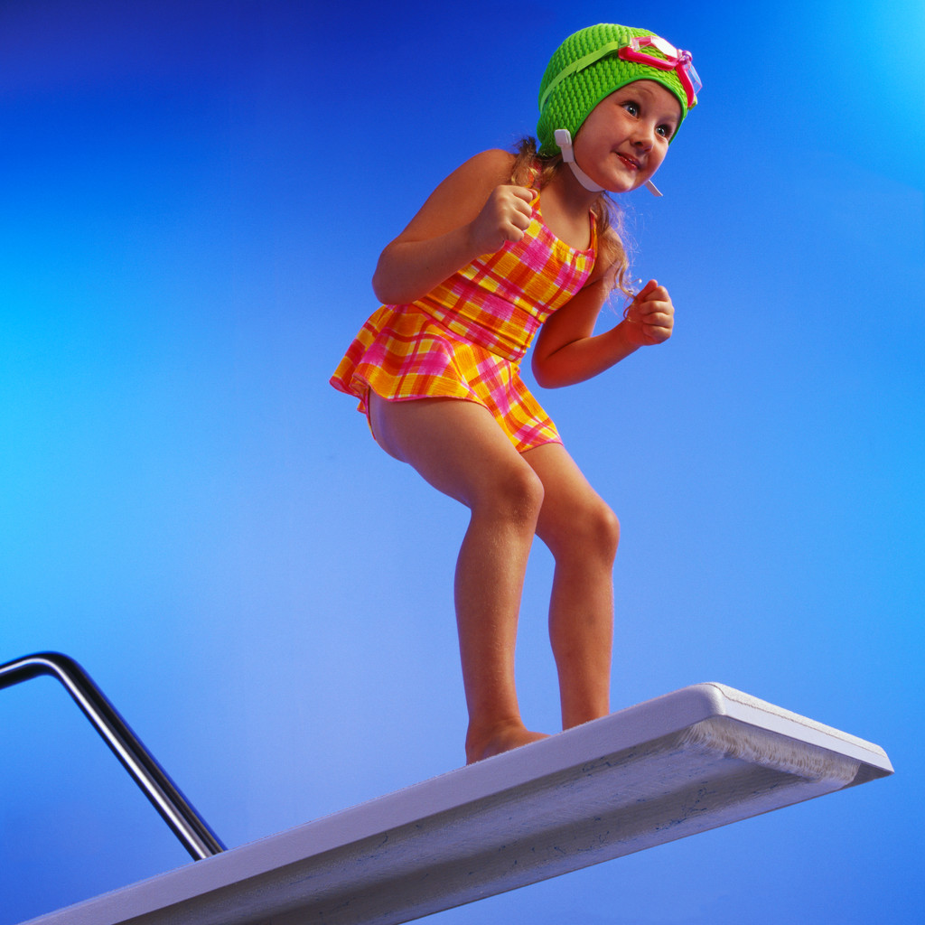
Energy conversion
What happens to the diver when she jumps off the diving board?
Her gravitational potential energy changes to kinetic energy as she falls toward the water. However, she can regain her potential energy by getting out of the water and climbing back up to the diving board.
This requires an input of kinetic energy. These changes in energy are examples of energy conversion, the process in which energy changes from one type or form to another

Slide 22
Energy conversion

Slide 23
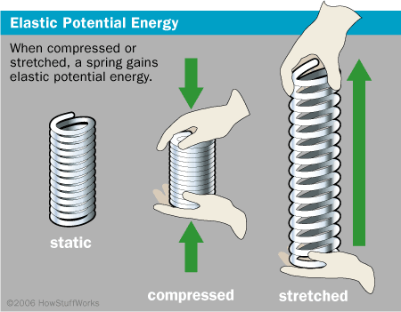
Elastic potential energy
Potential energy due to an object’s shape is called elastic potential energy.
This energy results when elastic objects are stretched or compressed.
Their elasticity gives them the potential to return to their original shape.

Slide 24
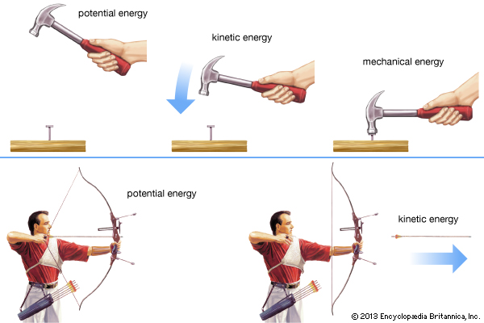
Mechanical energy
The amount of work an object can do because of the object’s kinetic and potential energies (total energy of an object).
Mechanical Energy= potential energy + kinetic energy

Slide 25
Conversions Involving chemical energy
Energy is stored in the bonds between atoms that make up compounds. This energy is called chemical energy, and it is a form of potential energy.
If the bonds between atoms are broken, the energy is released and can do work.
Example: Why do you always hear that breakfast is the most important meal of the day?
Example: What happens to wood when burned for a fire?

Slide 26
Light and thermal energy
Energy conversions in plants- how does light energy turn into thermal energy?

Slide 27
Electrical Energy
Alarm Clocks
Batteries
Light Bulbs
Blenders

Slide 28
Energy conservation
The law of conservation of energy states that energy can neither be created nor destroyed, it can change from one form to another.
This applies to energy conversions. Energy is not used up when it changes form, although some energy may be used to overcome friction, and this energy is usually given off as heat.
For example, the diver’s kinetic energy at the bottom of her fall is the same as her potential energy when she was on the diving board, except for a small amount of heat resulting from friction with the air as she falls.

